Slide 1
I, ROBOT
ISAAC ASIMOV
Luca Formentin 9/10/2013

Slide 2
Table of contents
Introduction
Content
Characters
Settings
Message to be learnt
New vocabulary learnt

Slide 3
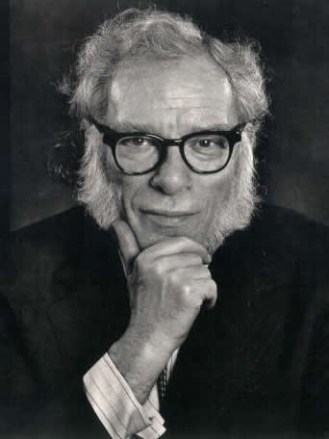
Introduction
Novelis : Isaac Asimov
Nationality: Rushian
Title: I, robot
Publication year: 1950
Genre: Anthology

Slide 4
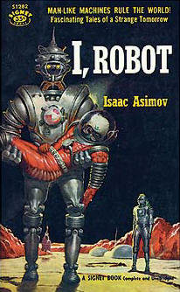
CONTENT
This book focuses on the work of two engineers whose job is to maintain stable operation of the robots. The book is divided into seven chapters, each one tells an adventure about the two protagonists: Gregory and Michael.

Slide 5
CHARACTERS
The main characers are:
Susan Calvin: doctor
Gregory Powell: engineer
Michael Donovan: engineer

Slide 6
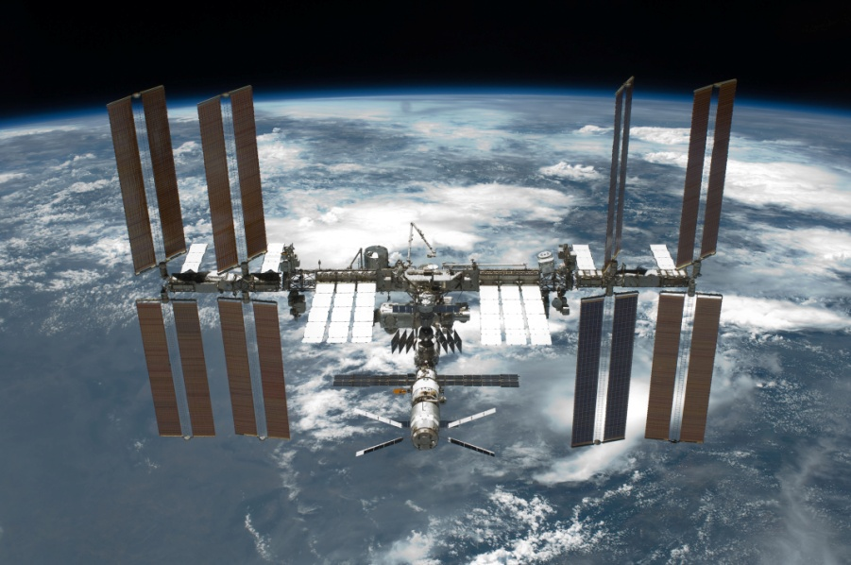
SETTINGS
The entire book takes place on different planets of the Universe such as Mercury. Other scenaries are laboratories or a space base.

Slide 7
MESSAGE TO BE LEARNT
The message that Asimov wants to refer us is that robots, despite useful and perfect they still need to be helped by human knowledge. The man even if it is not a machine should not hide behind the robot to make use of them.

Slide 8
NEW VOCABULARY LEARNT
Feverishly= febbrilmente
Boiling= in ebollizione
To nod= fare cenno
To frown= corruciarsi
Beam= onda, raggio
To rush= attraversare di corsa
Brainless= decerebrato
To spit= sputare
To bury= seppellire
Dull= monotono, noioso
Subsidiary= accessorio secondario
Redden= arrossare
To blame= rimproverare

