Slide 1
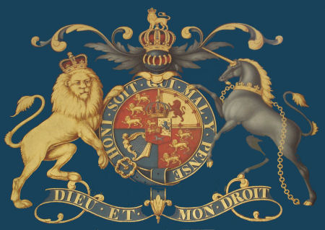
The Stuarts
Alunno: Ferrari Davide
Classe: 4ALS
Data: 25.03.14

Slide 2
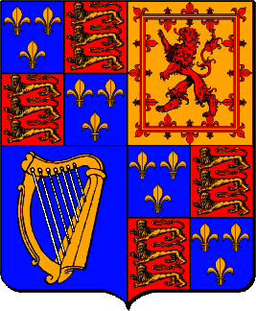
The Stuarts Dynasty
The Stuarts were the first kings of the United Kingdom.
The Stuart dynasty reigned in England and Scotland from 1603 to 1714.
The period saw a flourishing Court culture but also much upheaval and instability.

Slide 3
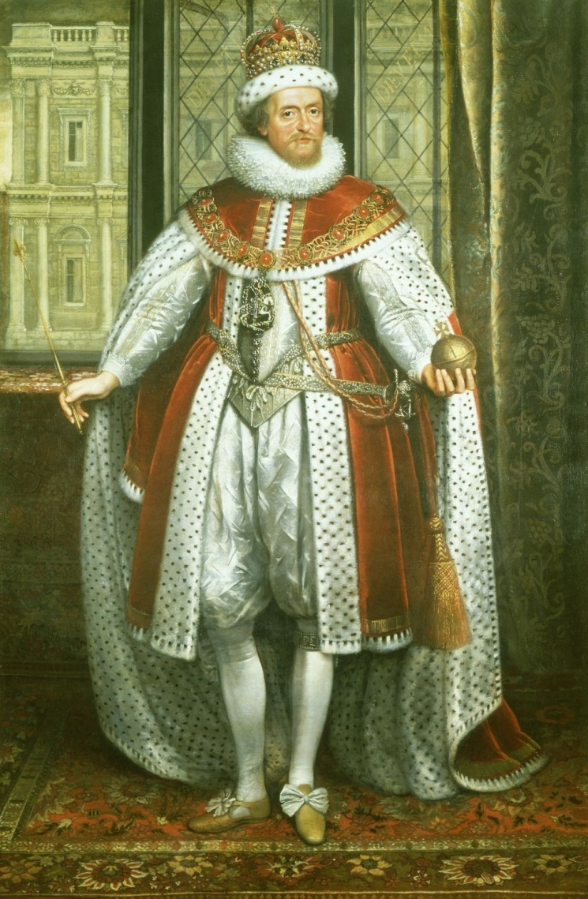
James I of England
He united the countries of England and Scotland under one monarch for the first time.
James believed in the Divine Right of Kings.
He introduced English and Irish Protestants into Northern Ireland.
He tried to keep England at peace with the rest of Europe.
He died in 1625.

Slide 4
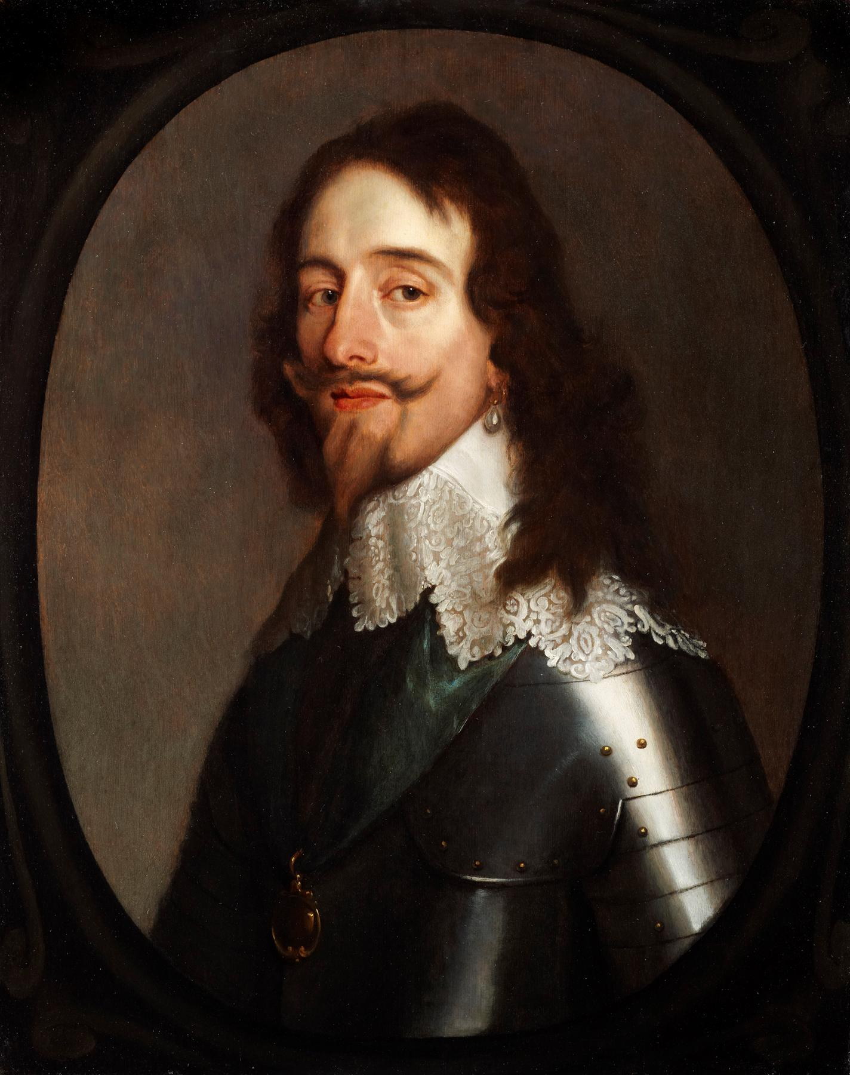
Charles I
He embarked on war with Spain and then with France.
He needed Parliament to grant him money.
In 1629 he dismissed Parliament and decided to rule alone for the next 11 years.
He upset his Scottish subjects by insisting that they follow the same religion as his English subjects.
The result was the two Bishops Wars (1639-1640)
Charles I was killed in 1649.

Slide 5
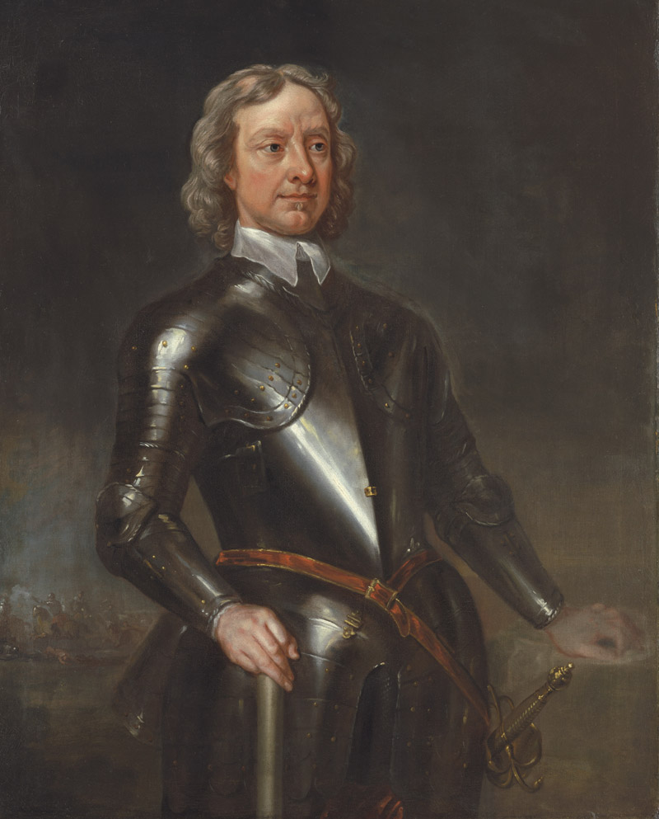
Oliver Cromwell
In 1649 took the title Lord Protector of the newly formed republic in England known as the Commonwealth.
Cromwell disliked the Irish Catholics .
He lay siege to the town of Drogheda in 1649.
He declared war on the Netherlands.
He went on to establish colonies in Jamaica and the West Indies.
Oliver Cromwell died in 1658.

Slide 6
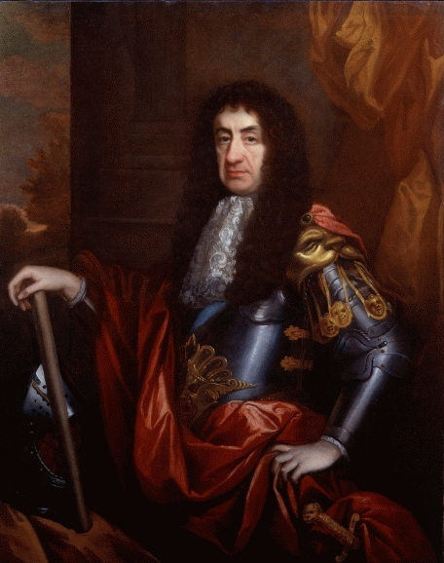
Charles II of England
He was formally recognized as King of Scotland and Ireland.
In 1651 he led an invasion into England from Scotland to defeat Cromwell and restore the monarchy.
In 1660 he was invited, by parliament, to return to England as King Charles II → “Restoration”.
Charles was forced to marry Portuguese Catherine of Braganza.
He allied England with France.
acquisition of New Amsterdam (now New York).
Charles II died in 1685.

Slide 7
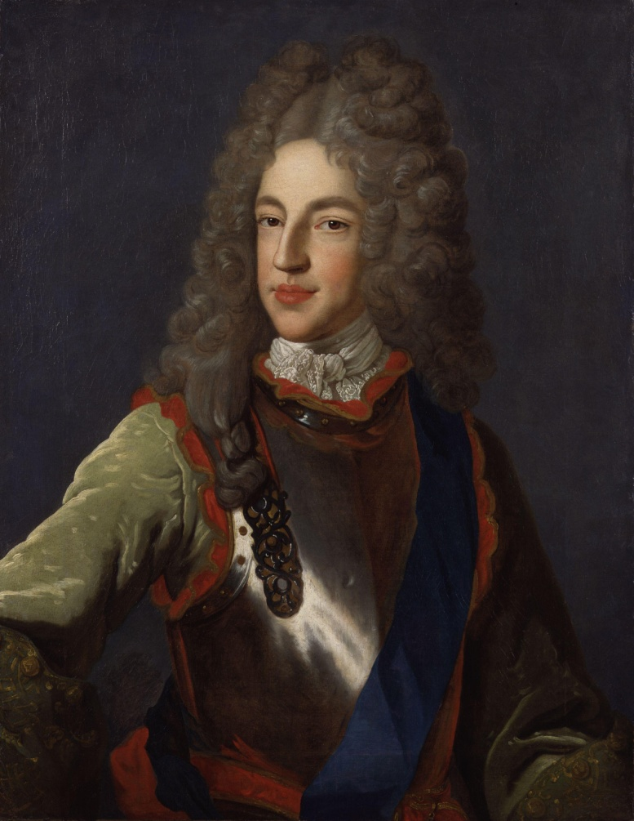
James II
He succeeded despite the passing of the Test Acts in 1673 and the efforts of Parliament to have him by-passed.
The Duke of Monmouth mounted an uprising against James II but it was crushed and a series of treason trials known as the Bloody Assizes .
After the Bloody Assizes James was replaced by his son-in-law, William of Orange in 1688.
William's accession to the throne is known as The Glorious Revolution.
James fled to France where he lived until his death in 1701.

Slide 8
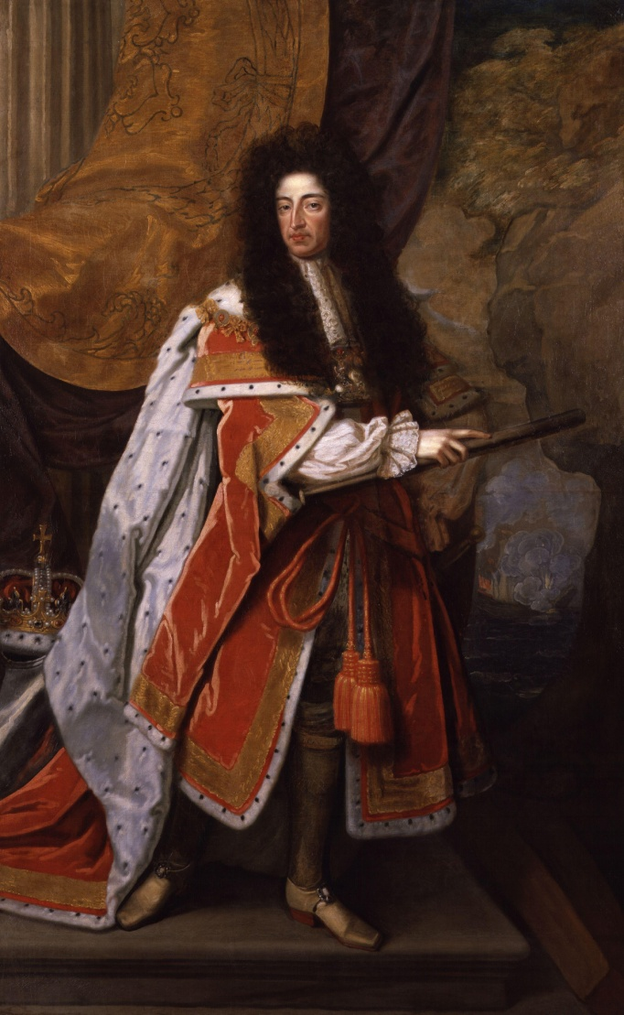
William III and Queen Anne
William led an army into Ireland and James was defeated at the Battle of the Boyne in 1690.
Mary II (William’s wife)died in 1694 and William ruled alone until his death in 1702.
Queen Anne supported the Glorious Revolution.
In 1707 the Act of Union formally united the Kingdoms of England and Scotland.
Anne died in 1714, she was the last Stuart monarch.

Slide 9
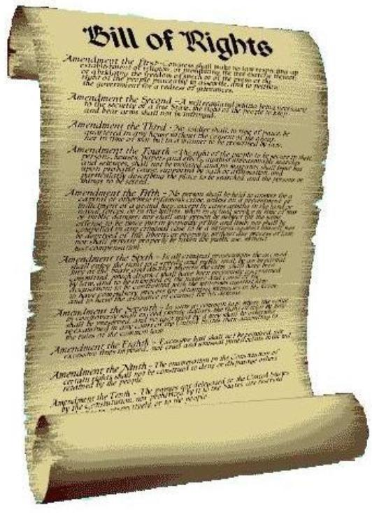
The Bill of Rights Act
The Bill of Rights Act, 1689.
The Bill of Rights represented the end of the concept of Divine Right of Kings.
It made kings and queens subject to laws passed by Parliament.
this has been called the 'Glorious Revolution‘.

