Slide 1
The language of Love

Slide 2
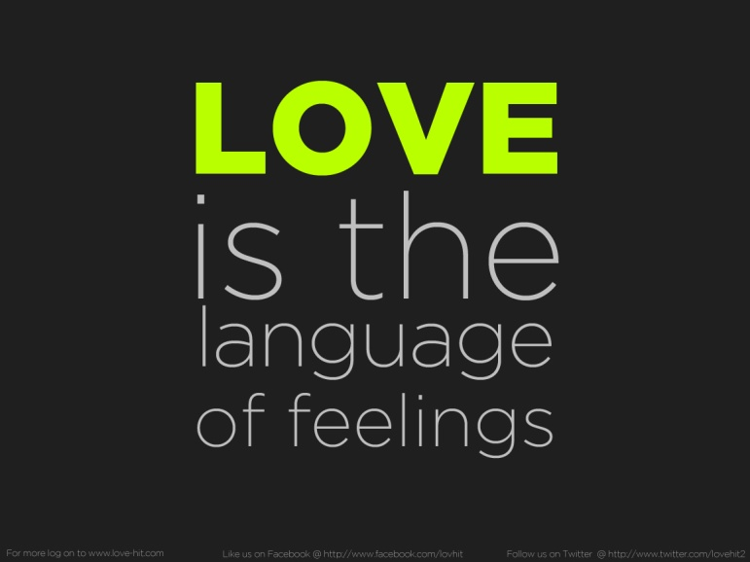
The language of Love: TABLE OF CONTENTS
Idea of Love
Where is love found?
Similarities and difference between the Renaissance and today
Why:
Is it easier to use written words that dialogue?
Is it a complicated language?
Does it require intimacy?

Slide 3
Love in Shakespeare
Love is a smoke and is made with the fume of sighs.
Shakespeare explores love as a non-perfect part of the human condition.
Love is :
a force of nature
earthy
sometimes uneasy

Slide 4
Where is it found?
It refers to the language used mainly in sonnets, tragedies and all the lyric poetry. It consists of rhetorical choices.
The language of poetry is useful to communicate feelings through figurative language and high language.
The first form of communication recommended by etiquette is metaphor. By using metaphor, a man uses it as an invitation, the woman can pretend she do not understand him and he can retreat without losing honor or she can participate in the metaphor and expand on it.

Slide 5
In “Romeo and Juliet” , immediately Juliet participates in the metaphor. To speed along the plot, the lovers are able to skip courting, and move on to plain talk about their relationship, deciding to be married.
The use of religious metaphors as well as the fact that their love is forbidden, put Romeo and Juliet in the tradition of religious and courtly love.

Slide 6
Similarities and difference between the Renaissance and today
The time gap is about six centuries
Courtly loves
An important element of courtly love is the love as an instrument of elevation, ennobling spiritual
Love today
Today’s forms of courting are:
speaking to beloved
texting (SMS or WA)
→it is easier than spoken language
New way to communicate:
Technology
A girl can court a boy

Slide 7
Why is it easier to use written language that dialogue(spoken language) ?
Dialogue lets you:
Show rather than tell – when characters act and speak, they become real to us
Build tension and drama
Reveal character in what’s said
Create white space on the page – attractive to busy readers
Dialogue is supposed to give an impression of real speech and what is not said is more powerful than what is said.
Therefore dialogue is more difficult than written words. Indeed when you write you can image the best form to tell something while in dialogue you have to be ready to find the right words.

Slide 8
Why is it a complicated language?
"True love is Hard to find, Difficult to leave, and Impossible to forget"
Language of poetry is a rhetorical language (full of figures of speech), so it is a difficult matter.
Love is a risk because the person might not feel the same thoughts:
Sin→ Humans are fallen creatures
It implies intimacy

Slide 9
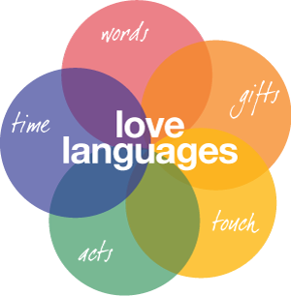
Why does it require intimacy?
Intimacy means things that are said or done only by people who have a close relationship with each other.
Using the language of love , intimacy is required because body language is an important element. Thus intimacy is in connection with Physical contact

Slide 10
Conclusion:
Communication changes from age to age
Communication changes from age to age for different reasons and changes during the time
The language of Love needs intimacy
In the Renaissance only men were allowed to court (using language of religion) while today also women can court.

