Slide 1
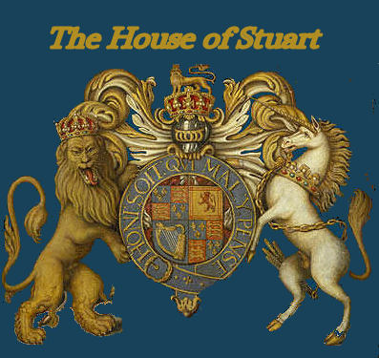
THE STUART DYNASTY AND THE MONARCHS
Pavoni Francesco, 4ALS, Liceo scientifico “A.Einstein”, Cervignano del Friuli

Slide 2
THE STUARTS
The Stuarts, that highly romantic but luckless dynasty, suceeded to the English throne on the death of the childless Tudor Queen Elizabeth I in 1603, in the person of James I and VI (1603-1625), son of Mary Queen of Scots and Henry Stuart, Lord Darnley, who became the first joint ruler of the kingdoms of both England and Scotland. The spelling of the ancient Scottish dynasty of Stewart was changed by Mary, Queen of Scots, during her long residence in France.
The earliest recorded member of the Scottish House of Stewart was Flaald I, who was of Breton origins and was employed in the serice of the eleventh century Lord of Dol and Combourg. Flaald and his immediate descendants held the hereditary and honorary post of Dapifer, or food bearer in the Lord of Dol's household.
The Stuart claim to England's throne derived from Margaret Tudor, eldest daughter of Henry VII, who married James IV. King of Scots. James I's successor Charles I (1625-49) was executed on the orders of Parliament, when England was declared a republic.
The monarchy was restored in 1660 when his son, the previously exiled Charles II (1660-85), was invited to return. Charles, or the 'Merry Monarch' as he is otherwise known, is famous for his many mistresses and his long liason with the actress Nell Gwyn. On the death of his niece, Queen Anne in 1714 the Stuart dynasty was displaced by its Hanoverian cousins. This section also contains biographies of the Stuart Pretenders including the courageous but highly impulsive Bonnie Prince Charlie.

Slide 3
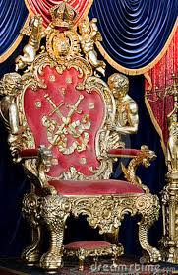
MONARCHS
James I & VI
Charles I
Oliver Cromwell
Charles II
James II & VII
William III & his wife Mary II
Queen Anne

Slide 4
James I and VI
BORN: 19 June 1566, Edinburgh Castle.
MARRIED: Anne of Denmark (1574 – 1619), 23 November 1589, Oslo, Norway.
ACCEDED: 24 March 1603
CROWNED: 25 July 1603, Westminster Abbey.
DIED: 27 March 1625, Theobald's Park, Hertfordshire.
INTERRED: Westminster Abbey.
NOTABLE EVENTS: The Gunpowder Plot, 5 November 1605.

Slide 5
Charles I
BORN: 19 November 1600, Dunfermline Palace.
MARRIED: Henrietta Maria of France (1609 - 69),
13 June 1625, St. Augustine's Church, Canterbury.
ACCEDED: 27 March 1625
CROWNED: 2 February 1626, Westminster Abbey.
DIED: 30 January 1649, Whitehall, London.
INTERRED: St. George's Chapel, Windsor.
NOTABLE EVENTS:
The English Civil War.
Execution of Charles I, 30 January 1649.

Slide 6
Charles II
BORN: 29 May 1630, St. James's Palace, London.
MARRIED: Catherine of Braganza (1638 – 1705), 21 May 1662, St. Thomas à Becket Church, Portsmouth.
ACCEDED: 30 January 1649 (by right), 29 May 1660 (restored)
CROWNED: 23 April 1661, Westminster Abbey.
DIED: 30 January 1649, Whitehall, London.
INTERRED: Westminster Abbey.
NOTABLE EVENTS: The Great Fire of London, 1666.

Slide 7
James II and VII
BORN: 14 October 1633, St. James's Palace, London.
MARRIED: (1) Anne Hyde (1637/8 - 71),
24 November 1659, Breda, Holland.
(2) Mary of Modena (1658 - 1718),
21 November 1673, Dover, Kent.
ACCEDED: 6 February 1685
CROWNED: 23 April 1685, Westminster Abbey(deposed: 11 December 1688).
DIED: 6 September 1701, St. Germain-en-Laye, France.
INTERRED: St. Germain-en-Laye, France.
NOTABLE EVENTS: ///

Slide 8
William III and his wife Mary II
BORN:
Mary II: 30 April 1662, St. James's Palace, London.
William III: 14 November 1650, Binnenhof Palace, The Hague, Holland.
MARRIED: 4 November 1677, St. James's Palace, London.
ACCEDED: 13 February 1689
CROWNED: 11 April 1689, Westminster Abbey.
DIED: Mary II:28 December 1694, Kensington Palace, London.
William III: 8 March 1702, Kensington Palace, London.
INTERRED: Mary II & William III, Westminster Abbey
NOTABLE EVENTS: Battle of the Boyne, 1 July 1690.

Slide 9
Queen Anne
BORN: 6 February 1665, St. James's Palace, London.
MARRIED: George of Denmark (1653 - 1708),
28 July 1683, Chapel Royal, St. James's Palace, London.
ACCEDED: 8 March 1702
CROWNED: 23 April 1702, Westminster Abbey.
DIED: 1 August 1714, Kensington Palace, London.
INTERRED: Westminster Abbey.
NOTABLE EVENTS: Act of Union, 1707.

