Slide 1
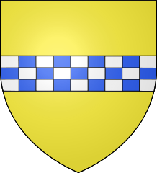
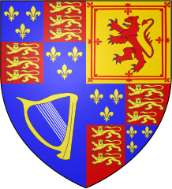
THE STUARTS

Slide 2
THE STUARTS
The Stuart Dinasty was the first ruling dinasty of both the reigns of England and Scotland
The Stuarts succeeded the Tudor dinasty, represented finallly by Queen Elizabeth.
The Stuart monarchs (1603-1704):
James I
Charles I
Charles II
James II
William III
Queen Anne

Slide 3
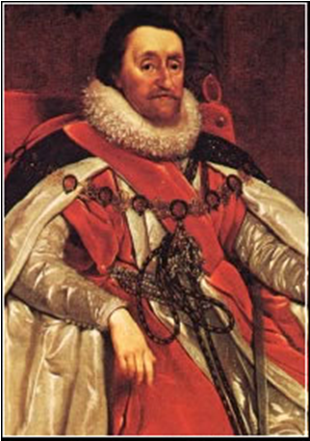
James I (1603-1625)
James VI, King of Scotland (Mary Stuart’s son, Queen of Scots), became also King of England after Elizabeth I’s death (1603)
He believed in the Divine Right of Kings → absolutism
He never obtained the Parliament’s support
He levied taxes wothout its approvation
He imprisoned some opponent Parliamentaries

Slide 4
James I (1603-1625)
He was large disapproved from people
He wasn’t able to manage finance
He was Scottish
He had strange attitudes
He was Anglican → conform to anglican practices
Conflict with Catholics and Puritans
Compulsory taxes to support the Church
King James Bible (still in existence today)
He died in 1625

Slide 5
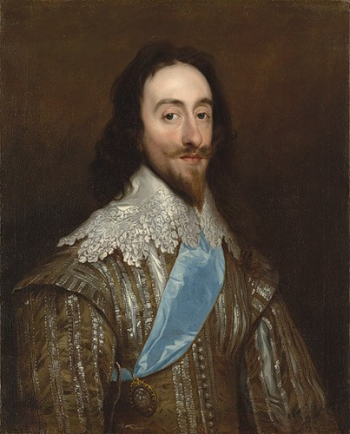
Charles I (1625-1649)
He became King after his father death (1625). He was influenced by him (Divine Rights of Kings and inability of manage finance).
He dismissed the Parliament in the 1629 and ruled without it for 11 years.
He was probably Catolich (he married Enricetta Marioa of France) and forced Scottish to change their religion.→ Bishop Wars (1639-1640)
Civil War (1642-1649): he was executed in 1649

Slide 6
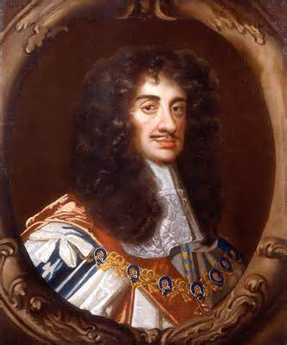
Charles II (1660-1685)
He was Charles I’s son. He was recognised as King of Scotland and Ireland (1649)
He was defeated by Cromwell in 1649, and also in 1651, when he tried to restore monarchy.
After Oliver Cromwell’s death (1658) he was asked by the Parliament to return to England as King Charles II (Restoration of 1660).
The “Merry Monarch”: parties, music and theatre
Money problems, alliance with France that brought the acquisition of New Amstersam
He died in 1685

Slide 7
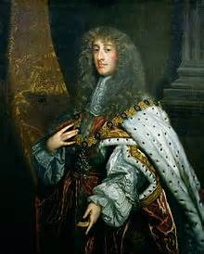
James II (1685-1701)
He succeeded his brother Charles II in 1685
He converted himself to Catholicism
He loss his tilte of Lord High Admiral
He was opposed by the Parliament
The Bloody Assizes: uprising against him
The Glorious Revolution: he was replaced by his son-in-law, the Dutchman William of Orange
In 1688 he fled to France when he lived until his death in 1701

Slide 8
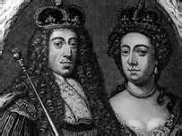
William III (1688-1702)
He and his wife Mary II (1688-1694) were proclaimed joint sovereigns of England in 1688 after the Glorious Revolution
In 1689 they were also accepted by Scotland
1689: Bill of Rights
Stronger power to the Parliament
Refusal of Catholicism
Civil Rights
They were accepted by Ireland (loyal to the catholic James II) after the Battle of the Boyne in the 1690
Mary II died in 1694, William III in 1702

Slide 9
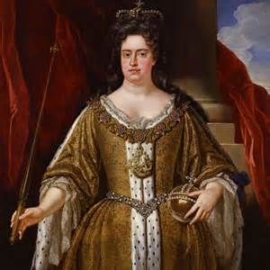
Queen Anne (1707-1714)
She was Mary II’s sister.
She was Protestant and supported the Glorious Revolution
Act of Union (1707) formally unified the Kingdoms of Englan and Scotland
She was the last Stuart Monarch (1707-1714)
She was replaced by George I of the dinasty of Hanover

Slide 10
THE END

