Slide 1
The Language of Love
Student: Nicoletta Soranzo
Class: 4^A
School year: 2013-2014

Slide 2
Table of Contents
The Language of Love. The difficult matter
The Language of Love in poetry
The Language of Love in the Middle Ages
The Language of Love in the Renaissance
The language of love in Shakespeare
Romeo and Juliet, Act II Scene II
The Language of Love today
Innovation and language of love

Slide 3
The Language of Love. The difficult matter
Literally mean Communication of thoughts and feelings related to the semantic field of love through a system of arbitrary signals, such as voice sounds, gestures, or written symbols.
The language of love is always related to the conception of love of the period in which the poet is writing.
Analyzing the language of love is difficult because it is often linked to the feelings of men and so it isn’t objective.

Slide 4
The Language of Love in poetry
The best genre used to speak about love is poetry because through the figure of speech is easier express feelings and emotion
The place where poet composed their poem were courts and the word courts recall the verb to court which means to seek another’s love, woo.

Slide 5
The Language of Love in the Middle Ages
During the Middle Ages the concept of love was related to religion and God and it was considered a way to reach Heaven. (the human body = source of Sin)
Courting in this period was a man function used to reach the divine
This kind of love was spiritual and not carnal so, in this period, the language of love often included concepts which are linked to religion

Slide 6
The Language of Love in the Renaissance
During the Renaissance, the vision changed: there were laical vision. The body was no longer considered a sin.
Courting, also in this period, was a man function used in a laical point of view
This kind of love was both spiritual and laical, so the language contain also religious and laical term.

Slide 7
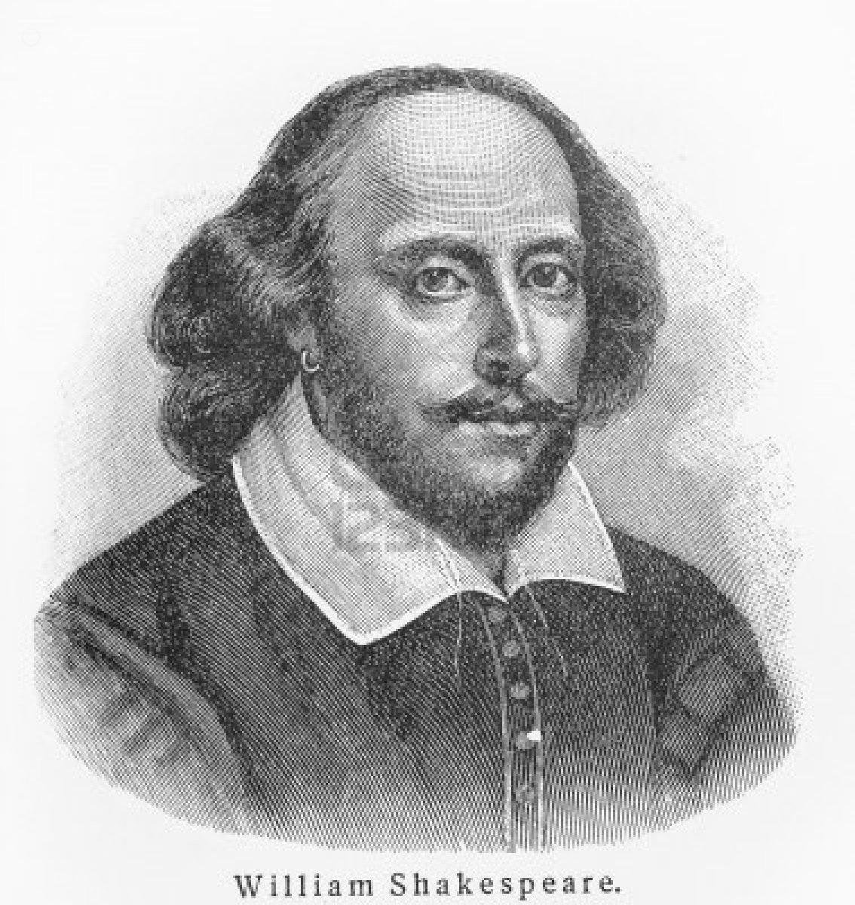
The language of love in Shakespeare
Shakespeare wrote different poem about the language of love
One of the most known is Romeo and Juliet, a love tragedy
Shakespeare wrote during the Renaissance and there is a contrast between religious concept of love and laical concept of love

Slide 8
Romeo and Juliet, Act II Scene II
ROMEO
She speaks:
O, speak again, bright angel! for thou art
As glorious to this night, being o'er my head
As is a winged messenger of heaven
Unto the white-upturned wondering eyes
Of mortals that fall back to gaze on him
When he bestrides the lazy-pacing clouds
And sails upon the bosom of the air.
JULIET
O Romeo, Romeo! wherefore art thou Romeo?
Deny thy father and refuse thy name;
Or, if thou wilt not, be but sworn my love,
And I'll no longer be a Capulet.
ROMEO
[Aside] Shall I hear more, or shall I speak at this?
JULIET
'Tis but thy name that is my enemy;
Thou art thyself, though not a Montague.
What's Montague? it is nor hand, nor foot,
Nor arm, nor face, nor any other part
Belonging to a man. O, be some other name!
What's in a name? that which we call a rose
By any other name would smell as sweet;
So Romeo would, were he not Romeo call'd,
Retain that dear perfection which he owes
Without that title. Romeo, doff thy name,
And for that name which is no part of thee
Take all myself.
ROMEO
I take thee at thy word:
Call me but love, and I'll be new baptized;
Henceforth I never will be Romeo.
All the word highlighted belong to the semantic field of love → Repetitive, usual and simple. This type of writing helps the protagonist or the narrator to express his emotion.

Slide 9
The Language of Love today
The conception of Love today is quite different as against the past.
Today people use different way to communicate love: speaking (less than years ago), texting through the use of social networks or mobile phones
Unconsciously also the body language is part of the language of love

Slide 10
Innovation and language of love
Middle Ages Renaissance Today
The language of love isn’t innovative
⬇
There are always the same features only expressed differently
It is a repetitive language with simple word

