Slide 1
Winter Group Work
Way of working
Love doesn’t kill you – Newspaper article

Slide 2
1^ step – group formation
Each member of the group is assigned a precise role and homework
First approach to a newspaper article: everyone searched the web for useful information about how to write a newspaper article
First meeting at the public library to plan the structure of the newspaper article and assign the members a paragraph to write

Slide 3
2^ step - topic
First considerations on the
assigned title (discussion):
Love doesn’t kill you
Individual study on
Jakobson’s functions of language
Further considerations about the topic
From the web to simplify the way to
face the problem (newspaper article about love communication by
a research group from University of West Virginia)
Planning the structure: lead, body, conclusion, abstract

Slide 4
3^ step – draft and development
Writing step by step:
Introduction, lead
Central body
Conclusion
Abstract
(we decided to consider it last because after we
wrote the text it was easier to consider the whole
article and simpler to find out how to increase the
reader’s curiosity and summarize the content)

Slide 5
Structure of the newspaper article
Title (Love doesn’t kill you)
Abstract (increasing the reader’s curiosity)
Lead (introductory function)
Body (facing the problem communicating love today: words and gestures)
Conclusion (summary and further details)

Slide 6
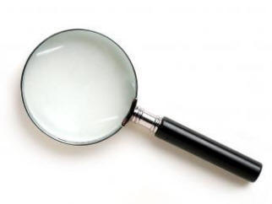
4^ step - revision
Reading the article
considering coherence,
cohesion, syntax,
rhetoric choices, interlocutor
Corrections
Adapting layout, font, header and footnote

Slide 7
5^ step - upload
Each member of the group is expected to upload the the final product on the teacher’s website

