Slide 1
THE STUARTS IN ENGLISH HISTORY

Slide 2
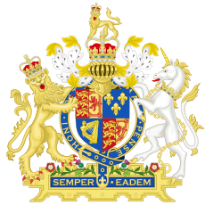
INDEX
James I
Charles I
The Petition of Rights
Oliver Cromwell
Charles II
James II
The Glorious Revolution
Mary and William
Anne I

Slide 3
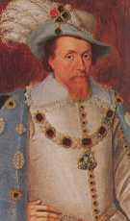
JAMES I
Mary Stuart’ son and Elizabeth I’s nephew;
He came to the throne in 1603 with the title of James I of England and VI of Scotland;
He believed in the Divine Right of Kings = absolutism;
He had to face religious problems and opponents from Parliament.

Slide 4
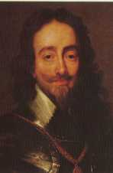
CHARLES I
James I’ son;
He ruled with absolutism;
He had financial problems because of the wars he was fighting;
He needed money and he asked Parliament for it;
Parliament answered with the “Petition of Rights”;

Slide 5
THE PETITION OF RIGHTS
It was a Parliamentary declaration of the rights
and liberties of the people that demanded:
that taxes could be imposed only with an accordance between the king and Parliament;
that no freeman should be imprisoned contrary to the laws of the land;
the abolishment of martial law.

Slide 6
CHARLES I
In 1629 he dismissed the body and he ruled alone for 11 years;
He recall the Parliament in 1640 but he dismissed it next: Short Parliament;
The need of money forced him to recall the Parliament once agian: Long Parliament;
The Civil War broke out in 1642.

Slide 7
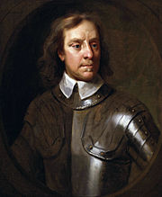
OLIVER CROMWELL
He toke control of the new –formed repubic: the Commonwealth;
He get the title of Lord Protector (Interregnum);
He led the Ironsides;
He formed the New Model Army;
He made lots of conquest;
His son Richard was unable to keep the power.

Slide 8
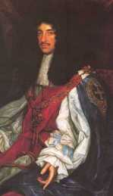
CHARLES II
He was the son of Charles I;
The Parliament crowned him in 1661: Restoration;
He supported the Anglicanism;
He imposed:
the Test Act (it prevented Catholics from holding officials positions in the State)
the Exclusion Bill (no Chatolic could become king)

Slide 9
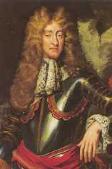
JAMES II
Charles II’s Brother;
He became king despite he was Catholic;
He evaded the Test Act;
Parlaiment try to have him by-passed;
The Bloody Assizes followed the Parliament’s attempt;
James get an heir in 1688.

Slide 10
THE GLORIOUS REVOLUTION
Protestants were concerned about a Chatolic succession;
Mary, James II’s daughter, and her husband, William of Orange, were invited to take the throne;
James fled to France;
Monarchs needed the consent of Parliament to rule = the concept of Divine Right was destroyed.

Slide 11
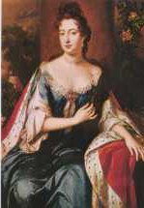
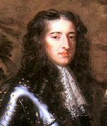
MARY AND WILLIAM
Mary II was James II’s daughter;
William , prince of Orange, was the son of Charles II and James II’ sister;
Parliament imposed them the Bill of Rights in 1689.

Slide 12
THE BILL OF RIGHTS
The Bill of Rights Act, 1689 mainly set out strict limits on
the use of Royal prerogatives by the sovereign.
The Act guarantee of some civil rights
It required the English monarch to always be Protestant
The Act guarantee lots of liberties for Parliamet giving it great power.
For addictional information about the Bill of Rights: http://www.marilenabeltramini.it/schoolwork1314/UserFiles/Admin_teacher/study_guide_bill_of_rights.pdf

Slide 13
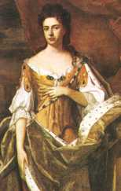
ANNE I
She was the sister of Mary II;
She was Protestant;
She followed the Glorious Revolution;
In 1707 the Act of Union formally united the Kingdoms of England and Scotland;
She was the last Stuart monarch;
She died in 1714.

