Slide 1
THE DEAD OF JERICHO

Slide 2
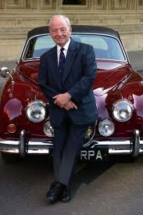
Index
Introduction.
Characters.
Content.
Settings.
New vocabolary.
Colin Dexter

Slide 3
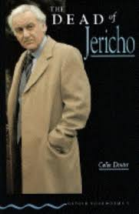
Introduction
Novelis : MR.Colin Dexter
Nationality: British
Title: The Dead of Jericho
Publication date: 4 June 1981
Genre: Crime Novel

Slide 4
Characters
Chief Inspector Morse
Anne Scott
George Jackson
Mrs. Purvis
Sergeant Lewis
Chief Inspector Bill
Constable Walters ( a young policeman)
Mrs Murdoch ( Morse’s old friend)
Charles Richards
Conrad Richards
Celia Richards ( Charles’ wife)
Anne’s Scott neighbors
Brothers owning a publishing company

Slide 5
Content
Inspector Morse met Anne in a Mrs. Murdoch’s party.
They talked all night to each other and she told him that once she had worked in a company of publicizing but now no longer worked there.
After about six months, Morse went to her house to meet her.
At that moment he realized that the door was open and there was a vest and a men's umbrella. At that moment, Morse came out and went away.
After some hours he became aware that Anne had committed a suicide. There was no longer the vest and the men’s umbrella , and the door was closed. It was a strange thing!

Slide 6
Morse began to investigate on his own because he had a personal interest in Anne.
He discoverd that she was pregnant.
Morse thinks that she killed herself because she had gone to bed with his son, who years ago had given up for adoption, and she had been pregnant.
After he became aware that the son of Anne died at the age of 3 years.
So he focused on the life of Charles and Conrad Richards. They are the leaders of the publishing company where Anne had worked.
Anne and Charles had had an affair. The child she was carrying when she was killed was the son of Charles Richards.

Slide 7
Anne’s neighbor , George Jackson, had seen Charles’ letter The murder was Charles. In exchange for his silence George had asked Charles a sum of money.
Charles gave him the money but his brother Conrad killed George Jackson.
The brother decided to reverse the roles. Charles was Conrad and Conrad was Charles. But inspector morse found out everything.

Slide 8
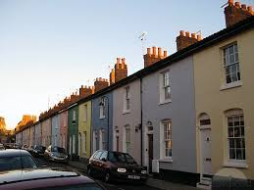
Settings
The events of the book were carried out in Jericho (Oxford).
Oxford is one of England’s most beautiful cities and it’s visited by lage number of tourists.
The area, in the north-west of the city, between Walton Street and the canal is called Jericho.

Slide 9
New Vocabolary
Account- money kept in someone’s name at a bank
Admit- to say something is true
Affair- sexual relationship with a man or woman
Attractive- good looking
Bare- with no clothes on
Bear- to suffer pain or unhappiness
Bet- to risk money on the result of something
Bloody- a swear-word
Case- a criminal or legal matter
Sergent- a police officer, more important than constable, less important than inspector
Shed- A small building in the garden for keeping tools in

Slide 10
Chairman- the head of a club or meeting
Classical- the best writing or music of an earlier
time.
Constable- a policeman
Fine- money paid as punishmet for parking in
the wrong place
Gown- a long black dress, worn by some university professors
Guilty- of someone who is or feels responsible for a crime
Inquest – legal investigation
Locksmith- someone who makes and sells keys and locks
Odd jobs- Small repair jobs in the house and garden

Slide 11
Lavoro svolto da:
Agolli Entina

