Slide 1
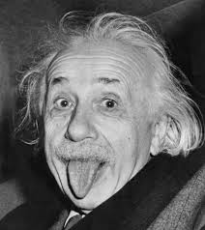
DISCOVERING EINSTEIN
A WEB QUEST
FOR
COMPETENCE BUILDING
LICEO SCIENTIFICO Albert Einstein
2ALS GROUPS

Slide 2
OUR OBJECTIVE
To answer our curiosities Albert Einstein
To experiment how to learn in groups
To use our competences in view of our interests
To experiment innovative methods of learning
To improve our knowledge of the English language.

Slide 3
ORGANIZATION
STEPS OF WORKSHOP
SELECTION OF RELEVANT INFORMATION COLLECTED
ARGUMENTATIVE STRUCTURE
FOR PRESENTATION OUTLINE
POWER POINT IMPLEMENTATION.
LAY OUT DESIGN
COMPLETION OF FILE
TEXT OF
POWER POINT
TEXT REVISION

Slide 4
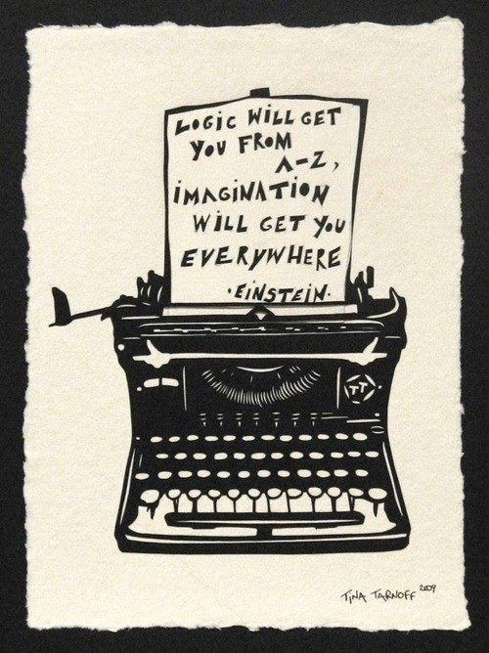
OUR CURIOSITIES
Peculiarities about Albert
Most relevant discoveries: 1905 – Annus Mirabilis
Nobel Prize
Additional prizes and awards
A real genius or one who also made mistakes?
Personality
The story of his life
Childhood
Kind of student
Reputation among common people
Religion
His relationship with God
The scientist and Zionism
Peace and War
Teachings he left posterity

Slide 5
ALBERT’S MAIN QUESTIONS
What does a light beam would look like if you can run alongside it at the same speed.
If light is a wave, then the light beam should appear stationary, like a frozen wave. And yet, in reality, the light beam is moving.
The question of his main thinking for 10 years. ⇨ question of the relative speed to the stationary observer and the observer moving with the light.
First "scientific paper" "The Investigation of the State of Aether in Magnetic Fields.“ He was 16.
He pictured lightning striking at both ends of a moving train. A person on the embankment might see the strikes as simultaneous, but to someone on the speeding train this would appear to have happened at different moments. ?

Slide 6
HIS RELEVANT DISCOVERIES 1905 – Annus Mirabilis
1905: published four works basic to the foundation of modern physics and changed views on space, time, and matter. (n the Annalen der Physik)
Photoelectric effect: it gave rise to quantum theory by suggesting that energy is exchanged only in discrete amounts (quanta).
Brownian motion: It describes the random motion of particles suspended in a fluid resulting from their collision with the quick atoms or that the speed of molecules in the gas or liquid.
Special relativity: It explains that the speed of light is independent of the motion of the observer.
E = mc2: The matter-energy equivalence estabilished that energy (E) equals mass (m) times the speed of light (c) squared. It means
mass is just one form of energy and that a small amount
of mass can be converted to a phenomenal amount of energy.

Slide 7
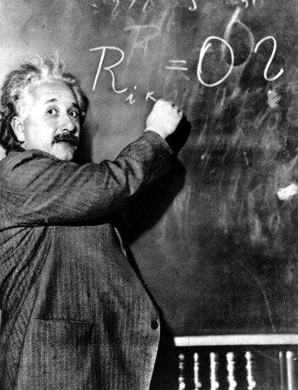
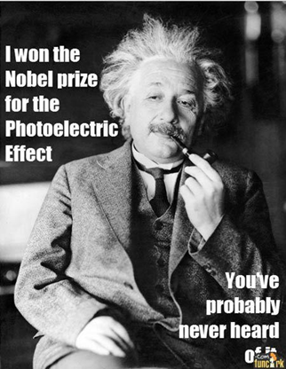
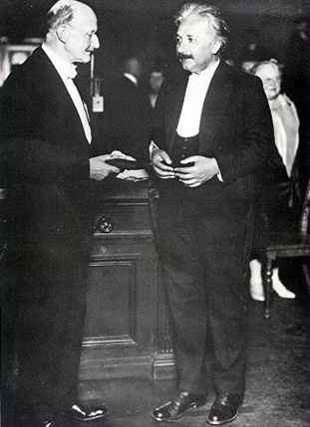
WHY HIS NOBEL PRIZE?
In 1921 Albert Einstein received the Nobel Prize in Physics for:
his discovery of the law of the photoelectric effect
his services to theoretical physics

Slide 8
ADDITIONAL PRIZES AND AWARDS
Albert Einstein’s most important recognitions:
1925 The Royal Society awarded him the Copley Medal
1934 he gave the Josiah Willard Gibbs lecture
1936 he was awarded the Franklin Institute's Franklin Medal for his extensive work on relativity and the photo-electric effect
1990 his name was added to the Walhalla temple for "laudable and distinguished Germans" which is located in Donaustauf in Bavaria.
1999 Time magazine named him the Person of the Century. In the biographer’s words "to the scientifically literate and the public at large, Einstein is synonymous with genius".
1999 an opinion poll of 100 leading physicists ranked Einstein the "greatest physicist ever”. A Gallup poll recorded him as the fourth most admired person of the 20th century in the U.S.
2008 he was inducted into the New Jersey Hall of Fame.

Slide 9
WAS HE A REAL GENIUS OR DID HE HIMSELF MAKE SOME MISTAKES?
Einstein’ published papers
ore than 300
over 150 other works
His great achievements and originality have made the word "Einstein" synonymous with genius, but he also made some mistakes:
1905 Mistake in transverse mass of high-speed particles;
1905 Multiple mistakes in the mathematics and physics used in calculation of viscosity of liquids, from which Einstein deduced size of molecules;
1905 Mistakes in the relationship between thermal radiation and quanta of light;
1905 Mistake in the first, second, third, fourth, fifth, sixth and seventh proof of E = mc²;
1907 Mistakes in the Principle of Equivalence of gravitation and acceleration;
1911 Mistake in the first calculation of the bending of light;
1915 Mistakes in several attempts at theories of general relativity;
1919 Mistakes in two attempts to modify general relativity;
1933 Mistakes in interpretation of quantum mechanics;
1939 Mistake in the interpretation of the Schwarzschild singularity and gravitational collapse (the “black hole”).

Slide 10
PERSONALITY
brilliant and immature, changeable, not sociable, far from the deep and durable love
Arrogant, individualist, cynic and sexist
unlimited gift for study, application and intuition
uncomfortable with
the principle of absolute obedience and
the military drills of school's atmosphere
Style
uncombed hair, a sweater, a pair of old threadbare trousers and a pair of sandals.
Attitude to women
had an adversarial relationship
despised their intelligence and the character of the fair sex
considered women's intellect subordinate.

Slide 11
HIS LIFE. A TIMELINE I
1879 born in Ulm (Wȕttemberg) on the 14th of March 1879.
1880-96 his family moved to Italy but Albert continued his education in Aarau, Switzerland
1896 began to attend the Swiss Federal Polytechnic School in Zürich ⇨happiest moment of his life ⇨ met Marcel Grossmann, a mathematician, and Michele Besso, with whom enjoyed lengthy conversation about space and time.
1900 he gained his diploma as a teacher in physics and mathematics.
1901 became a Swiss citizen, he accepted a position as technical assistant in the Swiss Patent Office.
1900-03 Very difficult moment: he could not marry Mileva ( without a job and his father’s business bankrupt)
1903 got married in in Zurich.
1904 he had his first son, Hans Albert
1909 -1913 he taught at the Polytechnic School in Zurich
1910 he had his second son, Edward, with Mileva

Slide 12
HIS LIFE. A TIMELINE II
1914 moved to Berlin - worked as a director of the Kaiser-Wilhelm Institute.
1919 marriage with Mileva was over. Married Elsa Lowenthal (his cousin)
1921 won the Nobel Prize for physics for his explanation of the photoelectric effect.
1933 renounced his German citizenship for political reasons - emigrated to America - worked as Professor of Theoretical Physics at Princeton.
1939 wrote a letter to Roosevelt ⇨ construction of the atomic bomb.
1940 became a US citizen
1945 retired
died on the 18th April 1955 (76 years)

Slide 13
CHILDHOOD
slow in learning how to speak - probably affected by autism.
had a cheeky rebelliousness toward authority.
slow verbal development
curious about ordinary things (space and time
tended to think in pictures rather than words.

Slide 14
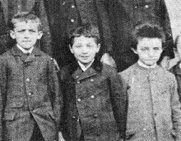
AS A STUDENT
had a clear view of the problems of physics determined to solve them.
personal strategy
able to visualize the main stages on the way to his goal.
"I never failed in mathematics”
"Before I was fifteen I had mastered differential and integral calculus."
"far above the school requirements" in maths – in primary school
By age 12 - "he already had a predilection for solving complicated problems in applied arithmetic“ (his sister)
decided to see if he could jump ahead by learning geometry and algebra on his own.

Slide 15
A.EINSTEIN’S REPUTATION
The academic and the scientific community did not immediately consider quickly his ideas true.
During German nationalism ⇨ target of campaigns to discredit his theories because of his Jewish descent.
His theories on relativity became a convenient target for Nazi propaganda.
Only after World War I the scientists approved of his ideas
the common people began to believe in him.
When he became famous, Einstein was hounded by reporters and photographers
Einstein became a scientific icon and humanist star,
The public elevated him into a cult of genius, and canonized him as a secular saint.
A century after his great triumphs, Einstein is considered a real genius.

Slide 16
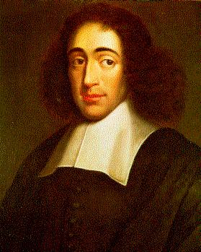
RELIGION
believed in a pantheistic God
⇩
represented by the harmony of nature's laws and the beauty of all that exists
his cosmic religious feeling was the motivation for scientific work;
identified closely with Baruch Spinoza, ⇨ believed the universe is governed by mechanical and mathematical laws of cause and effect
loved solitude and intellectual independence.
understood science and religion were connected
"Science without religion is lame,
religion without science is blind".
Baruch Spinoza
(1632-1677)

Slide 17
IDEA OF GOD
he insisted he believed in God
believed God's handiwork was reflected in the harmony of nature's laws and the beauty of all that exists
⇩
wondrous mixture of confidence and humility
⇩
God in His Words

Slide 18
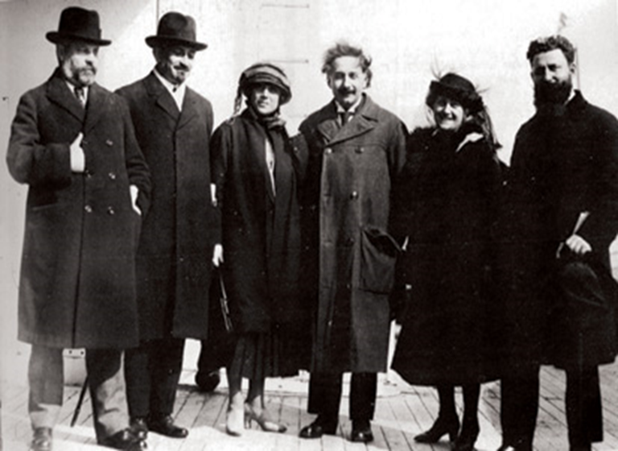
EINSTEIN AND ZIONISM
Zionism was a movement promoting a Jewish state in Palestine (19th and 20ieth century )
Passionate about preserving the Jewish values of social justice and intellectual aspiration
he wanted to create a place where Jewish could gain an education;
strong supporter of Hebrew University
1921: he went on a worldwide tour to raise money for this establishment.
He thought a Jewish state would serve as a cultural centre and not as a real state.
April 2, 1921
Zionist Movement fundraising tour

Slide 19
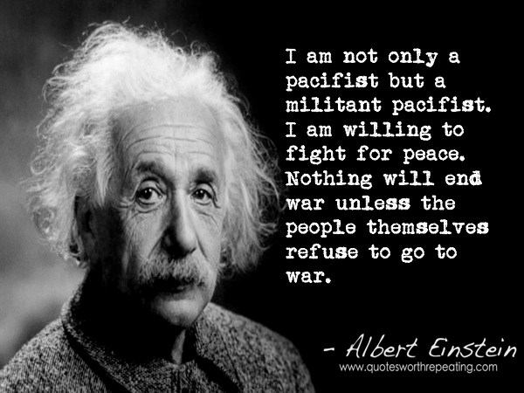
PEACE AND WAR
he did not in principle oppose to the using of arms,
WWI transformed him into a hard-core pacifist
1920s and 1930s ⇨ criticized the evils of armed struggle,
he urged young men to refuse military service
lent his name to international commissions to prevent future wars
before WW II declared the situation was so terrible that war was the only solution;
urged the building of the atom bomb
later became a leader in the movement to find ways to control war
Albert Einstein
(1879-1955)

Slide 20
TEACHINGS HE LEFT POSTERITY
Physics discoveries
the war is the worst kind of evil
humanity mustn’t be destroyed by his own thirst of power.
"war is a disease”
By signing the letter to Roosevelt he went against his pacifist principles.
In 1954, a year before his death, Einstein said to his old friend, Linus Pauling:
"I made one great mistake in my life, when I signed the letter to President Roosevelt recommending that atom bombs be made; but there was some justification: the danger that the Germans would make them ..."

Slide 21
CREDITS
BAIS VALENTINA
BELTRAMINO DAVIDE
BODIGOI DAVIDE
CANDOTTI SARA
CECCHETTO RICCARDO
DEL STABILE SOFIA
DE LUCA ALESSANDRO
DONAGGIO VALENTINA
FERRO GIADA
FRANCO RICCARDO
MAREGA PAOLO
MARTINELLO FEDERICO
PAOLINI LEONARDO
PARLATI VITTORIA
VIANELLO LUCA
VIDAL ROBERTA
VITA GIORGIA
WASCHL ANDREA Teacher: prof. Marilena Beltramini

