Slide 1
IRELAND

Slide 2
INDEX:
Presentation
Irish flag
History brief
Capital
Languages
Food
Festivities

Slide 3
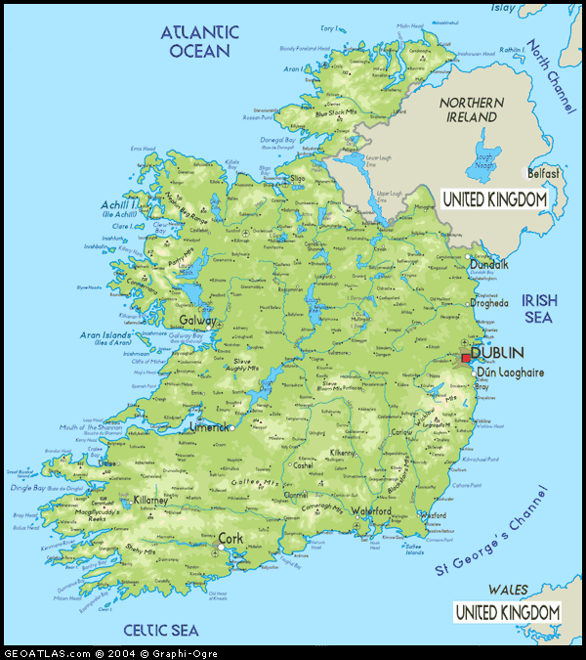
Ireland is an island situated in the Atlantic Ocean and separated from Great Britain by the Irish Sea.

Slide 4
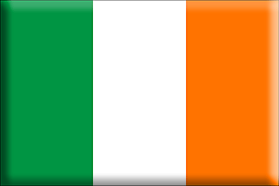
MEANINGOF THE IRISH FLAG
GREEN: represents the catholics who want an unit Ireland
WHITE: represents the hope for peace
ORANGE: represents the protestant community

Slide 5
HISTORY BRIEF
The republic of Ireland gained self government since 1922, consists of 26 counties.
Norman invasion started in the early 12th century and set in place Ireland’s uneasy position within England’s sphere of influence.
1800: “The Act of Union” in which Catholics were excluded from Parliament.
1914: “Home Rule”
1916: A failed rebellion on a Eastern Monday (15 of the surrendered leaders were shot by firing squad and 1 hanged).
1919-1921: “Irish War of Independence”
1922-1923: “Irish Civil War”
1949: Irish free State became “Ireland” and withdrew from the British Commonwealth of Nations.
Late 1960s: “The Trubles” saw large scale confrontation between opposing paramilitary groups seeking to either keep Northern Ireland as part of the United Kingdom or bring it into the Republic of Ireland
1998: “Good Friday Agreement”

Slide 6
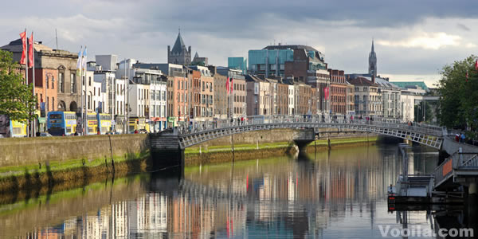
THE CAPITAL
Dublin is the capital of Ireland and it has got 325,000 inhabitants.
Dublin is a major European cultural centre and the origin of many prominent literary figures.
Dublin is the centre of both media and communications in Ireland, with many newspapers, radio stations, television stations and telephone companies.

Slide 7
LANGUAGES
Two main languages are spoken in Ireland: Irish and English
The Irish language has a vast treasure of written texts from many centuries, and is divided by linguists into Old Irish from the 6th to 10th century, Middle Irish from the 10th to 13th century, Early Modern Irish until the 17th century, and the Modern Irish spoken today.
English was first introduced to Ireland in the Norman invasion. It was spoken by a few peasants and merchants brought over from England, and was largely replaced by Irish before the Tudor Conquest of Ireland.

Slide 8
FOOD
Irish cuisine is a style of cooking originating from Ireland or developed by Irish people. It evolved from centuries of social and political change.
The cuisine takes its influence from the crops grown and animals farmed in its temperate climate.
The introduction of the potato in the second half of the 16th century heavily influenced Ireland's cuisine thereafter and, as a result, is often closely associated with Ireland.
Representative Irish dishes: Irish stew, bacon and cabbage, boxty, coddle, and colcannon.

Slide 9
IRELAND FESTIVITIES
St. Patrick's Festival is Ireland's official celebration. Around the globe on Saturday 17th March Ireland is celebrated with parties and parades.
Pan Celtic Festival began in Killarney in 1971 when it aimed to foster better relations between the Celtic nations of Ireland, Scotland, Brittany, the Isle of Mann, Cornwall and Wales. Today it has grown to a fully fledged celebration of Celtic culture with parades, music, dancing and sports.
Fleadh Nua Festival brings together concerts, music, song and dancing workshops, and each year thousands of people in search of traditional entertainment attend.
Puck Fair is one of Ireland's oldest and most popular festivals, with hours of free family entertainment, a traditional horse fair, open air concerts, parades and fireworks.

Slide 10
THE END
The work is produced by:
Camilla Toso
4ALS Liceo Scientifico “A. Einstein”

