Slide 1

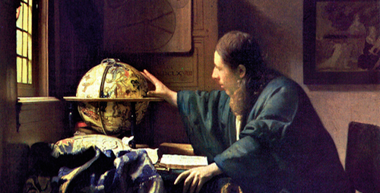
The scientific revolution
The astronomer - Vermeer, 1668

Slide 2
Table of contents
New scientific methods
The royal society
Newton’s view of the universe

Slide 3
What does the word “method” mean?
Method means a procedure, technique or a set of rules employed in an activity or to approach the problems of truth and knowledge.
The concept of method probably came from the Greek philosopher Socrates (ca 469-399 BC)
The Socratic method was applied in philosophical discussion regarding ethics and politics

Slide 4
There are three different approaches to the study of natural phenomena:
deductive method: the conclusion necessarily follows from the premises (logic, mathematics and geometry).
experimental method: formulation of hypotheses and their verification through experience. It moves from the particular to the universal (physics, chemistry and biology).
classification method: placing the organism into a group, class or family according to its biochemical, anatomical or physiological characteristics (biology).

Slide 5
The first half of the 17th century in Europe is characterized by the process of the scientific method.
The scientific method is the study of the physical world by sensory observation and experiment, by mathematical measurement and inductive reasoning.
It had been established by Galileo Galilei and Johannes Kepler.
In England the first age of science culminated with the work of Isaac Newton, who demonstrated the laws of gravity and the motion of planets.

Slide 6
The Royal Society
In 1662 the Royal Society was founded in London with King Charles II’s patronage. At the same time, London was the centre of the development of the new scientific philosophy.
It is the oldest scientific academy in continuous existence; it aims to expand the knowledge by the development and use of science, mathematics, engineering and medicine for the benefit of humanity and the planet.
The motto of the society “nullius in verba” was a direct challenge to the dependence of the old philosophy on written authorities.
From 1660 some of the typical traits of the English character began to emerge: a materialistic and practical mind, tolerance, reasonableness and common sense.

Slide 7
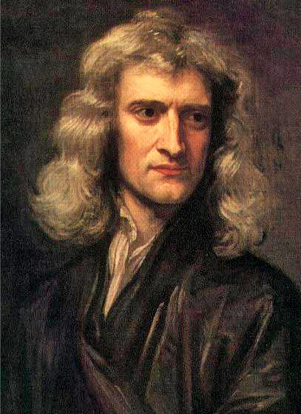
Newton’s view of the universe
The most important change of European thought in 17th - 18th century was the scientific revolution.
Scientific revolution implied: systematic doubt, empirical and sensory verification, the division of human knowledge into separate sciences and the view of the world as a machine.
There are three sides in the debate of scientific method:
the Aristotelians: they analyze the nature of things through mathematics, experiments and logical arguments starting from a few basic premises.
Francis Bacon’s school: he professed the inductive method. He believed scientific should collect all the data possible through experimentation and observation
Portrait of Isaac Newton in 1689 by Godfrey Kneller

Slide 8
Mathematical - deductive approach
Isaac Newton believed in the mechanical universe. He thought the universe could be explained completely through the use of mathematics.
He believed all the planets and other objects moved according to a physical attraction between them: gravity.
Newton based his view of the universe on the concept of inertia.

