Slide 1
Dickensian Societies
Charles dickens’ Themes: today and yesterday

Slide 2
Dickens’ Narrative: Main Themes
Industrialization and growth of cities
Work and social classes
Education
Children exploitation
Hunger and living conditions

Slide 3
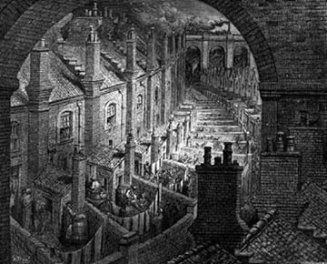
Industrialization: Victorian Age
It was a town of red brick, or of brick that would have been red if the smoke and ashes had allowed it; but as matters stood, it was a town of unnatural red and black like the painted face of a savage. It was a town of machinery and tall chimneys, out of which interminable serpents of smoke trailed themselves for ever and ever, and never got uncoiled. (Charles dickens – Hard Times – “Coketown”)
It contained several large streets all very like one another, and many small streets still more like one another. (Charles dickens – Hard Times – “Coketown”)

Slide 4
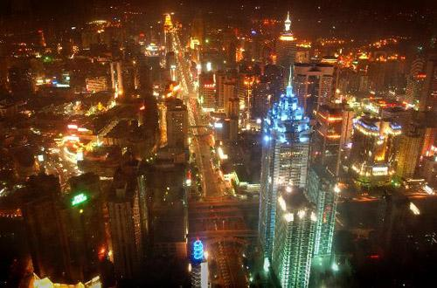
Industrialization: Modernity
China is the major case of the current industrialization.
It was the world's largest producer of CO₂ in 2011, reaching the highest levels in history.
It counts a strong soil and aquifer pollution.
Buildings grow in height because of the lack of space
The scheme of the city develops according to larger main roads that gradually become smaller and ramified.
Chinese cities today are the modern version of the Dickensian Coketown, developed on a wider scale.

Slide 5
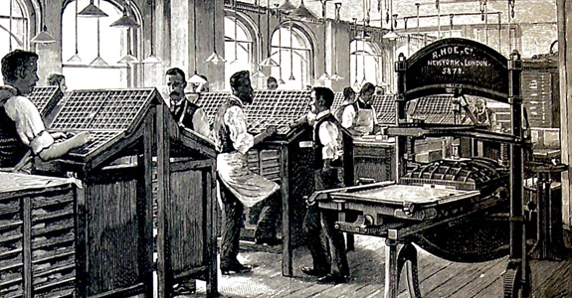
Work: Victorian Age
You saw nothing in Coketown but what was severely workful. (Charles Dickens – Hard Times – “Coketown”)
Inhabited by people equally like one another, who all went in and out at the same hours, with the same sound upon the same pavements, to do the same work, and to whom every day was the same as yesterday and to-morrow, and every year the counterpart of the last and the next. (Charles Dickens – Hard Times – “Coketown”)
A man who could never sufficiently vaunt himself a self-made man. (Charles Dickens – Hard Times – “Mr. Bounderby”)

Slide 6

Work: Modernity
L’Italia è una Repubblica democratica, fondata sul lavoro. (Costituzione Italiana – Articolo 1).
Today saying that the essential condition to achieve happiness is self-realization in the daily work is not an utopia but the true reality.
The use of machines and programmed rhythms lead to a “robotization” of the individual and to his depersonalization and alienation.
Work homogenizing the masses and its importance in society are a constant that binds Dickens’ considerations to the present society and that makes them perfectly compatible with it.

Slide 7
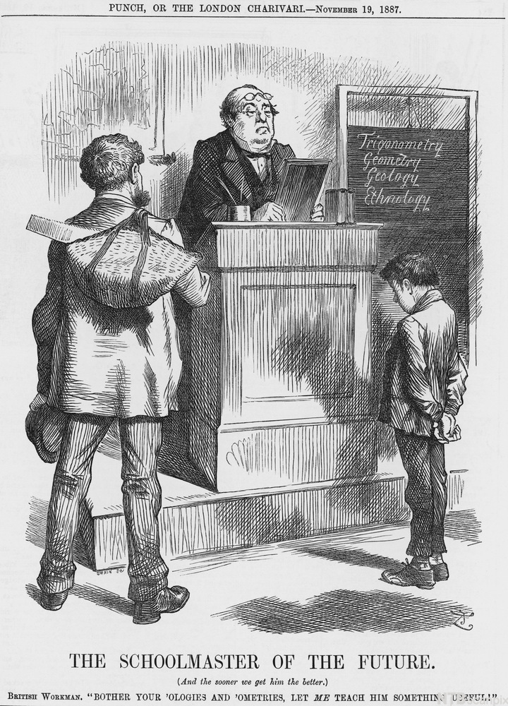
Education: Victorian Age
He seemed a kind of Cannon loaded to the muzzle with facts. (Charles Dickens – Hard Times – “Definition of a horse”)
Thomas Gradgrind now presented Thomas Gradgrind to the little pitches before him, who were to be filled so full of facts. (Charles Dickens – Hard Times – “Definition of a horse”)
“Girl number twenty,” said Mr. Gradgrind, squarely pointing with his square forefinger, “I don’t know that girl. Who is that girl?” (Charles Dickens – Hard Times – “Definition of a horse”)

Slide 8
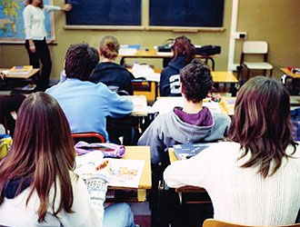
Education: Modernity
The right to study, as regard to the industrialized countries, is undeniable at any age and social status.
Educating does not mean imposing ideas, but rather stimulate children minds to a flexible, varied and elastic growth.
Understanding of specific data and storing them is only one part of school education.
The relationship between teacher and student is regulated by special rules that require it nor totally friendly nor totally detached and anonymous.
The statements of Dickens in the current reality find only a partial confirmation: students are individuals and not just memories.

Slide 9
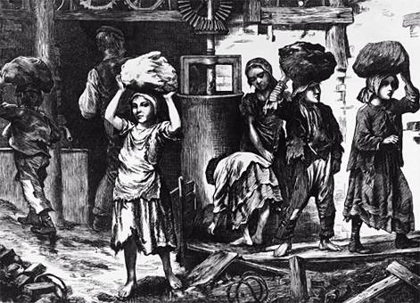
Children Exploitation: Victorian Age
The room in which the boys were fed, was a large stone hall, with a copper at one end. (Charles Dickens – Oliver Twist – “Oliver wants some more”)
Oliver was ordered into instant confinement; and bill was next morning pasted on the outside of the gate, offering a reward of five pounds to anybody who would take Oliver Twist off the hands of the parish. (Charles Dickens – Oliver Twist – “Oliver wants some more”)

Slide 10
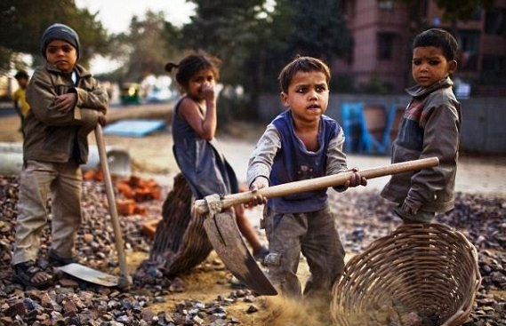
Children Exploitation: Modernity
In all, 246 million children work. For more than half, work is risky to health and they have from 5 to 14 years.
They live mostly in Asia (150 million), many in Africa and Eastern Europe; but they don't lack in the West.
The children are used as soldiers, sex slaves, hard workers, porters and spies.
They suffer the consequences of strain and hunger, are treated with violence and sold.
Dickens’ considerations adapt to the present; the spread of child exploitation, however, concerns not only England but also the rest of the countries.

Slide 11
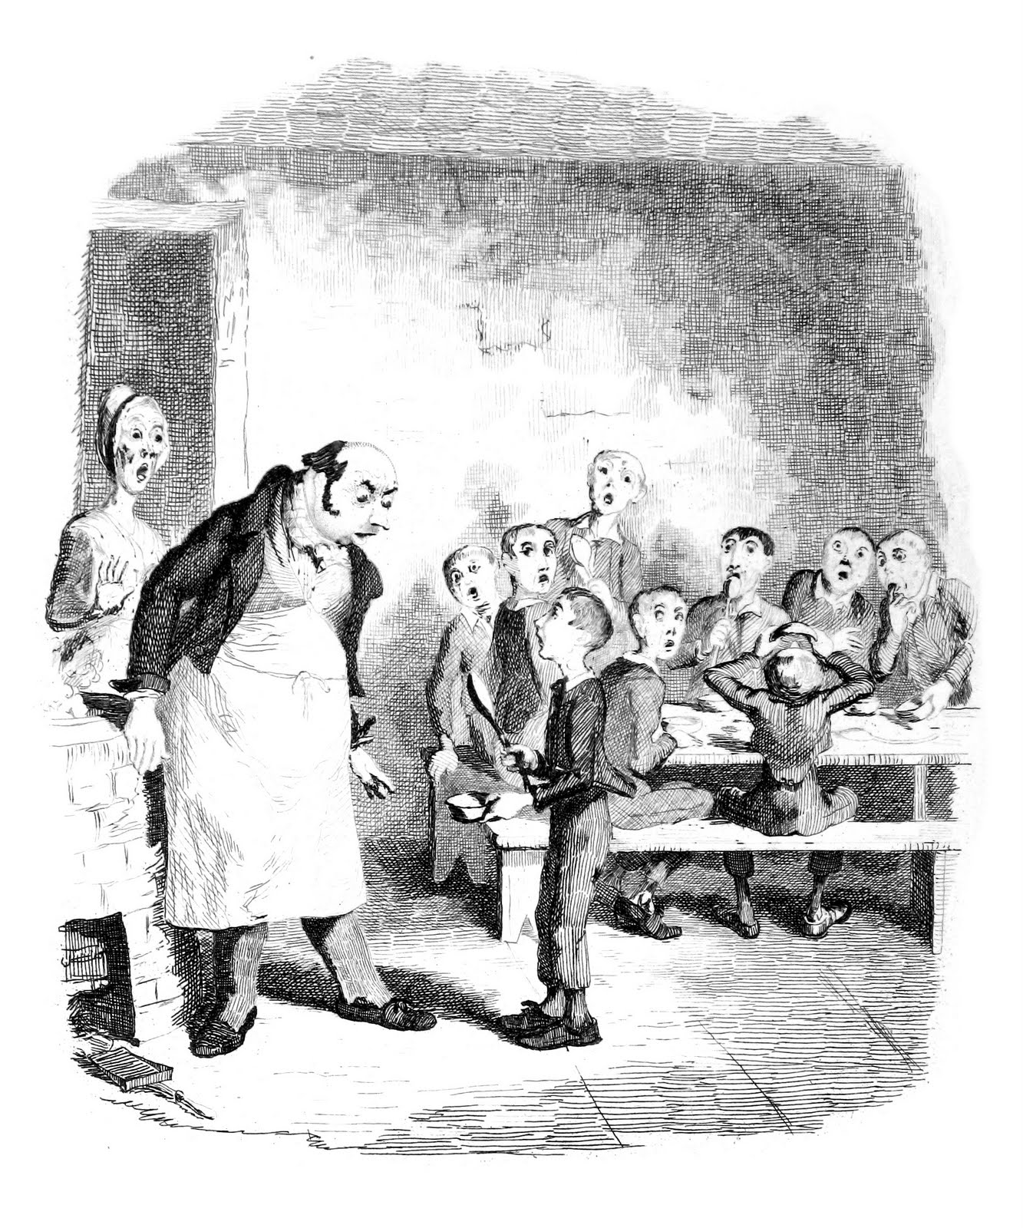
Hunger: Victorian Age
“Please, sir, I want some more” (Charles Dickens – Oliver Twist – “Oliver wants some more”)
I was one of the most miserable little wretches ever seen. I was so sickly, that I was always moaning and groaning. I was so ragged and dirty, that you wouldn't have touched me with a pair of tongs. (Charles Dickens – Hard Times – “Mr. Bounderby”)
The bowls never wanted wasting. The boys polished them with their spoons till they shone again. (Charles Dickens – Oliver Twist – “Oliver wants some more”)
Oliver and his companions suffered the tortures of slow starvation. (Charles Dickens – Oliver Twist – “Oliver wants some more”)

Slide 12
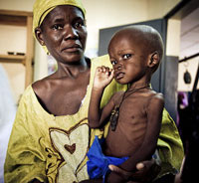
Hunger: Modernity
The problem of suffering hunger today mainly affects populations living on the Third World.
Poor nutrition leads to weight loss, apathy, nervous system depression, lower resistance to disease, premature aging, death by starvation. These consequences are manifested especially in children.
The request of Oliver Twist symbolizes the need for food among children, but currently this need is not so common in Western industrialized countries.
The "symptoms" described in Hard Times are the same that are found currently. The statements of Dickens can be addressed to the present completely but the reference zone must be enlarged.

