Slide 1
THE MODERN AGE
(1890 – 1930)
Student: Ferrari Davide
Class: 5ALS
Second Term

Slide 2
Historical Causes
Economic depression (1870 – 1880) showed how liberalism would not produce benefits for every citizen.
First World War (1914 – 1918) showed how science and progress had not produced a better world but they had produced weapons with which men would destroy it.

Slide 3
Social Consequences
  The project of the modern Welfare State;
  The birth of Communism;
  The sense of man’isolation → The loss of values and the pessimism;
  New ways of thinking and looking at reality;
    Albert Einstein’s General Theory of Relativity”;
    Henri Bergson’s stream of consciousness;
    Sigmund Freud’s Interpretation of Dreams;
    Carl Jung’s Psychology of the Unconscious.
  The change in the literature.

Slide 4
New Ways of Thinking and Looking at Reality
Albert Einstein’s General Theory of Relativity;
Henri Bergson’s stream of consciousness;
Sigmund Freud’s Interpretation of Dreams;
Carl Jung’s Psychology of the Unconscious.

Slide 5
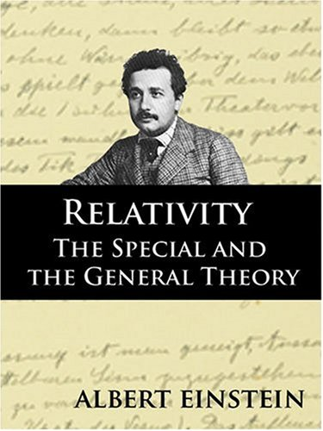
Albert Einstein’s General Theory of Relativity (1906)
The space and the time did not exist as separate, but changed according to the point of view of the observer.

Slide 6
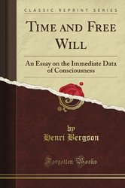
Henri Bergson’s stream of consciousness
  The stream is what constitutes a person’s mind and determines his thinking. It is irrational, it flows at a semiconscious level.

Slide 7
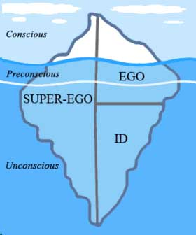
Sigmund Freud’s Interpretation of Dreams (1900)
  People’s behaviour depends on the unconscious part of their mind which is composed into three parts:
    The instinctive part (Id);
    The social conditioning part (Super-Ego);
    The rational part (Ego)

Slide 8
Carl Jung’s Psychology of the Unconscious
  Man’s unconscious mind was formed by his racial memory;
  Racial memory is the primitive memory preserved by each individual of the experience of his race during its evolution;
  It operated on a symbolic level;
Ordinary figures had great symbolic power.

Slide 9
The Change in the Literature
The Symbolist Poetry;
The Aesthetic Movement;
The Imagist Movement;
New Dramatic Novel;
Eliot’s mythical method:
Eliot’s Objective Correlative.

Slide 10
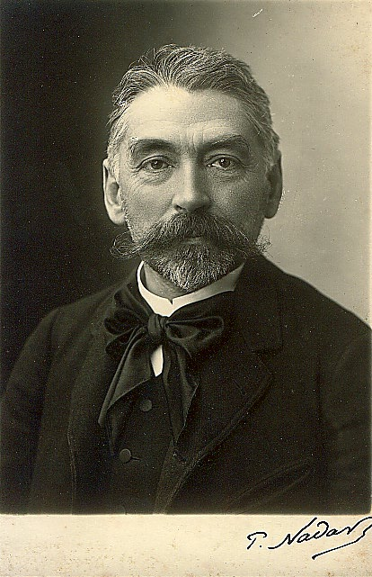
The Symbolist Poetry
Poets tried to giving mystical significance to their impressions of the observed world.
  They using language which spoke to the irrational rather than the rational in the reader.

Slide 11
The Aesthetic Movement
  The greatest exponents of the movement are: Ezra Pound, T. E. Hulme and T. S. Eliot;
  It is characterized by the concentration on the sentiments and impressions of the poets;
  It expressed a regret for a world which would not return;
  The greatest exponents of the movement are: Walter De La Mare, A.E. Housman and Edward Thomas.

Slide 12
The Imagist Movement
  The greatest exponents of the movement are: Ezra Pound, T. E. Hulme and T. S. Eliot;
  The imagists wanted poetic language to be dry and hard, with clear and precise images;
  They tried to producepoetry which reflected the cold, mechanical reality of the modern society;
  Their text was difficult, obscure and full of literary references.

Slide 13
New Dramatic Novel
Characters tell and represent the story;
The author is hidden;
The reader has to discover the meaning and the judgment of the text;
The use of the interior monologue (no logiacal connection);
The reader has the task to reconstruct the characters and discover their identities.

Slide 14
Eliot’s mythical method
He sees myth and ritual as a potential means of ordering and transforming into significance contemporary experience.
Technical function for him is more important than the symbolic meaning.
By compression and allusion he condenses the immense panorama, his contemporary history.

Slide 15
Eliot’s Objective Correlative
The way of expressing emotion in the form of art is by finding an “objective correlative”; it is a situation, a chain of events which shall be the formula of that particular emotion;
A succesful artistic creation requires an exquisite balance between form and matter;
If one prevails over the other we have not found the “formula”.

