Slide 1
Similarities and differences:
CHARLES DICKENS’ FICTION
VS
CONTEMPORARY REALITY
Liceo Scientifico “A. Einstein”
School year: 2014 - 2015
Class: 5 ALS
Student: Vitale Elisa

Slide 2
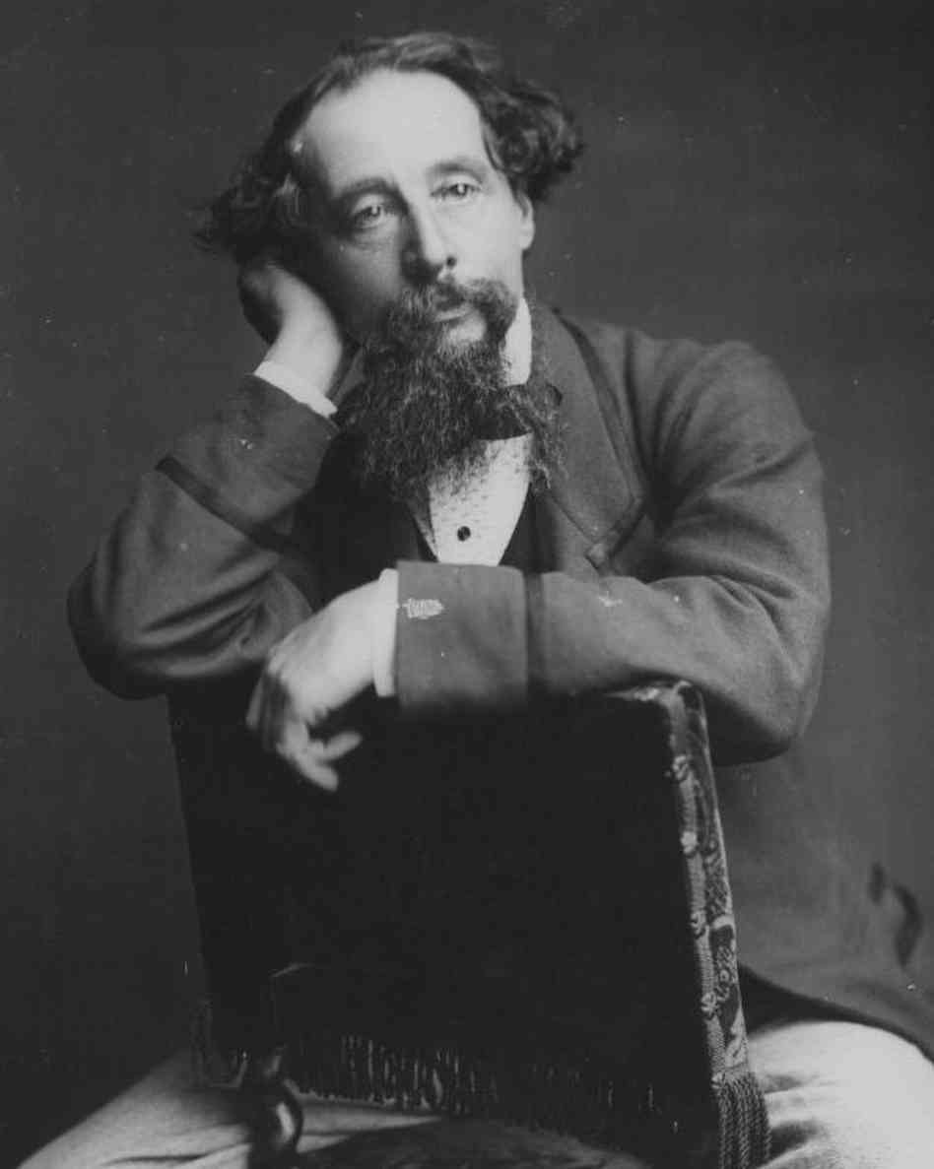
Introduction
A LEAD-IN
OBJECTIVES
To analyse the themes developed by Charles Dickens’ novels.
To trace Dickens’ themes and problems in contemporary reality (with reference to the news).
THE MAIN THEMES IN DICKENS’ FICTION ARE…
1. Education
2. Poverty, hunger and child labour
3. Industrialization
4. Gender inequality
Charles Dickens in 1861

Slide 3

EDUCATION…
THEME
1
… IN DICKENS’ FICTION
In such terms, no doubt, substituting the words “boys and girls”, for “sir”, Thomas Gradgrind now presented Thomas Gradgrind to the little pitchers before him, who were to be filled so full of facts.
[C. Dickens, Hard Times (1854), Chapter 2, “The definition of a horse”]
… IN THE VICTORIAN AGE
Only rich children could to go to school.
Sexism: boys and girls were separated and taught different subjects.
Strict education: children were physically punished and humiliated.
Children were equipped with blackboards, pencils and calculators.
The Elementary Education Act (1870) made education compulsory.

Slide 4
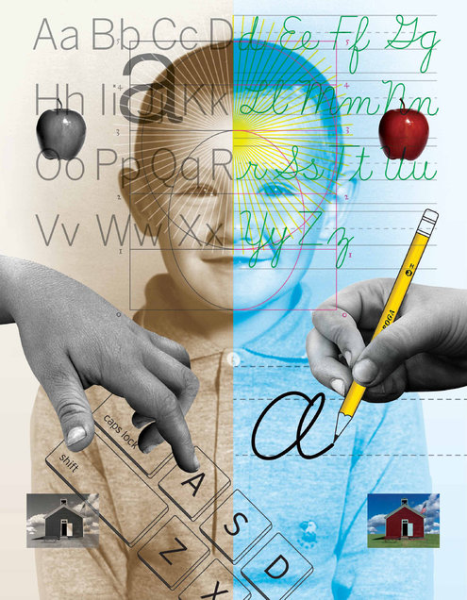
EDUCATION…
THEME
1
… TODAY IN FINLAND
2016: Finnish children will be taught keyboard typing instead of handwriting.
Education goes hand in hand with technology:
  Pro: technology makes learning easier
  Cons: learning cursive handwriting affects brain development.
Today’s education is completely different from the Victorian Age.

Slide 5
POVERTY, HUNGER AND CHILD LABOUR…
THEME
2
… IN DICKENS’ FICTION
[…] at last they got so voracious and wild with hunger, that one boy, who was tall for his age, and hadn’t been used to that sort of thing (for his father had kept a small cookshop), hinted darkly to his companions, that unless he had another basin of gruel per diem, he was afraid he might some night happen to eat the boy who slept next him […].
[C. Dickens, Oliver Twist (1837-39), Chapter 2, “Oliver wants some more”]
… IN THE VICTORIAN AGE
Workhouses: children were given a fixed amount of food (check the table).
Child labour was spread because:
    Families had no money (even if there is an economic growth due to the Industrial Revolution and colonialism)
    Children are small

Slide 6
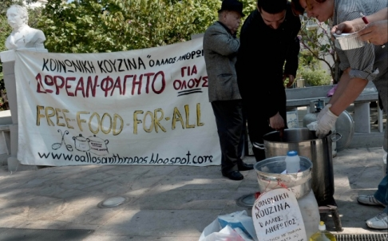
POVERTY, HUNGER AND CHILD LABOUR…
THEME
2
… TODAY IN GREECE
2012: economic crisis is affecting Greece from three-four years.
Huge debt and cuts: people don’t have money.
The crisis affects children as well:
  They are forced to work
  They faint at school because of hunger
The situation is not different from the Victorian Age.
A FEW STATISTICS
2,800,000 | poor families (less than 470€ per month)
400,000 | families with no income
60,000 | families cannot pay debts
200 | underfed newborns admitted to hospital in one month
100,000 | children work

Slide 7
INDUSTRIALIZATION…
THEME
3
… IN DICKENS’ FICTION
It was a town of red brick, or of brick that would have been red if the smoke and ashes had allowed it; but as matters stood, it was a town of unnatural red and black like the painted face of a savage. It was a town of machinery and tall chimneys, out of which interminable serpents of smoke trailed themselves for ever and ever, and never got uncoiled. It had a black canal in it, and a river that ran purple with ill-smelling dye, and vast piles of building full of windows where there was a rattling and a trembling all day long, and where the piston of the steam-engine worked monotonously up and down, like the head of an elephant in a state of melancholy madness.
[C. Dickens, Hard Times (1854), Chapter 5, “Coketown / The Keynote”]

Slide 8
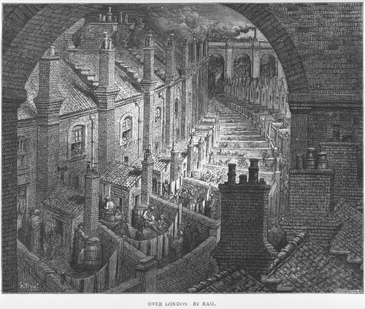
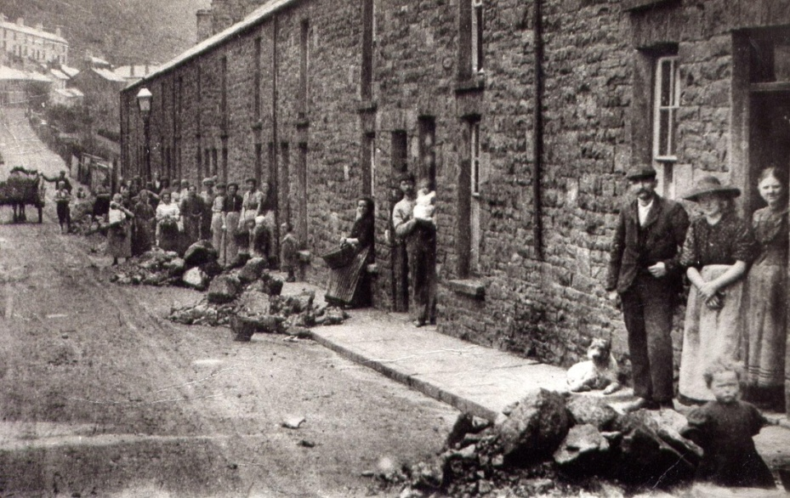
INDUSTRIALIZATION…
THEME
3
… IN THE VICTORIAN AGE
Industrialization and maritime power granted Great Britain’s supremacy.
Consequences of the Industrial Revolution:
  Urbanization and infrastructure improvements
  Overcrowding of London
  Cities were dirty: the lack of sanitation led to health problems

Slide 9
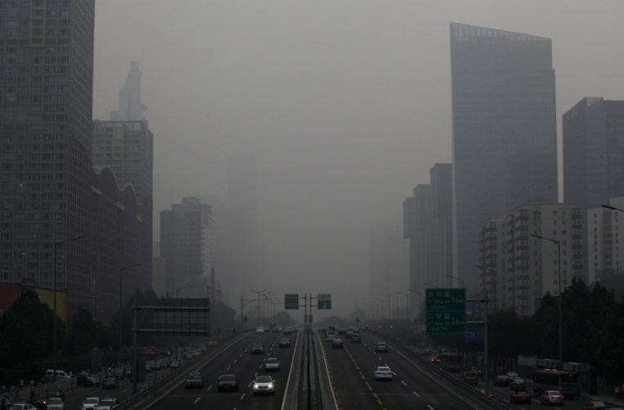
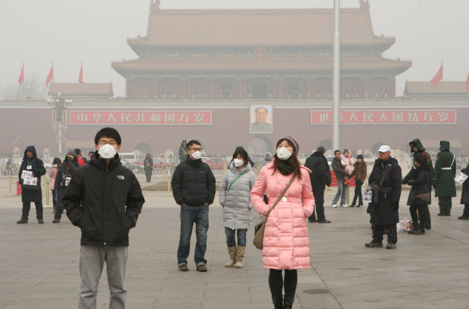
INDUSTRIALIZATION…
THEME
3
… TODAY IN CHINA
2010s: China’s uncontrolled industrialization makes people concerned about pollution
  Every year China drains 3.5 million tons of plastic in the sea
  18,000 polluting factories closed
  Cities are surrounded by clouds of smoke and sand
Industrialization still causes problems: the situation is not so different from the Victorian Age.

Slide 10
GENDER INEQUALITY…
THEME
4
… IN DICKENS’ FICTION
Mr. Bounderby delivered some observations to Mrs. Gradgrind on the circumstance of its being his birthday. He stood before the fire, partly because it was a cool spring afternoon, though the sun shone; partly because the shade of Stone Lodge was always haunted by the ghost of damp mortar; partly because he thus took up a commanding position, from which to subdue Mrs. Gradgrind.
[C. Dickens, Hard Times (1854), Chapter 4, “Mr. Bounderby”]
… IN THE VICTORIAN AGE
Men were considered more intelligent and could study in Universities
Women had to stay at home and take care of children: they were considered weak and ill (especially during menstruation periods)
At school boys and girls were separated and taught different subjects

Slide 11
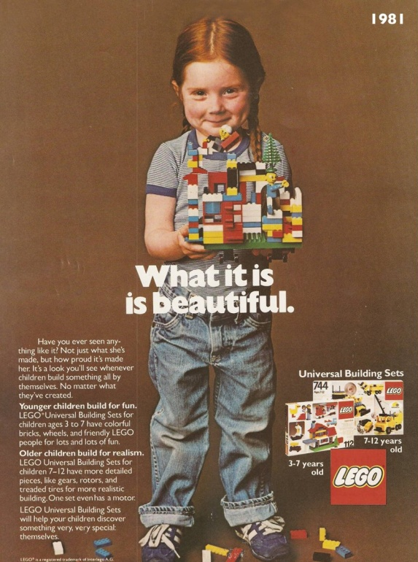
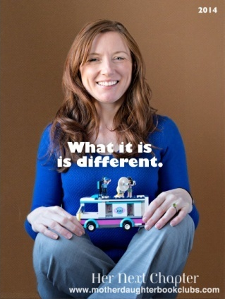

GENDER INEQUALITY…
THEME
4
… TODAY IN WESTERN SOCIETY
Gender equality: feminism (equality between men and women) has become popular in the last years
Gender inequality can be seen in children’s toys:
  Children toys convey messages about gender
  Children’s minds are conditioned
  How can we expect to reach equality in the future?
Gender (in)equality is still a big deal
In 1981, LEGOs were for boys and girls. Nowadays, toys have messages built into them before a child even opens the pink or blue package. In 1981, LEGOs were simple and gender-neutral, and the creativity of the child produced the message. In 2014, the toy delivers a message to the child, and this message is weirdly about gender.
[Rachel Giordano. She posed for LEGOS ads]

Slide 12

Sources
Online newspapers:
BBC News
Daily Mail
The Economist
The Independent
Il Sole 24 Ore
Other sources:
British Library
Focus
The Victorian Web
YouTube
Women you should know
Teacher’s notes

