Slide 1
The Modern Age
Liceo Scientifico “A. Einstein”
School year: 2014 – 2015
Class: 5 ALS Student: Vitale Elisa

Slide 2
The Modern Age: political and economical crisis
1890 – 1930
Tension between European nations because of
Colonialism
Trade
Tension led to World War I (1914 – 1918)
New technologies: shocking power of destruction
Battleground included Europe, Asia and Africa
Consequences:
Europe lost self confidence
URSS and USA became the leading nations in the world
People lost faith in liberal democracy, capitalism, the idea of progress
People lost faith in religion
NEXT

Slide 3
The rise of the working class
1917: October revolution led by Lenin
The working class wanted to achieve a better position
People lost faith in liberal democracy and capitalism
1870s – 1880s: economic and financial crisis caused unemployment
Karl Marx’s “Communist Manifesto” (1848) encourages the rise of the working class
The middle class introduced
National insurance
Unemployment pay
Medical treatment
BACK

Slide 4
Religious crisis
World War I: violence and death
↓
Absence of God = Man’s isolation
How was it perceived in literature?
Pessimism and acceptance (Hardy, Conrad)
Personal relationship replaced divine love (Woolf, Lawrence, Forster)
Adhesion to Christianity (Chesterton, Eliot)
Social commitment (Show, Wells)
BACK

Slide 5
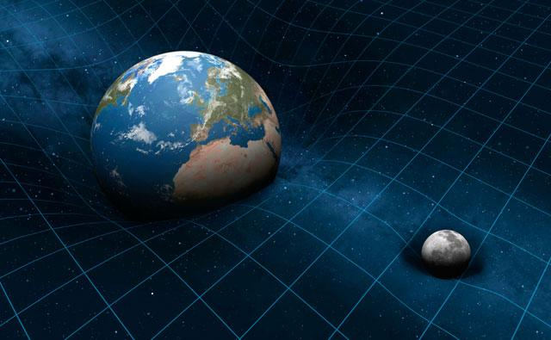
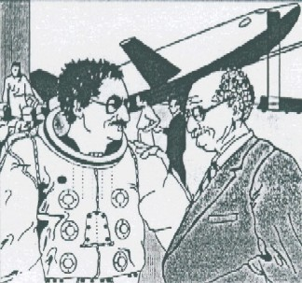
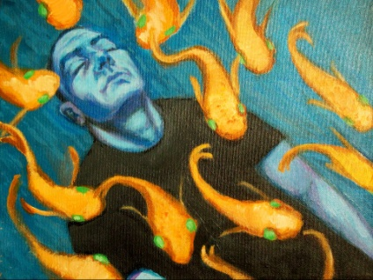
New discoveries and ideas
Science
Euclidean geometry → non Euclidean geometries
Newtonian physics → 1905: Albert Einstein’s relativity
Time and space depend on the observer’s point of view
Philosophy and psychoanalysis
Henri Bergson: past and future fuse together with the present in a stream of consciousness
Sigmund Freud: “The ego is not master in its own house”

Slide 6
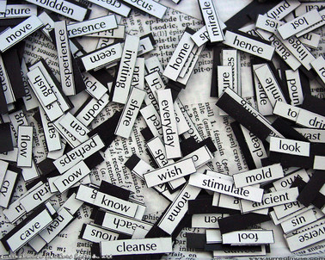
Modern Literature: Poetry
War poetry
Importance given to sounds
Irony
Realism, details
Unconventional structure, punctuation
Symbolist poetry
The poet understands the unconscious
Literary language speaks to the irrational part of the reader
Importance given to sounds
Free verse
The Imaginist Movement
Dry and hard language
Clear precise images
Reflects modern reality
Literary references: poetry addresses a small audience

Slide 7
Modern Literature: the Novel
Old Novel
VS
New Novel
The reader is guided by a first/third person omniscient narrator
It conveys:
A set of values
A judgement
Narrative structure of the novel
The reader is invited to interact with the literary work:
No judgement, comments, observations from the narrator
The narrator hides behind characters
Identification with characters
New idea of time
Stream of consciousness
Dramatic structure of the novel

Slide 8
Modern Literature: T. S. Eliot
Mythical method
“[Using myth] is simply a way of controlling and ordering, of giving a shape and a significance to the immense panorama of futility and anarchy which is contemporary history”
Correlative objective:
“a set of objects, a situation, a chain of events which shall be the formula of that particular emotion”
Immediate evocation of emotions

Slide 9
Modern Literature
James Fraser
Jesse Weston
Interest in
Darwin’s theories
Symbolist poetry
Mythology and pre-history
Civilization (study of society)
Unconscious conveyed through symbols
Synthesis of geography and history
Interest in the Middle Ages and Grail legends
“romantic literary version of the figure of a divine or semi- divine ruler at once God and King, upon whose life, and unimpaired vitality, the existence of his lord and people directly depend.”

