Slide 1
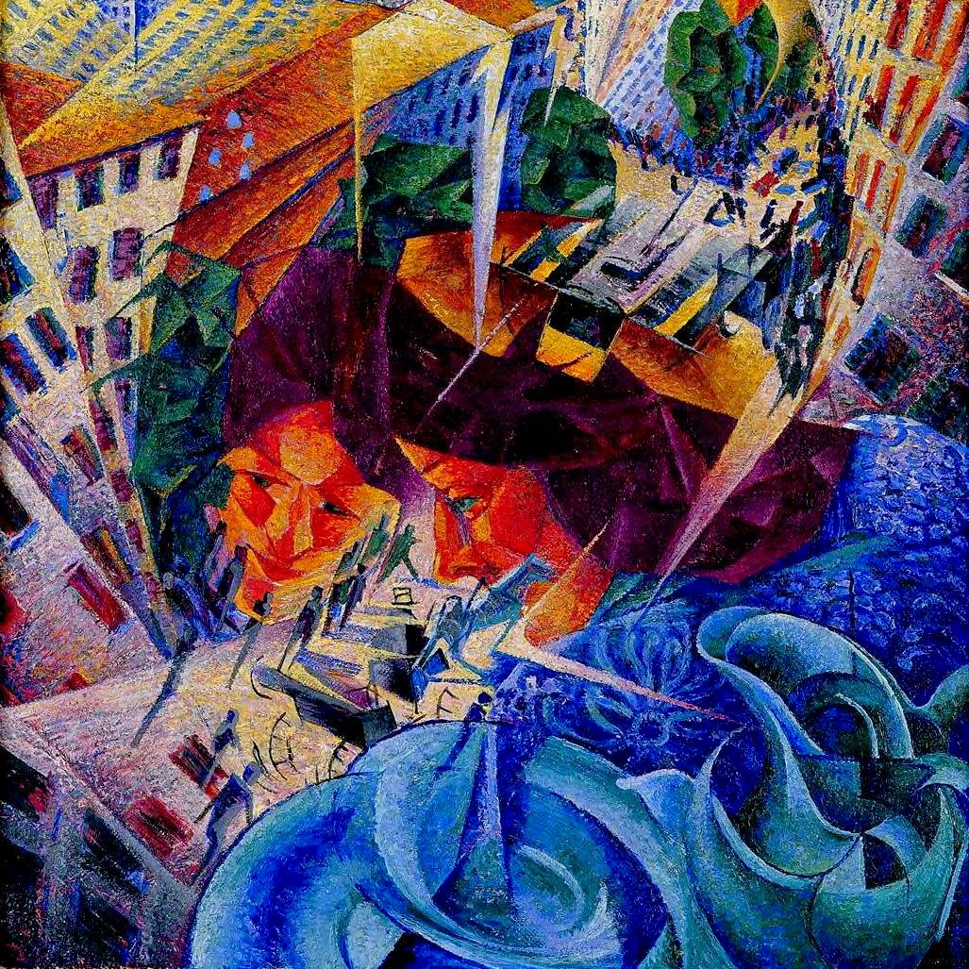
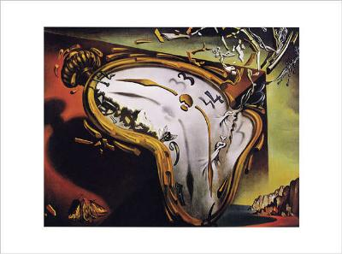
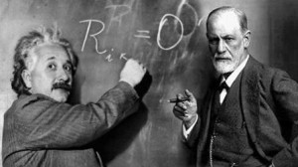
the Twentieth Century
Liceo Scientifico “A. Einstein”
School year: 2014 – 2015
Class: 5 ALS Student: Carbonera Francesco

Slide 2
Historical data
Victorian doubts and fears were confirmed;
Economic depression in the 1870’s and 1880’s:
unemployment in working class,
“laissez-fair” would not produce benefits for everyone (Welfare State);
in 1917 Lenin and the Bolshevik party took control of the Russian state in name of the Russian working class :
Marxism offered an optimistic secure view of the future, as suggested in The Communist Manifesto of 1848;
in 1914 - the First World War:
It made lose faith in liberal democracy, capitalism and the Victorian idea of progress;
after 1920 the U.S.A and Russia replaced France and Britain as the two great powers (American capital began the dominant force);
After the Darwinian’s theory the most profound fear was religious. Man was only a superior animal, isolated in an indifferent mechanical universe, living a life without a meaning and without God (world did not seem to obey any divine principles or to be part of any divine plan).

Slide 3
Thinkers trasformed the world
In 1906 Albert Einstein’s General Theory of Relativity : space and time did not exist as separate but changed according to the point of view of the observer;
The philosopher Henri Bergson (1859 - 1941) and the American philosopher William James (1842 - 1910) rejected conventional ideas of time: past and future exist together with the present in people’s mind. (new form of narrative :“stream of consciousness”);
the psychologist Sigmund Freud (1856-1939) in The Interpretation of Dreams (1900): people’s behaviour depends on the unconscious part of their minds. They are :
motivated by their instincts (Id);
controlled by their social conditioning (the Super-Ego);
Apparently expression of the conscious “Ego” (man’s power of reason);
The psychologist Carl Jung (1875-1961) in The Psychology of the Unconscious (1916): a basic element of man’s unconscious mind was formed by his racial memory, that is the primitive memory preserved by each individual of the experience of his race during its evolution.

Slide 4
Poets’ reactions
The sense of doubt , insecurity and isolation is clear in the works of writers that produced different responses :
T. Hardy and J. Conrad were pessimists (they cultivated a stoical dignity);
V. Woolf, D. H. Lawrence and E. M. Forster found in personal relationship and human core a substitute for the divine love;
Hillarie Belloc, G. K. Chesterton and T. S. Eliot decided to ignore their rational doubts and became Christians;
G. B. Show and H. G. Wells found purpose and direction in trying to improve society and dedicated themselves to social reform:
the novelist disappeared from his own work:
They left their characters to speak for themselves, to present their own version of reality, without interviewing to offer the reader an alternative point of view.

Slide 5
Symbolist poets
C. Jung's study operated on a symbolic level, which meant that certain figures or objects in the ordinary world had great symbolic power and that people responded to them without realizing it.
The French Symbolist poets :
tried to do giving mystical significance to their impressions of the observed world;
influenced the writers of the Aesthetic Movement: Ezra Pound ‘s and T.S. Eliot’s works broke completely with the Victorian tradition.
English poetry at the end of the 19th century was sentimental, elegiac and often pastoral, as the poems of Thomas Hardy show.
In the years before the First World War (called the Georgian Period), the poet Edward Thomas (1878-1917), Walter De La Mare (1873-1956) and A. E. Housman (1859-1936) produced original verse. It expressed instead a regret for a world which would not return.

Slide 6
A new poetry was necessary and T. S. Eliot and Ezra Pound produced it.
Eliot was influenced by:
T. E. Hulme condemned the Romantic idea that art was only a matter of self-expression on the part of the artist: it should be impersonal in the way that Neo-Classicism had been. He wanted writers to return to a Pre - Romantic idea of man, the one of Pope’s Essay on Man (1733). Verse was always controlled, with emotion dominated by critical reason.
Pound, who had helped found the Imagist Movement. The Imagists wanted poetic language to be:
dry ;
hard;
clear;
precise images.
They tried to produce poetry which reflected the cold, mechanical reality of the modern world.

Slide 7
New Dramatic Novel
Characteristic:
the narrator is invisible, hidden or doesn’t appear (absence of comments, judgments and interference, ambiguity and uncertainty permeate the novel);
characters tell and represents the story;
the story is self-told;
the analysis is transferred from the novel to the reader;
aesthetic values have taken the place of moral values.
In H. James’ works the author turns inside people’s consciences to explore the flux of his mental experience(“stream of consciousness”). The interior monologue appears where there is no perception for logical connection, deep thoughts, the one nearest to the unconscious.

