Slide 1
Similarities and Differences
C. Dickens' fiction and contemporary reality

Slide 2
AIMS AND OBJECTIVES
Objectives
  Identify the main themes of Dickens' production.
  Gain awareness of the contemporary reality trough the analysis of Charles Dickens' themes.

Slide 3
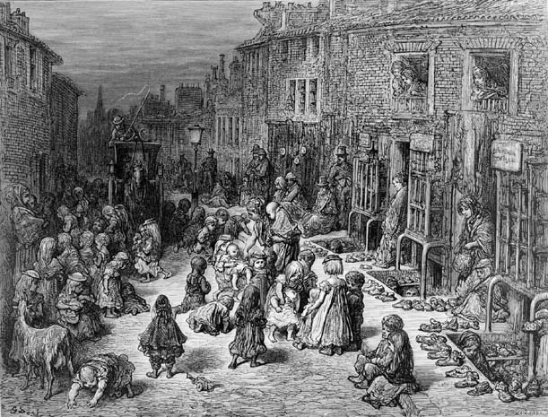
Industrial Revolution’s societies
  Industrial Revolution’s societies were characterized by great differences between middle class and working class.
  Poverty was largely diffused
  People lived in cities full of mud, smoke and dirt.
  Very difficult conditions of work for men and exploited children.

Slide 4
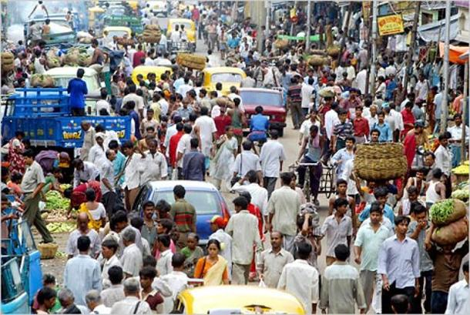
Modern Societies
  Dickens’ cities described in his production seems so similar to nowadays cities, under different points of view.
  Some examples are:
  Overpopulation
  Huge gaps between the riches and the poors
  Heavy pollution, especially in emerging countries
  High criminality
  Extended unhealty areas dominated by criminals.

Slide 5
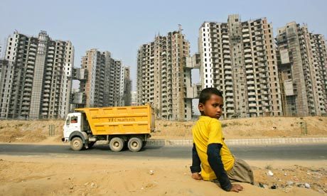
Similarities
Both London in the IX century and modern cities have in common the process of an heavy and too fast urbanization, made up by three phases:
migration
economic development
evolution of transport.

Slide 6
similarities
The migration consists in the movement of many people to cities. This is the first cause of cities development.
The migration in Dickens’ London was caused by Agricultural Revolutions (enclosures in particular) that caused many unemployed who moved to cities.

Slide 7
similarities
The economic development is both caused by the new manpower as a consequence of the migration and by new inventions and organization of work. This aspects caused a fast development of a city.
  The Industrial Revolution was fundamental in London’s advancement
  Nowadays industrial productivity and financy increase urbanization

Slide 8
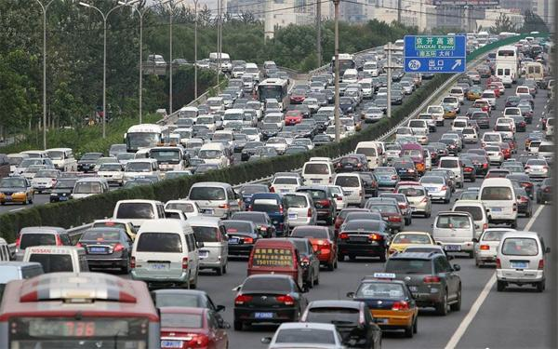
similarities
The evolution of transport is foundamental in order to distribute properly the enormous quantities of goods produced and to supply industries in this new order of production.
The development of transports also permits a growth of the cities.
  In the XIX century, the development of cars and railways allowed faster transfers and, as a consequence, the growth of the size of London.
  Tram, trains and underground also contribute to the extension of our cities.

Slide 9
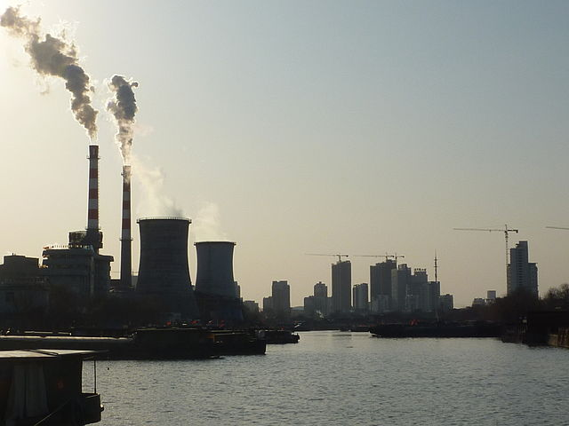
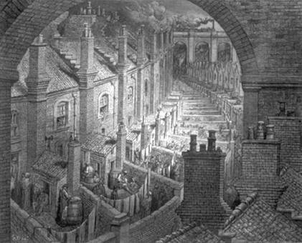
conclusions
It is possible to say how Dickens’ London were so similar to nowadays new cities because of improvements of services. Unfortunately we also assist to the growth of many problems related to the order.
Dickens uderstood problems related to a fast growth of a city. We can say that a fast increase of wealth doesn’t mean an increase of well-being.

Slide 10
sitography
http://www.telegraph.co.uk/culture/charles-dickens/9018185/Dickenss-London-in-pictures.html
http://charlesdickenspage.com/dickens_london.html
https://emiliashop.wordpress.com/2012/02/09/charles-dickens-e-henry-mayhew-un-doppio-bicentenario-ignorato/
http://data.un.org/Default.aspx
http://www.bl.uk/romantics-and-victorians/articles/henry-mayhews-london-labour-and-the-london-poor
http://en.wikipedia.org/wiki/Urbanization

