Slide 1
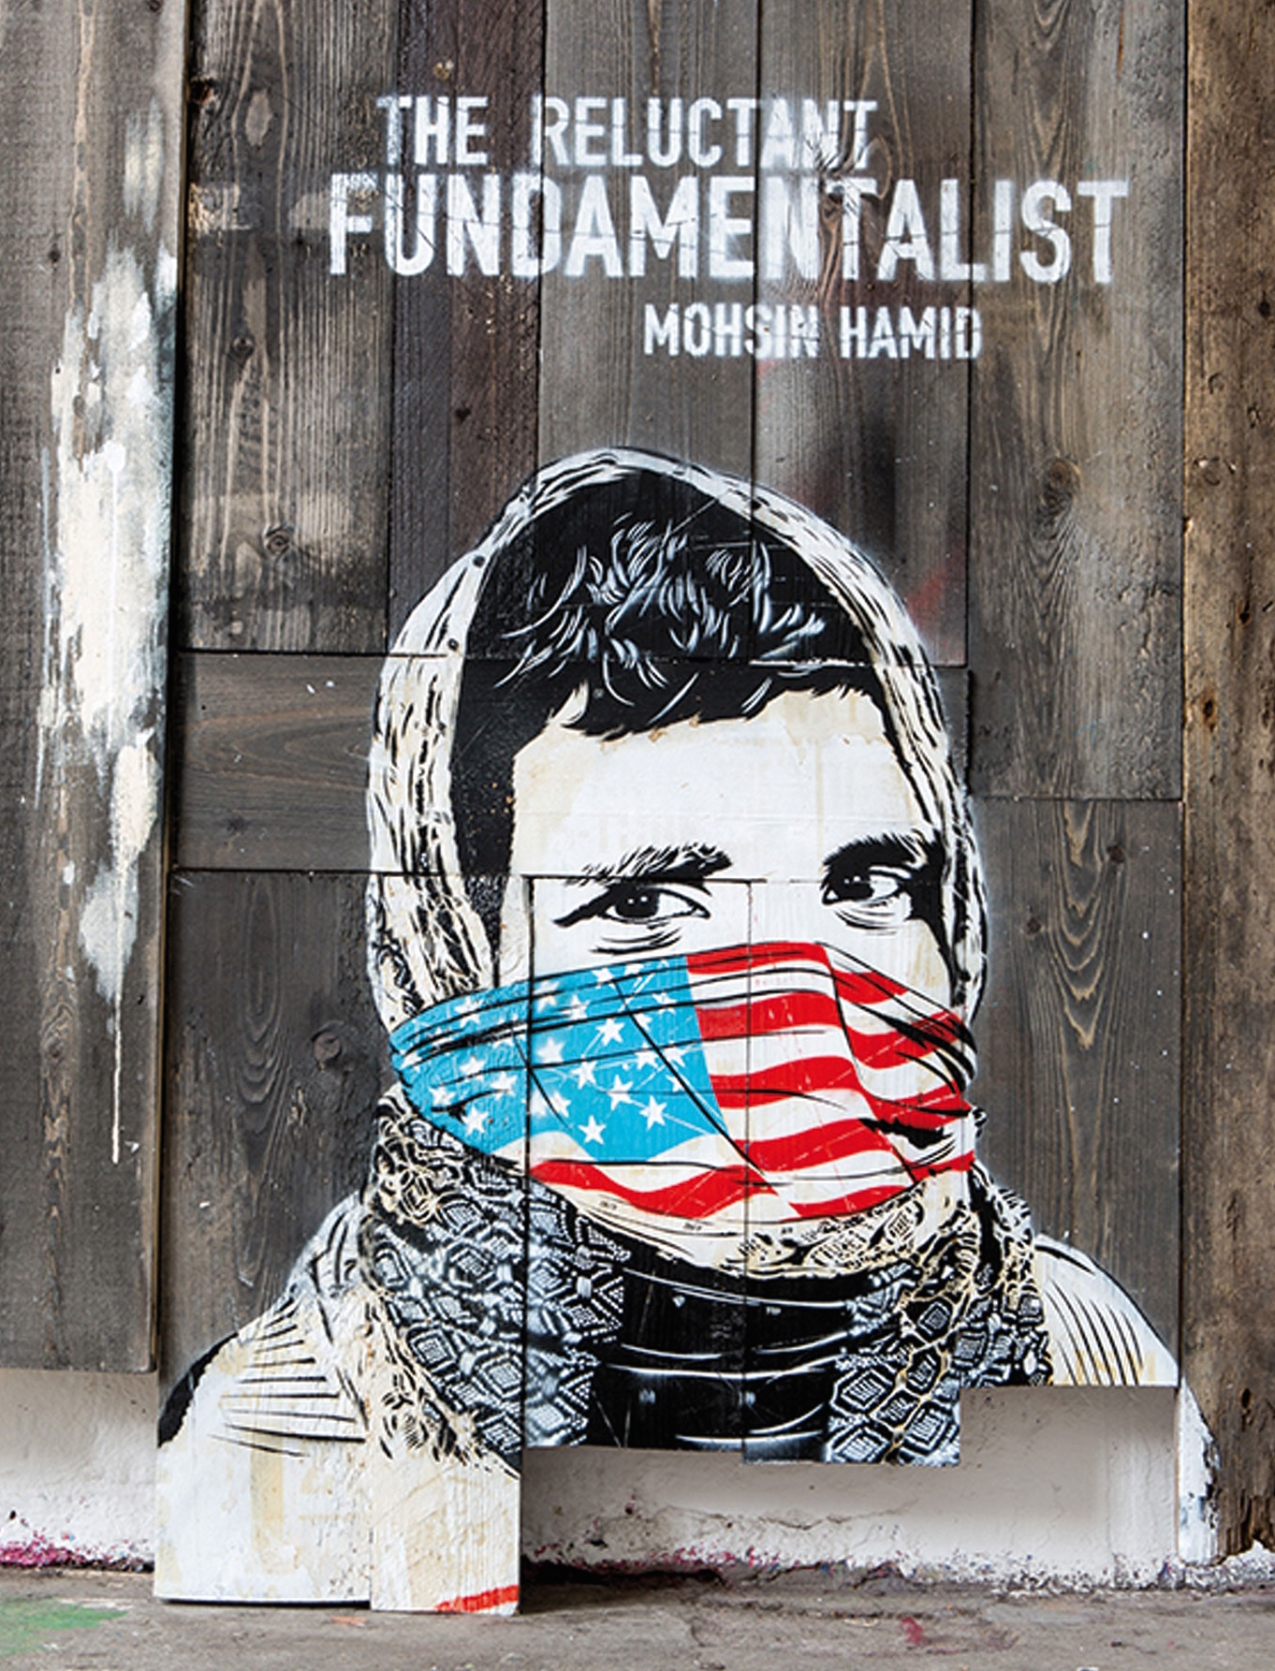
The Reluctant Foundamentalist
Mohsin Hamid
Giacomo Cecchetto – 5 ALS –2014/2015

Slide 2
AIMS
Students should be aware of the importance of:
  Knowledge and skills related to intercultural dialogue
  Language and learning awareness
  Project skills in multilingual and intercultural dimension
  Documentation in cultural exchange
  Effective communication in a multilingual context
  Semantic research in language learning
  Cultural features and stereotypes
  The way language makes meaning with respect on the previous

Slide 3

OBJECTIVES
Students should be able to:
  Discuss the structure in principle of the novel Moshin Hamid, The Reluctant Fundamentalist, Reclams-Universal Blibliothek, number 19876, 2013 Philipp Reclam Jun
  Single out the main function of each chapter with reference to message
  Find out keywords and expression used to convey different linguistic and cultural perspectives
  Carry out relevant textual analysis with reference to structural elements of fiction (title, layout, structure, denotation, characters, setting, narrative strategy, use of language)
  Draw personal conclusions and argumentations supported by textual reference
  Relationship signifier-signify

Slide 4
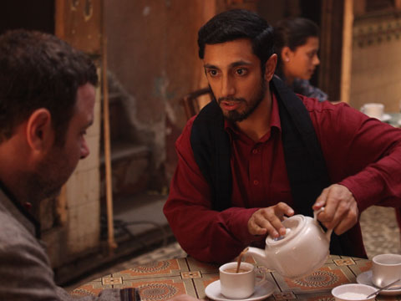
CHAPTER 1
FUNCTIONS
  Introduction of the characters: Changez and the American interlocutor
  Introducton of the setting: Cafè in Lahore (Pakistan), Princeton (USA)
  Presentation of the narrative tecnique: Dramatic Monologue
MAIN POINTS
  Presentation of Changez as a lover and connoisseur of America and its culture
  Events that led Changez to be employed in a prestigious valuation company (Underwood Samson)
KEY WORDS
  Mission
  Fundamentalism
  Dream

Slide 5
CHAPTER 2
FUNCTIONS
  Introduction of a new character: Erica
MAIN POINTS
  Use of the character Erica in order to highlight Changez’s feelings for america;
  Beginning of the relationship between Changez and Erica (Different religious faiths, social classes and culture meeting)
  Presence of stereotypes during the meeting with the “other”
KEY WORDS
  Different
  Traditional
  Inappropriate
  Improper
  Regal
  Tiara
  Intimacy

Slide 6
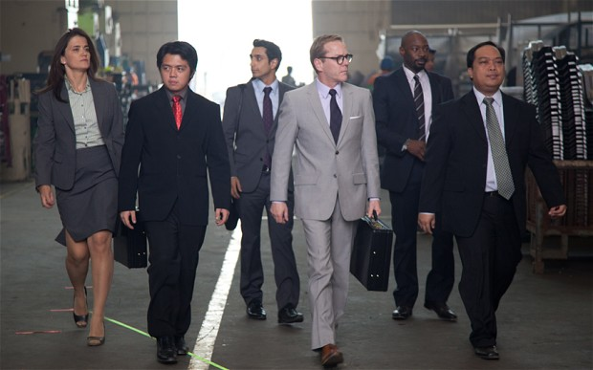
CHAPTER 3
FUNCTIONS
  Explicate Changez role in american society: member of the Underwood Samson
MAIN POINTS:
  Changez feels America like home
  Comparison between two tecnologically advanced cities (Lahore, New York). The first in the past the second in the present, and the inability of Pakistan to grow.
KEY WORDS
  Urban
  Proud
  Power
  Efficiency
  Professionalism

Slide 7
CHAPTER 4
FUNCTIONS
  Presentation of the cultural clash between Erica’s father and Changez
MAIN POINTS
  Cultural meeting between the Western and the Eastern cultures
  Growing of relationship between Changez and Erica
  Stereotypical view of Pakistan
KEY WORDS
  Nostalgia
  Market fundamentalism
  Stereotypical
  Open-mindedness
  Cosmopolitan

Slide 8
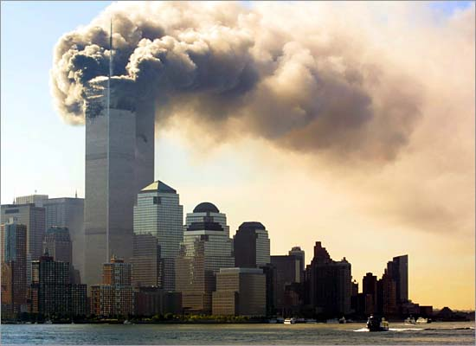
CHAPTER 5
FUNCTIONS
Event of Change: World Trade Center attack destroyed Changez’s feelings about America and its culture
Discrimination spreaded fear and violence against Muslims
MAIN POINTS
Changez goes to Philippines for valuation job of music company.
Changez is ashamed of being considered American
World Trade Centre collapses ,Changez sees this on TV and ‘smiles’.
KEY WORDS
        Nostalgia
        Longing
        First class
        Privileges
        Expensive foreign
        Victims
        Symbolism

Slide 9
CHAPTER 6
FUNCTIONS
Progressive estrangement between Erica/America and Changez
MAIN POINTS
Changez is not able to keep on going with his relationship with Erica/America and Underwood Samson
Changez grows his beard according to his newly found Muslim identity
Changez fails having sex with Erica, not being able to get in touch with her
KEY WORDS
Patriotims
Jasmine
Mourning

Slide 10
CHAPTER 7
FUNCTIONS
To exploit the final breach of Changez’s attempt to rebuild a relationship with America
To introduce Jim’s identity
MAIN POINTS
Lahore being bombed after the attack
Changez focuses on the foundamentals of his work but He feels himself closer to the countries attacked by USA
Changez doesn’t want to lose his identity in order to accomplish his pleasure (sex whit Erica) and so he fails
KEY WORDS
Fundamentals
Rage
Change
Vanish

Slide 11
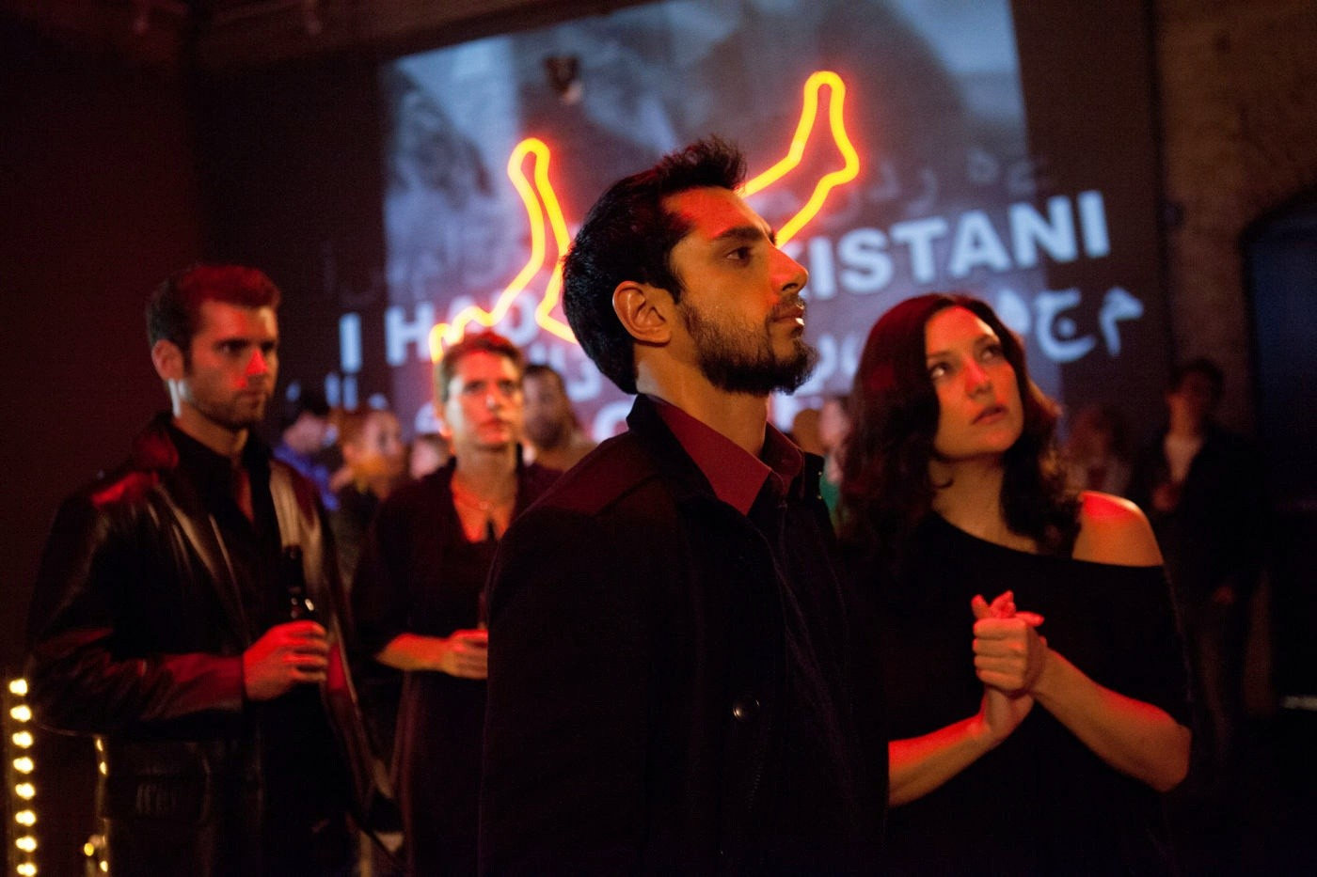
CHAPTER 8
FUNCTIONS
Introducing of the economic fundamentalism
Introducing the theme of racism and racial profiling
MAIN POINTS
Erica is focused totally on the past; Changez’s relationship with her comes to an end
Erica’s mother tells him she didn’t need a boyfriend
Underwood Samson keeps following his route in growing his businesses
Changez reacts violently to provocations of “Arab haters”
Changez visit his family in Lahore and gets angry about the situation in his home country
KEY WORDS
Nostalgia
Racism
Economic fundamentalism

Slide 12
CHAPTER 9
FUNCTIONS
Changez’s problem of conflicted identity
Changez’s incompatibility with American society
MAIN POINTS
Changez revaluate is home country feeling part of the Pakistani population
Both Changez and Erica/America can’t communicate, especially because of her choice of keeping far from him
KEY WORDS
Identity
Nostalgia
Foundamentalism
Regret

Slide 13
CHAPTER 10
FUNCTIONS
To clarify the sentiment Changez felt toward every kind of fundamentalism
To exploit Changez’s inner struggle due to his love
MAIN FUNCTIONS
Loving Erica is in contrast with his resentment toward America
Changez is not able to fully follow both religious and financial fundamentalism
KEY WORDS
      Failure
      Return capitalism
      Equality
      Foreigner
      Powerless

Slide 14
CHAPTER 11
FUNCTIONS
Changez leaves his job and finds out Erica has disappeared and possibly committed suicide
MAIN POINTS
Changez refuses to conform to the western model in order to maintain his Pakistani identity
He thinks about America’s foreign policy criticizing his activities and attitudes
KEY WORDS
Solitude
Awareness
Dead
Fundamentalism
Foreign policy

Slide 15
CHAPTER 12
FUNCTIONS
Explaining Changez’s new life in Lahore as a university lecturer
To show Changez as an opposer of America
To conclude the novel
MAIN POINTS
Changez’s American interlocutor remains mysterious
he seems to be increasingly opposed to American actions
KEY WORDS
Well wishers
Nostalgia
War
Terrorism

Slide 16


