Slide 1
British Imperialism
Liceo Scientifico “A. Einstein”
Class: 5 ALS
Iacumin Jessica

Slide 2
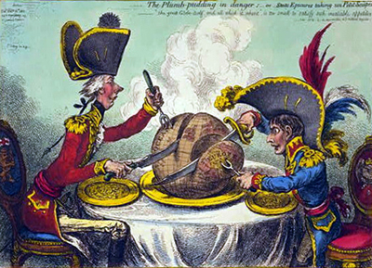
List
When did British Imperialism start?
The British Empire under Queen Victoria
British point of view about imperialism

Slide 3
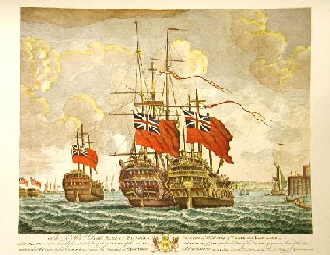
When did British Imperialism start?
1550 – early 1600
Plantations in Ireland were encouraged by Queen Elizabeth I and King James I
31st December 1600
Elizabeth I creates the British East India Company → Britain controls trading in the Indian Ocean
Extension of the commercial empire
Bangladesh
India
Pakistan
Sri Lanka

Slide 4
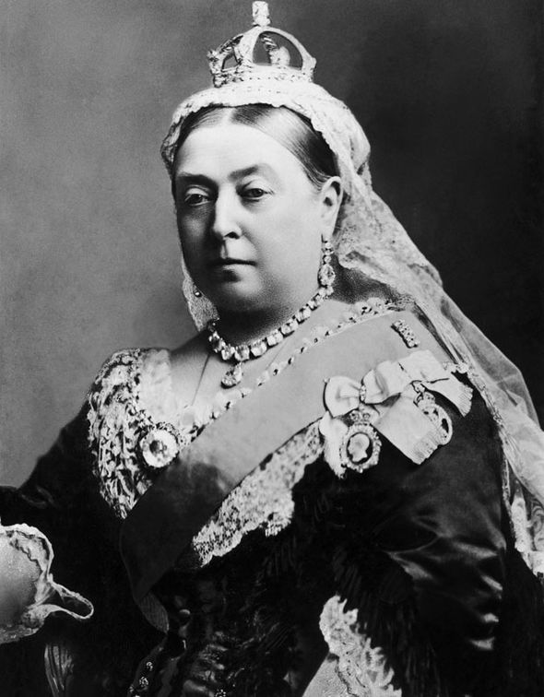
The British Empire under Queen Victoria
New colonies
Australia (1770 – 1829)
China, Hong Kong (1841)
Egypt (1882)
India (1857: Indian Mutiny)
New Zealand (1788)
South Africa (1899 – 1902)
Southeast Asia (Burma in 1866)
Sudan (1884)
The empire was able to adapt to each colony: it was extended and varied.

Slide 5
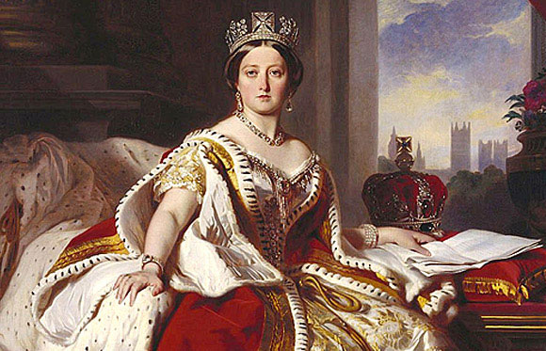
The British Empire under Queen Victoria
1857
Indian Mutiny → the British East India Company was dissolved
India officially became part of the British Empire
1876
The Royal Titles Act was presented by the Prime Minister Benjamin Disraeli
1877
Queen Victoria became Empress of India

Slide 6
British point of view about imperialism
Imperialism = civilisation
Superiority of the white man in terms of:
  way of life
  culture
  religion
  politics
Superiority was imposed by God
The Greenwich Mean Time was established in 1884 in order to fix time zones

