Slide 1
CHARLES DICKENS’ FICTION
VS
CONTEMPORARY REALITY
Liceo Scientifico “A. Einstein”
Class: 5 ALS
Iacumin Jessica

Slide 2
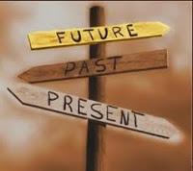
Introduction
OBJECTIVES
To analyse the themes in Charles Dickens’ novels.
To compare Dickens’ themes and problems in contemporary reality.

Slide 3
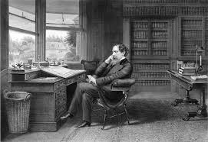
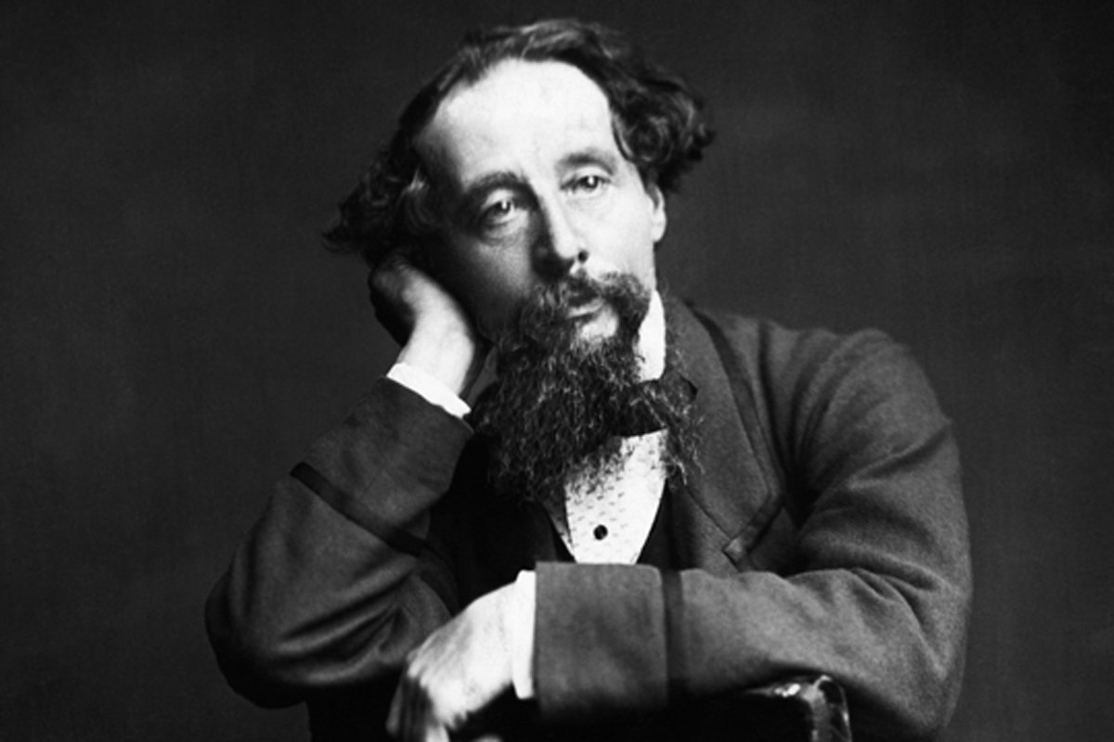
List of topics
Child labour - poverty
Industrialization – smog

Slide 4

Child labour – poverty
[…] at last they got so voracious and wild with hunger, that one boy, who was tall for his age, and hadn’t been used to that sort of thing (for his father had kept a small cookshop), hinted darkly to his companions, that unless he had another basin of gruel per diem, he was afraid he might some night happen to eat the boy who slept next him […].
[C. Dickens, Oliver Twist (1837-39), Chapter 2, “Oliver wants some more”]
This quotation shows the children’s difficult conditions. Indeed in workhouses the children were given a fixed amount of food; only rich children could to go to school.
Child labour was spread because families had no money and children are small and so they can do the work that adults can not do.

Slide 5
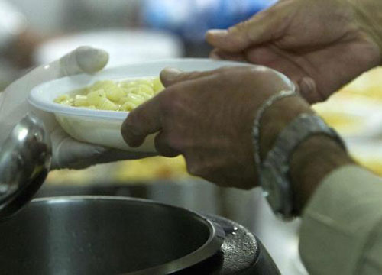

Child labour-poverty
Cause of child labour is poverty.
Today the economic crisis is affecting specially Greece.
Huge debt and cuts: people don’t have money.
The crisis affects children because they are forced to work and they faint at school because of hunger.

Slide 6
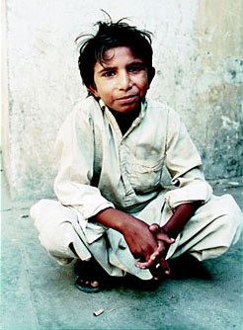
Child labour - poverty
Despite the documentation of the horrors of child labor even today, even in Italy, thousands of children work rather than going to school and live their childhood with serenity.
Today, child labor was reduced because it is illegal, but has not disappeared, and all the dead who gave their lives for the rights of workers are not served at all, is an example Iqbal, a Pakistani boy of 12 who is became the symbol of the fight against child exploitation because he had the courage to denounce the men who held him in bondage succeeded in freeing many children.
This problem is present especially in less developed countries where the poverty line is very high.

Slide 7
Industrialization-smog
It was a town of red brick, or of brick that would have been red if the smoke and ashes had allowed it; but as matters stood, it was a town of unnatural red and black like the painted face of a savage. It was a town of machinery and tall chimneys, out of which interminable serpents of smoke trailed themselves for ever and ever, and never got uncoiled. It had a black canal in it, and a river that ran purple with ill-smelling dye, and vast piles of building full of windows where there was a rattling and a trembling all day long, and where the piston of the steam-engine worked monotonously up and down, like the head of an elephant in a state of melancholy madness.
[C. Dickens, Hard Times (1854), Chapter 5, “Coketown / The Keynote”]

Slide 8
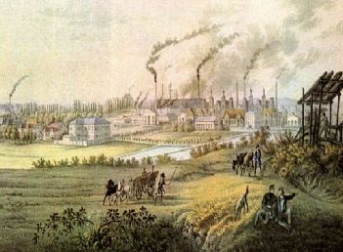
Industrialization-smog
In the Victorian age are visible the consequences of the Industrial Revolution. The consequences are the urbanization and infrastructure improvements, the overcrowding of London and the dirt of the cities.

Slide 9
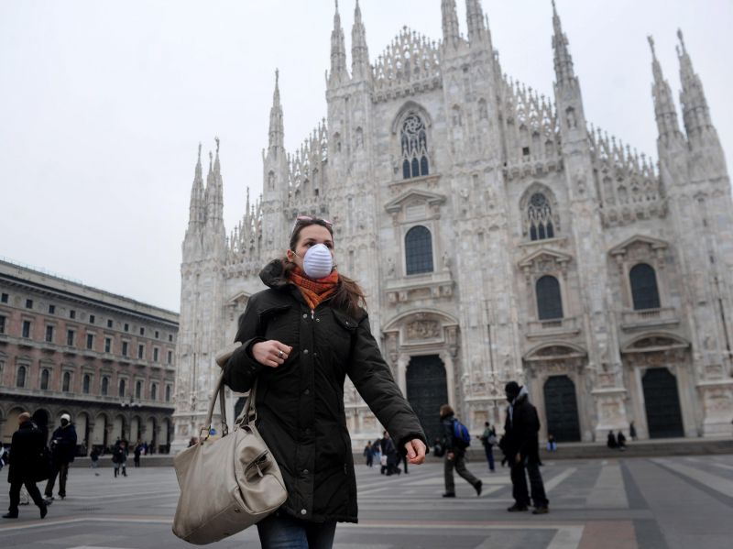
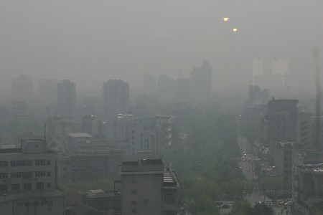
Industrialization-smog
  Today we find a situation similar to that of Coketown in Milan.
  Indeed, both the PM10 and the average of concentrations exceeded the legal threshold: 56 micrograms against 40 established forever from Europe as the maximum limit.
  Cities are surrounded by clouds of smoke and sand.

Slide 10
Sitography
http://milano.repubblica.it/cronaca/2015/03/02/news/smog-108503580/
http://www.marilenabeltramini.it/
https://www.youtube.com/
http://www.wordreference.com/it/

