Slide 1
THE DICKENS' LONDON:
A MODERN MEGALOPOLIS
Similarities and Differences:
C. Dickens' fiction and contemporary reality

Slide 2
AIMS AND OBJECTIVES
The purposes of the work are:
  To actualize themes and problems surfaced by Dickens’ analysis
  To make a comparison between the past and the contemporary societies
  To find out what of the past is remained and what has changed

Slide 3
SUMMARY
Dickens’ London
Henry Mayhew
Modern Megalopolis
Dickens’ London: a Megalopolis
Law of averages
Conclusions

Slide 4
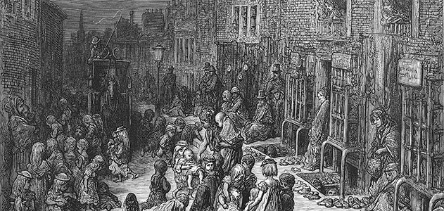
Dickens’ London
The London described by is charaterized by:
  A great difference between upper and middle class and working class and paupers
  Largely diffused poverty
  Crowed places
  Mud and dirt
  Hawkers, thieves and vagabonds
  Child labour and more generally terrible conditions for childood, as no education and starvation

Slide 5
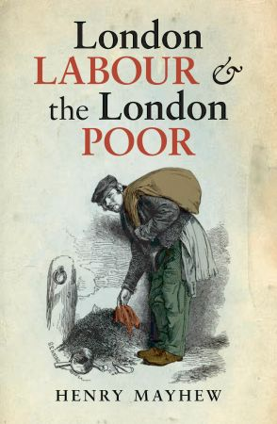
Henry Mayhew
H. Mayhew (1812-1887) was an english journalist and social researcher
He published the book series London Labour and the London Poor (1851), a groundbreaking and influential survey of the city's poor → Dickens gained at Mayhew’s research to recreate London as the setting of his novels
Mayhew’s studies confirm that London was:
  Characterizeb by squalor and filth
  Lack of sanitation and hotbed of numerous diseases
  Overpopulated, full of poors thath lived in awful conditions
  Divided into two big side: the one of the rich classes and the one of the working calss, need and criminality

Slide 6
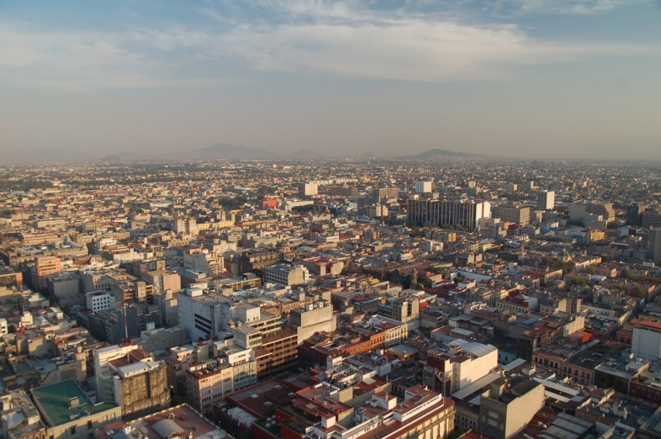
Modern Megalopolis
Dickens’ London seems to have some in common with the modern megalopolis. Indeed, also the problems of mega-cities nowadays are:
  Overpopulation
  An huge gap between the riches and the poors
  Ambiental sustainability and pollution
  Criminality and noneffective laws
  Extended destitute and not-healty areas lacking of services and of food and water provisions, wracked by criminality

Slide 7
Dickens’ London: a Megalopolis
Both London in the IX century and modern megalopolis have in common the process of urbanization, made up by three phases: the migration, the economic development and the evolution of transport.
The migration: the move of many people to the cities is the first cause of the city development.
  The migration to Dickens’ London was generated by the Agricultural revolution that caused many unemployed who moved to the city
  Here and now it is a natural consequence of the baby boom

Slide 8
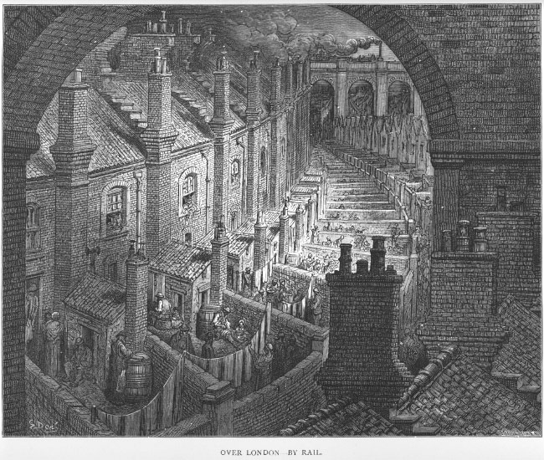
Dickens’ London: a Megalopolis
The economic development: it is both a consequence of the new manpower and a cause that boosts the development of the city.
  The Industrial Revolution was fundamental in London’s advancement
  Nowadays growths in industrial productivity and in financy increase the urbanization

Slide 9
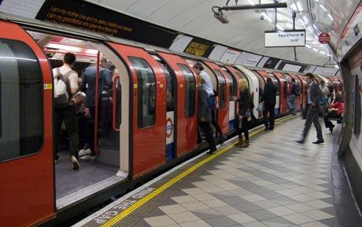
Dickens’ London: a Megalopolis
The evolution of transport: cities are historically extended in relation to the predominant means of transport.
  In the XIX century, the development of cars and railways allowed faster transfers and, as a consequence, the growth of the size of London.
  Tram, trains and underground also contribute to the extension of modern megalopolis

Slide 10
Law of averages
URBAN POPULATION | 1900 | Nowadays
 | 3% | 50%
GROWTH OF POPULATION
 | 1800 | 1900
London | 900.000 | 6.000.000
 | 1970 | 2000
Bombay | 6.000.000 | 16.000.000
San Paolo | 7.000.000 | 18.000.000
Shanghai | 5.000.000 | 13.000.000
CHILD LABOUR
London (1850) | 120.000
Bombay (2008) | 68.000

Slide 11
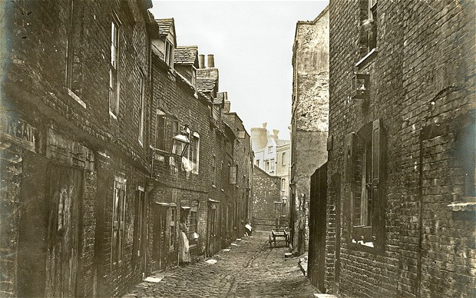
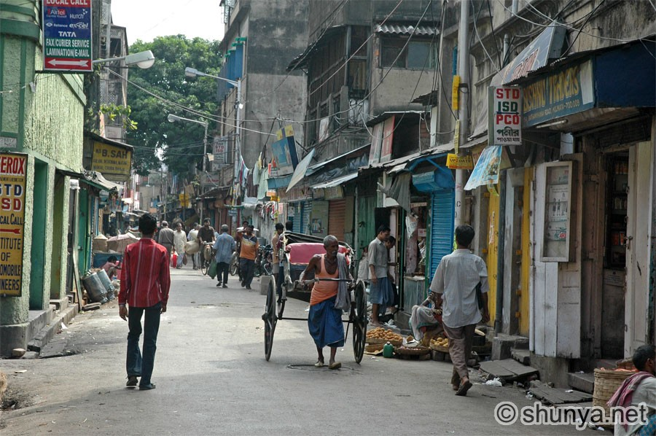
Conclusion
It’s possible to say that London was the first “megalopolis”, thanks to the Agricultural and the Industrial revolutions that developed London urbanization
What happened to London continues to happen even more faster to several cities nowadays
Dickens seems to have understood the problems of such a process and to have tried to report it
“…but Dickens has done more: he has remained modern” - G. K. Chesterton

Slide 12
Sitography
http://www.telegraph.co.uk/culture/charles-dickens/9018185/Dickenss-London-in-pictures.html
http://charlesdickenspage.com/dickens_london.html
https://emiliashop.wordpress.com/2012/02/09/charles-dickens-e-henry-mayhew-un-doppio-bicentenario-ignorato/
http://data.un.org/Default.aspx
http://www.bl.uk/romantics-and-victorians/articles/henry-mayhews-london-labour-and-the-london-poor
http://en.wikipedia.org/wiki/Urbanization

