Slide 1
Charles Dickens
The Victorian Age
vs
The 21st Century
Santini Leonardo 5 A

Slide 2
Introduction
Through his writings, Charles Dickens has given a disenchanted and critic representation of his time, in all his contradictions and most disturbing traits.
The themes of his novels however, are still very actual and so can be applied with ease to today’s world.
The purpose of this work is, therefore, to compare the Victorian England to our world looking at the themes of Dickens’ novels.

Slide 3
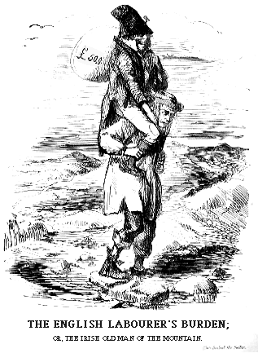
The Truth Behind The Mask
Victorian Age was an age of big contradictions. Discoveries and technological improvements powered Britain’s economy and increased its political prestige, but behind this golden mask there was also a world of poverty and moral decay.
The suburbs of the cities were full of people who had to work in factories at impossible rhythms and live in subhuman conditions. The sanitary conditions were terrible and the overpopulation favoured crime in the worst parts of the cities.
This resulted in the development of two different social groups, separated from a huge difference: the capitalists and the workers.

Slide 4
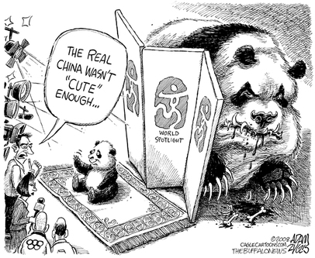
The Truth Behind The Mask (Today)
Dickens throughout his work helped to unveil the reality that was behind the mask of greatness of the Victorian Britain. In the same way, most of today’s countries present some dark sides, no matter how perfect they appear.
One of the most evident cases is China. China indeed, has recently improoved his economic and political influence over the international market with extreme quickness. On the other side though, it is ruled by an autoritary force that is not afraid to use censure and any other kind of repression. Moreover, there are almost every year more than one million of premature deaths caused by pollution, due to the extreme exploitation of natural resources.
The actual state of things does not always correspond to its appearence. Dickens teaches how even the most perfect of societies can present some dark sides and this is a lesson that everyone may always keep in mind, at any time.

Slide 5
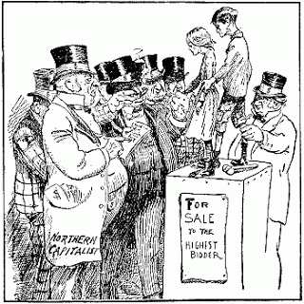
Child Labour
Dickens in his novel has always criticized the conditions the kids had to live in, especially for what concerns the workhouses. An example of this is provided by one of his most famous characters: Oliver Twist.
Child Labour was a fundamental part of English economy and it has been calculated that most of the kids between 5 and 17 years were actually employed.
In Dickens’ novels kids stand in opposition to the world of adults and often become real heroes, bearers of strong values, the values that were being forgotten by the most. In this way, their poor state is emphasized even more due to the contrast to the adult society, which instead is hardly criticized.
Moreover, thanking to the narrative strategy of grotesque, Dickens is able to provide a range of strong and realistic images that are very useful to reinforce the the message.

Slide 6
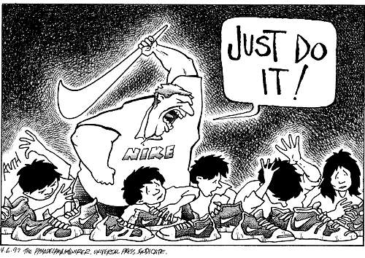
Child Labour (Today)
Child labour is not as severe an issue as it was a century ago, but it still affects millions of kids worldwide. Statistics from the International Labour Organization show that there are about 73 million children between ages 10 and 14 that work in economic activities throughout the world, and 218 million children working worldwide between the ages of 5 and 17. These figures do not even include domestic labour.
India is one of the biggest “kid employer”. Child labour in India makes up 3.6% of the country’s total work force. Figure show that this figure have increased since 1990s.
Dickens’ critic therefore, doesn’t sound far from the actual situation. Especially in the emerging countries indeed, the issue of child labour is still very present.

Slide 7
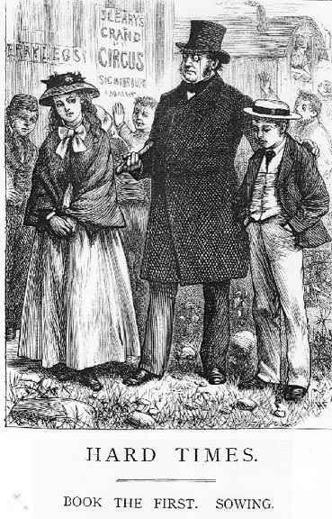
The Value of Social Status
During Victorian Age England was dominated by a trend of thoughts that considered the structure of society as a result of an order, no matter if divine or natural. As a consequence, wealth and economic power were the only goals to achieve and people were classified only according to their social status.
Dickens, on the contrary, stands against this idea, often ridiculing this kind of belief through the creation of comic characters such as Mr. Bounderby of “Hard Times”. Mr Bounderby indeed, personifies the ideals of the middle class and appears comic to the reader, thanking to the use of grotesque, which deforms his main traits.

Slide 8
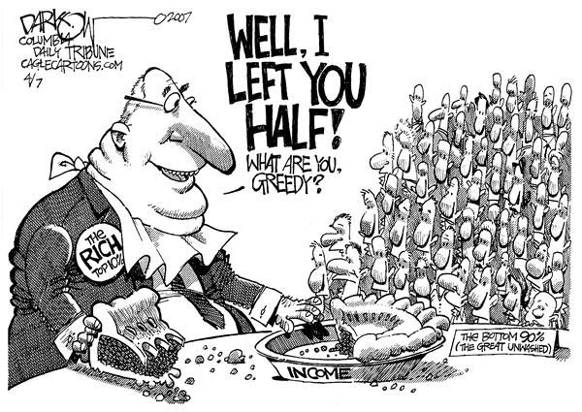
The Value of Social Status (Today)
Nowadays the western world, like the Victorian England, tends to associate personal success to value. Someone is often evaluated only looking at his bank account and without taking into consideration his moral virtues. The capitalistic model indeed, gives importance only to the capacity of a man to produce; nothing else matters.
This theme, in particular, can be found in the novel “The Reluctant Fundamentalist” by Moshin Hamid.
The book indeed, analyzes the main traits of the American mentality and makes the reader understand that in such kind of society, an individual is classified only in terms of production.
Dickens’ critic to the mentality of its period adapts perfectly to our world, underlining how, despite technological advances, the main social dynamics didn’t evolve that much.

Slide 9
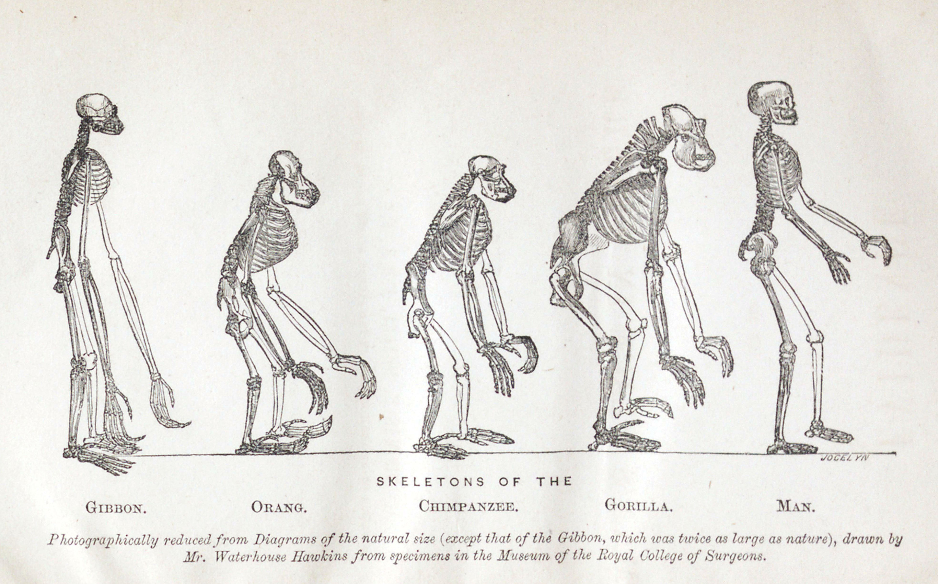
The “Factual” Mentality
During the Victorian Age in England gained popularity the belief that only objective knowledge was to consider valid. Dickens provides an example of this process in “Hard Times”.
Mr Gradgrind is the character that better embodies this belief, being a teacher that believed just in “facts”. To him even a horse can be described just according to his physical characteristics and anatomic traits.
Dickens through the description of this character though, is comic and deformed, underlining Dickens’ critic point of view toward this ideology.

Slide 10
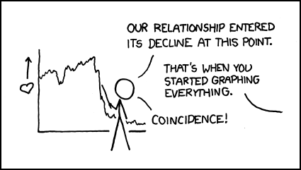
The “Factual” Mentality (Today)
Nowadays, objective knowledge is considered almost the only form of knowledge that counts. Metaphysic explanations have lost all of their reliability.
The number of atheists is in constant growth and people are losing every kind of faith but the one in scientific knowledge.
The risk is to get back to the condition Dickens portrayed. So it’s important not to rely only on facts to define an ethic. Especially because even the disciplines that seem more objective, now can’t provide satisfying and absolute results.

Slide 11
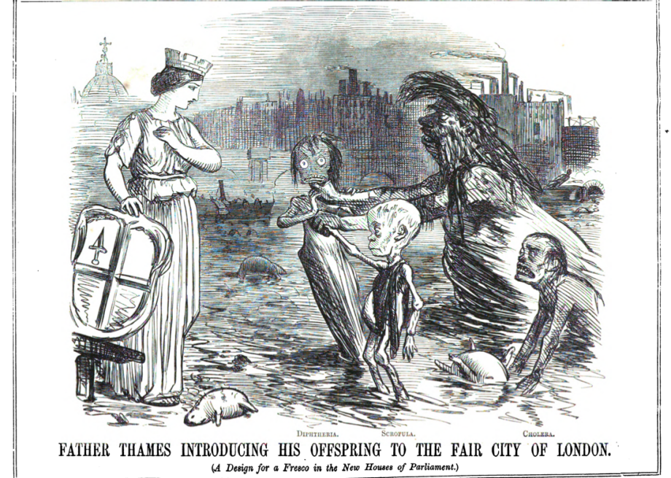
Poverty and Environmental Degrade
Dickens has often underlined the state of decay of the big cities such as London both from a moral point of view and from a more practical one. In the description of Coketown for instance, he exploits the poor living condition of people and the pollution of the city, giving a very strong image of the city in all its decay. The industrial power of such place was indeed in contrast to its condition.
In fact, it is to say that London was really polluted at the time. In a particularly hot summer indeed, the Thames started to stink so much that life became very hard for Londoners. This episode is called “The Great Stink” (image)

Slide 12
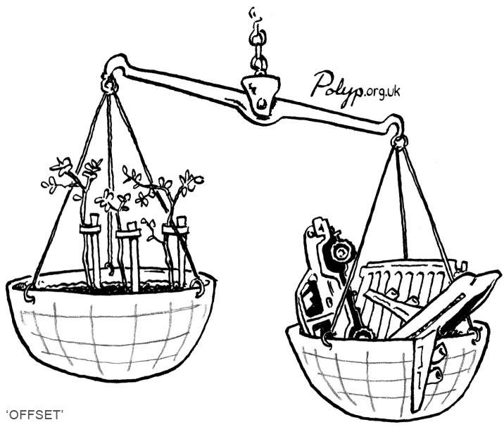
Poverty and Environmental Degrade (Today)
The issue of pollution represents one of the biggest problems of the 21st century, even the most advanced countries have to face this fundamental issue indeed.
Actually, it is one of the most advanced of all that is more highly polluted: Japan. The process of economic growth that Japan has undergone the past 50 years left it in the necessity to burn more and more of its natural resources. Thus, one of the most stable countries in the world economically speaking, has to face the problem of carbon dioxide, for example. Moreover it is facing the problem of global warming and also some issues with nuclear power, without counting that a huge number of sea creatures is being threat by extinction.
So, this theme is probably more actual than ever at this time. The risk is to sacrifice our environment just for technological and economical improvement.

