Slide 1
Islam: sources and schools of law
Liceo Scientifico “A. Einstein”
Year: 2014 / 2015
Class: 5 ALS
Work Group: Bianchin Ilaria, Pavoni Francesco, Puppo Simone, Scarpin Cosetta, Scuz Selene, Vitale Elisa

Slide 2
Islamic Law
Islam = social religion. Muslims must observe the Shari’a:
Shari’a (= path)
  Law or standard ritual
  Divine will that manifested in Muhammad: perfect and unchangeable
  Fiqh (= comprehend, understand)
  Shari’a’s readings are used to fully comprehend it
  Operated by expert theologians-lawyers through fatwa → law schools

Slide 3
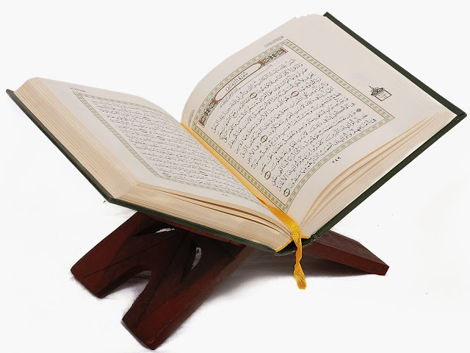
Shari’a sources
Canonical sources:
1. Quran (koo-rahn)
2. Sunnah (soo n-uh)
3. Ijma
4. Qiyas
Non canonical sources:
5. Urf

Slide 4
1. Quran
Etymology: Quran = reading, book, recitation
Structure: 114 sura (chapters), 6236 verses in total
Transmission:
  According to tradition: the text was copied from the Archangel Gabriele’s mantle
  According to historical facts: the text was orally transmitted by Muhammad, collected on bones, skin and stones
Language:
  Arabic

Slide 5

1. Quran
Readings:
  It should be given by a Mulim and not bought
  It should be read in its original language
  After the reading, it must be left closed
Versions: different versions of the Quran with the Caliphates → only one version preserved (the third Caliphate)
"Corano“ Calligraphy

Slide 6
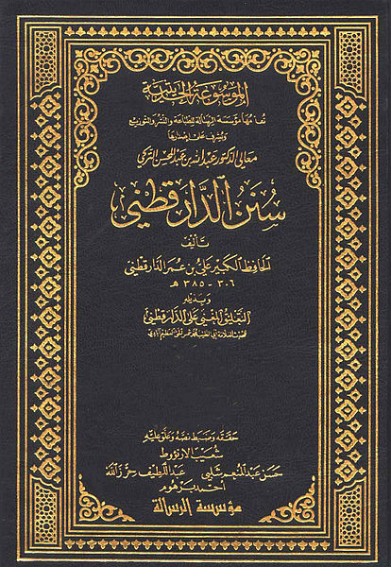
2. Sunnah
Etymology: sunna = way of life
Structure:
  Shiites: 3 books
  Sunnis: 6 books
Transmission:
  Oral transmission
  Hadith: anecdotes, stories
Content:
  Extension of the Quran
  Sayings, facts and behaviour by the Prophet Muhammad → examples follow
Sunnah from the X century

Slide 7
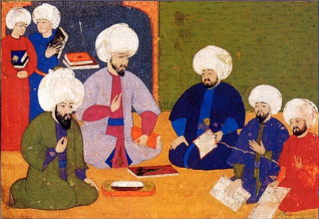
3. Ijma
Etymology: ijma = consensus
What is it?
  Consensus of the ummah (Muslim community)
  Consensus given by ulema (scholars of Muslim religious law) → they have the right to make judgements
The legitimacy of Ijma is given by a hadith of the Prophet Muhammad → Sunnah
Ulema students and master from an ottoman madrasah (school)

Slide 8
4. Qiyas
Meaning: qiyas = measurement, analogy
How did it start?
  Islamic expansion after Muhammad’s death
  The Quran’s meeting with external realities : Hellenic culture
  Assimilation of the deductive method
What is it?
  Comparing the Quran and Sunnah
  Teachings taken from the followers through deduction or similarity
When? End of IX century a.d.

Slide 9
5.Urf
Etymology: Urf = knowledge;
What is it?
  Traditions and «knowledge» of a society.
  Traditions dating to Muhammad, not repealed by the Quran and Sunnah
  Equivalent to common law
  It must be compatible with the Shari’a
  Not formally included in Islamic Law
When?
  First recognition by Abu Yusuf
  Opposition by al – Sarakhsi → traditions and customs cannot take precedence over written texts
  End of IX century a.c.

Slide 10
5.Urf
Application:
  Recent pratices only accepted if correct/right for the population (also correct for Allah)
  Consequences: possible condemnation or lack of application of the law (fiqh)
Autority:
  The same authority as Ijma
  More authority than qiyas

Slide 11
Law Schools
632: Death of Muhammad
Disagreement on the interpretation of the Quran → Sunni and Shiite schools
Sunni
Shiites
Loyal followers of Sunni
83 % Muslim
Law Schools:
  Hanafi
  Maliki
  Shafi’i
  Hanbali
Party/faction of Ali
10 % Mulim
Law Schools:
  The law is subject to Imam authority

Slide 12
Sunni Law Schools
Hanafi School
Where? Turkey, Egypt, India, Pakistan, ex URSS
Person of Reference: Abu Hanifa al-Nuʿman
Features:
  Liberal schools
  Focused on the behaviour of the loyal followers: allows changes to the Quran’s prohibitions.
Maliki School:
Where? Maghreb
Person of Reference: Anas ibn Malik
Features: Relevance to the traditions and scholars of Medina.

Slide 13
Sunni Law Schools
Shafi’i Schools
Where? Indonesia, Syria and East Africa
Person of Reference: Mohammed ibn Idris al- Shafiʿi
Features: Restrictions on analogical reasoning → greater adherance to the laws
Hanbali Schools
Where? Saudi Arabia
Person of Reference: Ahmed ibn Ḥanbal
Features:
  Religious crisis→absolute fidelity to Islamic written sources
  Analogical reasoning: exceptional cases

Slide 14
Shiite Law Schools
  The law is subject to Imam authority
  Person who “stays in front”
  Successor of Muhammad→ The Prophet’s representative
  Isma = “immunity from error” → institution of divine origin
Duties of Imam:
  To govern the Muslim community
  Interpret religious texts, the law and seize their meaning
  Guide men in their spiritual life (directing public and community prayer on Fridays)

Slide 15
Fatwa
Meaning: fatwā = advisory opinion
Religious judgement
  Request to a qadi (Muslim judge) to know the orientation of a legal case
  Emitted by a faqih (Shari’a expert) from a Sunni or Shiite law school
Council on behaviour
  Request to a qadi, from a Muslim or a non-believer
  Emitted by a faqih said mufti
  Qadi and mufti adhere to the same school → fatwa mandatory
  Qadi and mufti do not adhere to the same school → fatwa = opinion.

