Slide 1
Similarities and Differences: C. Dickens’ fiction and contemporary reality
Nicoletta Soranzo
cl.5^A
A.S. 2014-2015

Slide 2
Charles Dickens and the Victorian novel
Charles Dickens was born in Portsmouth in 1812
He is one of the most important novelist of the Victorian Age (1837-1901), also according to the theme of his novels.
The Victorian novel deals with the social reality and its problems
  Industrialization
  The mechanization of human beings
  Children exploitation
  Children education
  Poverty
  Corruption and inadequacy
The setting was the city: the main symbol of industrial civilization but also the expression of anonymous lives and lost identities
  Coketown, the city of Fact, foreshadows the emergence of a monstrous mass urban society based on rationalism, anonymity, dehumanisation

Slide 3
Social reality and its problems
Charles Dickens writes is novel like a photograph of social reality. He describes the problems of relationship between different classes, the problems that arose from exploitation of labour, corruption and inadequacy in the social services.
Even today, writing is used to denounce the problems of society. And according to literature and mass media, we are going to compare Industrial Revolution’s problems with today’s one to search if there are similarities or difference.

Slide 4
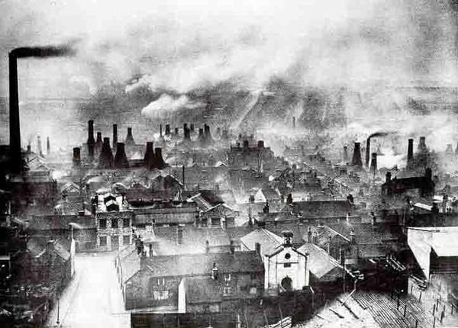
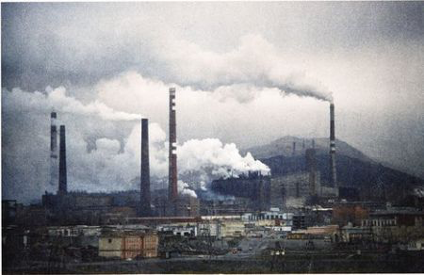
Industrialization
It is a period of social and economic change
It transforms the world from an agrarian society into an industrial one
It introduces a form of philosophical change where people obtain a different attitude towards their perception of nature, and a sociological process of ubiquitous rationalisation
Markets for consumer goods and services tend to expand and provide a further stimulus to industrial investment and economic growth.
The first industrialization: the Industrial Revolution (XIX century) helped to shape the modern world

Slide 5
Industrial Revolution | Today
During the Industrial Revolution, many industries experienced mechanisation | The mechanisation of industries allowed goods to be mass produced.
It was the age of progress, stability, great social reforms | The standard of living for workers gradually improved.→ the quality of products are very high, and the production of goods is very efficient
The civilisation aspiration assumed that British civilisation was innately superior to those it was subjagating → Imperialism | Industrialism has determined the economic structure of many countries around the world.
Technology gap that non-European nations would find difficult to compete with. It was also characterized by poverty, injustice and social unrest. | Unemployment and a widening gap between rich and poor
Mass-produced goods that would flood the markets around the world | Many industrial countries have adopted capitalism.

Slide 6
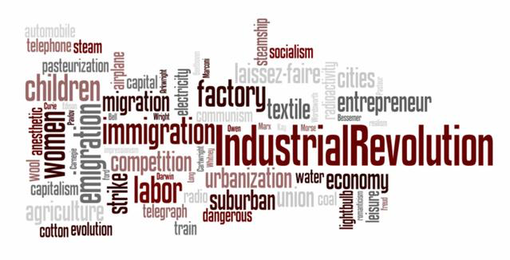
Industrial Revolution | Today
In Britain, factories were responsible for raising pollution levels | Other damage is caused by soil erosion and land degradation from land clearing
Industrialism has altered social structure | Modern societies are 'mass' societies, comprising cities populated by millions of people
The world of the workhouses founded upon the idea that poverty was a consequence of laziness. | Unemployment and poverty are major factors for many industrial countries.
The idea was that, through working, the poor would learn good habits, growing less lazy and perhaps learning to fend for themselves | There are large groups of homeless and unemployed people in many industrial countries.

Slide 7
The mechanization of human beings
The society, during nineteenth century wanted to turn human beings into machines by thwarting the development of their emotions and imaginations. (their nature can be measured, quantified, and governed)
“A man of facts and calculations. A man who proceeds upon the principle that two and two are four, and nothing over, and who is not to be talked into allowing for anything other”(Hard Times, Chapter 2)”
The mechanization of human beings exists today as well. The workforce today still isn’t completely separate and void from the monotony of factory life for the benefit of wealthy factory owners during Industrialization.

Slide 8
“La condizione operaia” di Simone Weil
Due fattori essenziali entrano in questa schiavitù: la rapidità e gli ordini.
La rapidità: per “farcela” bisogna ripetere un movimento dopo l’altro a una cadenza che è più rapida del pensiero e quindi vieta non solo la riflessione, ma persino la fantasticheria. Mettendosi dinnanzi alla macchina, bisogna uccidere la propria anima, i propri pensieri, i sentimenti, tutto per otto ore al giorno. Irritati, tristi o disgustati che si sia, bisogna inghiottire, respingere in fondo a se stessi irritazione, tristezza o disgusto: rallenterebbero la cadenza. Per la gioia, è lo stesso.
Gli ordini: dal momento in cui si timbra per l’uscita, si può ricevere qualsiasi ordine in qualunque momento. E bisogna sempre tacere e obbedire. L’ordine può essere penoso o pericolosa da eseguire, o anche ineseguibile; oppure due capi possono dare ordini contradditori; non fa nulla: tacere e piegarsi. Rivolgere la parola a un capo, anche per una cosa indispensabile, anche se è una brava persona (le brave persone hanno pure i loro momenti di cattivo umore) vuol dire rischiare di farsi strapazzare. E quando capita, bisogna ancora tacere. Per quanto riguarda i propri impulsi di nervi o di malumore, bisogna tenerseli; non possono tradursi né in parole né in gesti, perché i gesti sono, in ogni momento, determinati dal lavoro. Questa situazione fa sì che il pensiero si accartocci, si ritragga, come la carne si contrae dinnanzi al bisturi.

Slide 9
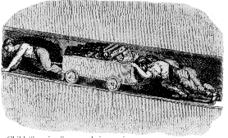
Children exploitation
Industrial Revolution | Today
Poor child only options seems to be the workhouse and the struggle to survive in the savage world of the underclass | Child labor is not as severe an issue as it was a centuries ago, but it still affects millions of kids worldwide.
Children worked eight or twelve hours a day, six days a week in terrible conditions They were weak physically, mentally and morally. | Working conditions are appalling
Poor families’ child were sent to workhouses: a place to live and work | Also in industrialised countries, children (engaged in hazardous or illegal work) start earning money before reaching the minimum age for full-time employment
They were forced to work in factories because families were very poor and they didn't have enough money to live | The relatively low wages paid to children are often a reason why employers prefer them to adult workers. → more obedient and easier to control

Slide 10
Industrial Revolution | Today
“Factory owners were looking for cheap, malleable and fast-learning work forces- and found them ready –made among the children of the urban workhouses” said Professor Humphries | Adults justify the involvement of children in certain jobs on the grounds for their “nimble fingers”
By the early 19th century, England had more than a million child workers (including around 350,000 seven to-10-year-olds)- accounting for 15 per cent of the total labour force. | Eight million children are believed to work in terrible circumstances : forced into bonded labour or other forms of slavery, into prostitution or pornography, or into participation in armed conflict or other illicit activities
They did not receive any sort of formal education as education was thought to be unimportant by the people of that time. Most children began working very young and were not allowed to leave the factory until they were 21 | Children who receive little or no school education miss out on the knowledge that can create options for them later in life.

Slide 11
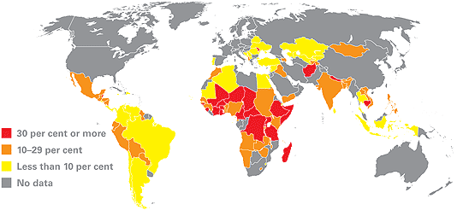
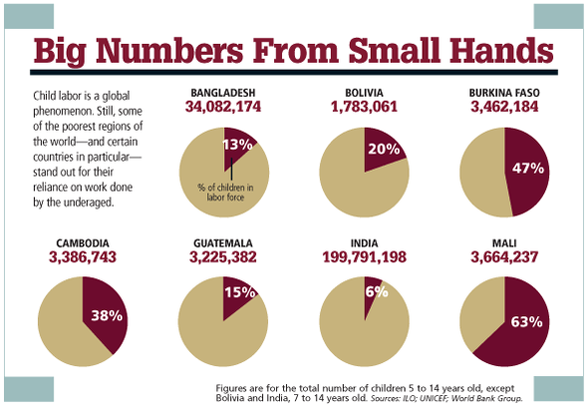
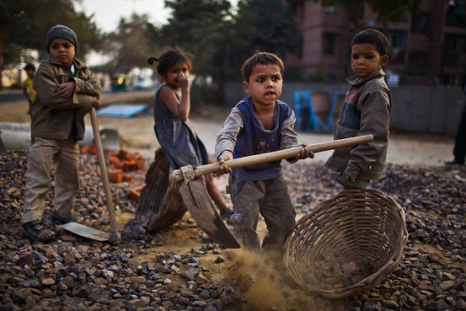
Child Labour today

Slide 12
Poverty and corruption
Labouring class conditions: long hours of work under sordid conditions, and the large-scale employment of women and children for tasks which destroy body and soul.
The poor were made to wear a uniform. This meant that everyone looked the same and everyone outside knew they were poor and lived in the workhouse.
The main reason why children start work instead of attending school, or leave school before completing their primary education, is that their families are poor and cannot pay the basic costs of food and housing without their child earning something as well.
The spectre of working class poverty and misery during the industrial revolution has been and still remains an important justification for government intervention into social and economic affairs.

Slide 13
Conclusion
“Fundamental technological, political, regulatory, and economic forces are radically changing the worldwide competitive environment. We have not seen such a metamorphosis of the economic landscape since the Industrial Revolution of the nineteenth century. The scope and pace of the changes over the past two decades qualify this period as a modern industrial revolution, and I predict it will take decades for these forces to be fully worked out in the worldwide economy.” Michael C. Jensen, Harvard Business School
Analysing the themes present in Dickens’ novel, concerning the Industrial Revolution’s society and its problems, we note that even today, after more than two centuries, we are still plagued by the same problems, almost in the same way.

