Slide 1
Similarities and Differences
C.Dickens' fiction and contemporary reality
Patrick Indri - 5ALS

Slide 2
Objectives and Structure
Objectives
  Identifying the main themes of Dickens' literary production.
  Gaining awareness of the contemporary reality trough the analysis and the actualization of Charles Dickens' themes.
Structure
  Dickens: a social novelist
    Poverty
    Working conditions
    Pollution
    Child exploitation
    Education

Slide 3
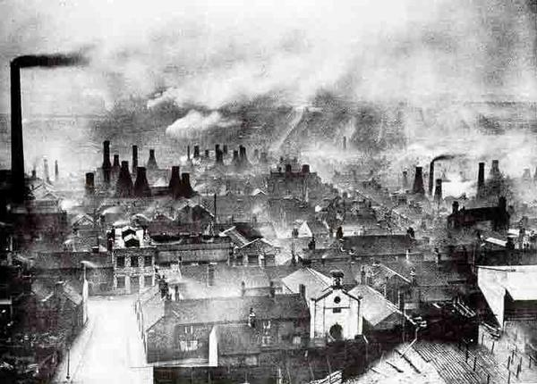
Dickens: a social novelist
Charles Dickens' fiction is a dramatization of the social problems of the Victorian Age
  Poverty, precarious working conditions, class prejudice and child labor
His production develops a critique of the social stratification and of the terrible consequences of utilitarianism on lower classes
Hard Times is one of the best examples of social novel due to his focus on the social and economic problems of a symbolically-called industrial city, Coketown
A polluted city of the Victorian Age

Slide 4
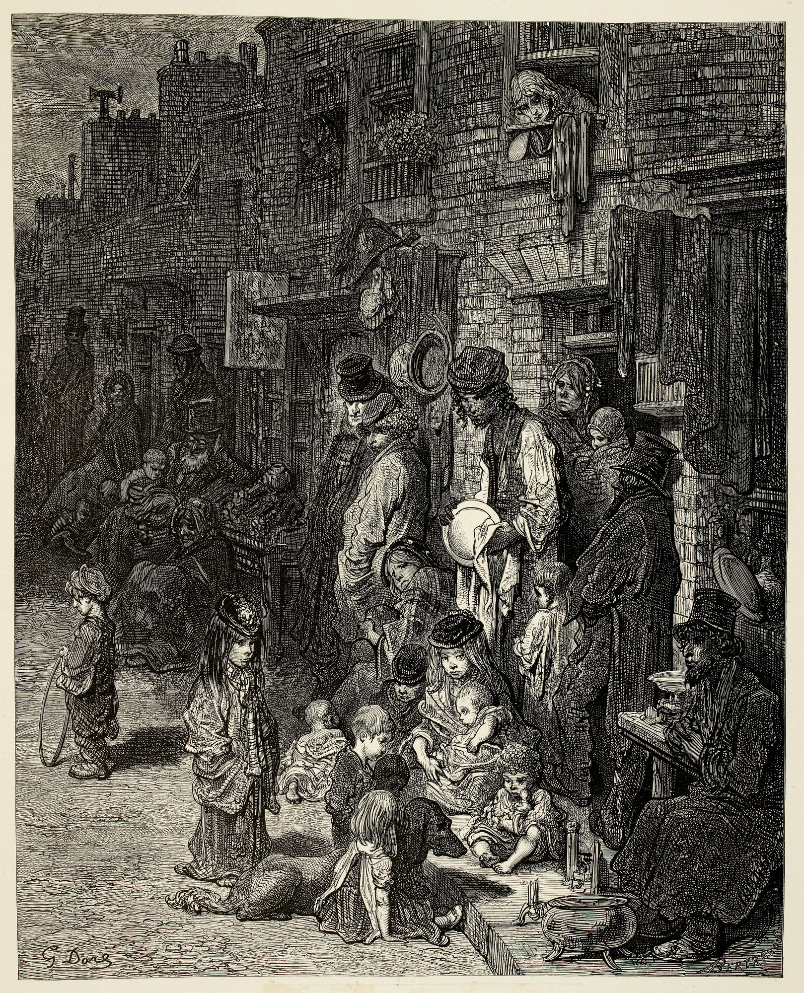
Poverty - Dickens
Charles was born in a family that suffered from poverty
  Attention for the poor condition of the lower working class
He kept a sympathetic attitude towards poor people
  poor people (especially women and workers) deserved compassion
  this belief is in contrast with the Utilitarian doctrine and the Puritan principles
He focused on the consequences of poverty
  Epidemic disease proliferated in the rotten boroughs
  the overcrowded cities were full of criminal and pickpokets
  alcoholism was a serious problem for poor people
Poor people on the street

Slide 5
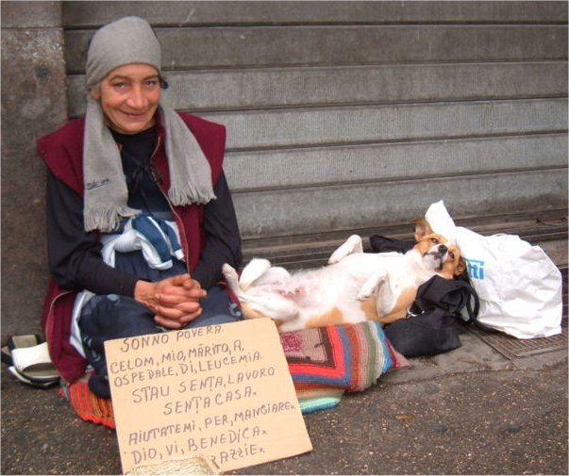
Poverty nowadays
Nowadays poverty has become a world wide issue, going belong the limits of Coketown or England
  963 million people live in poverty
  3 billion people earns less than 2 USD in a day
  almost a third of the world population has no access to medical resources
The consequences of poverty are devastating
  A lot of clochards and beggars can be found in almost every city
  Alcoholism, smoking and drug addiction are one of the main causes of death and a source of violence and degrade
  Illegal activities are one of the direct consequences of poverty
Poverty is no longer considered as a God's punishment
  Thinkers now agree that poverty is a plague to be fought
  Dignity and well being are some of the universal rights of men
A beggar in Italy

Slide 6
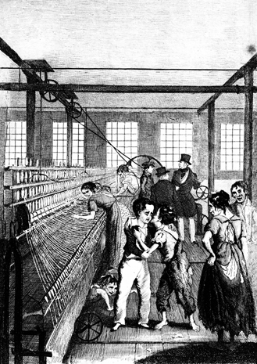
Working conditions - Dickens
Oliver Twist and Hard Times provide a complete picture of the working condition during the industrialization process
  Workers had to work for up to 16 hours per day
  Factory work exposed to dangerous inhalations of smoke
  The rhythm of machinery was in contrast with the rhythm of nature
  The monotonous and repetitive work brought workers to alienation
  The mass of lower class workers overcrowded the cities
  Children and women were usually exploited as a low cost source of work
  No kind of work-tutelage was adopted: illnesses and injuries were a common and disgraceful event
Factory boys

Slide 7
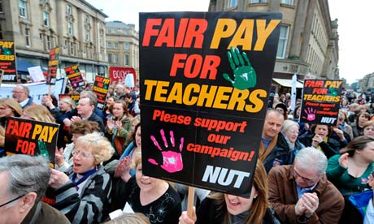
Working conditions nowadays
Working conditions have improved since the end of the 19th Century
  Workers must not work for more than 8 hours every day
  Working is now considered as a Universal Right
    "L'Italia è una repubblica democratica fondata sul lavoro", Art. 1 of the Italian Constitution
  Strikes and workers' associations are now permitted
  Paid holidays are guaranteed to every worker
  Children must not work while women have the same rights of men
Unemployment and low salaries are the main problems of the industrialized countries
  Poor countries are still fighting child labor and terrible working conditions
    In 2000 Nike was accused of child exploytation in eastern Asia
Teachers asking for higher salaries

Slide 8
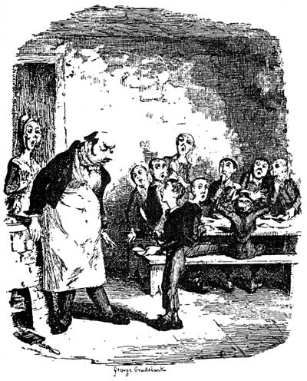
Child exploitation - Dickens
Dickens describes Oliver's condition in the workhouse
  Children had to work for hours and were poorly fed
  They suffered slow starvation
  Everyone asking for more food would be punished with expulsion
Cambridge University reveals the role of children in the Industrial Revolution
  Industrial revolution was powered by child slaves
    They were fast learning, malleable and cheap
  More than a half of all the English children were laborers in the middle 19th Century
    There were more than 1 million child workers
Oliver Twist asking for food

Slide 9
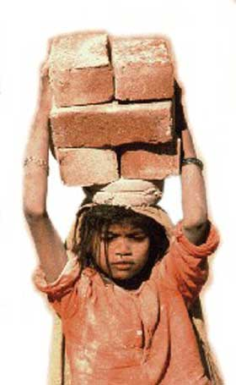
Child exploitation nowadays
Child labour is now considered illegal
  Child labour refers to children from 3-4 to 15 years old
  Despite being illegal it is a phenomenon which troubles the entire world
  More than 150 million children are working up to 15 hours per day
Child labour is more frequent in poor countries
  Child labourers are adopted because of they low costs and the manual ability
  Carpets and shoes production often involves children
  Parents usually sell their children in order to earn money
  Child soldiers are frequently used in African wars
    More than 50% of child labourers do risky works
A girl carrying bricks

Slide 10
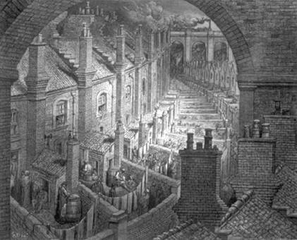
Pollution - Dickens
Dickens presents the terrible air condition of London in a famous extract of Bleak House
  "Smoke lowering down from the chimney pots, making a soft black drizzle [...], fog everywhere" -chapter 1
  London is a critically overcrowded and polluted city
  1858, Great Stink, River Thames is full of rubbish making the air unbreathable
Coketown presentation provides a description of the consequences of pollution in Victorian Age industrial cities
  City walls were blackened by smoke which made it hard to breath
    Black prevails on everything
  All the bricks were painted "like the face of a savage"
London: overcrowded and polluted

Slide 11
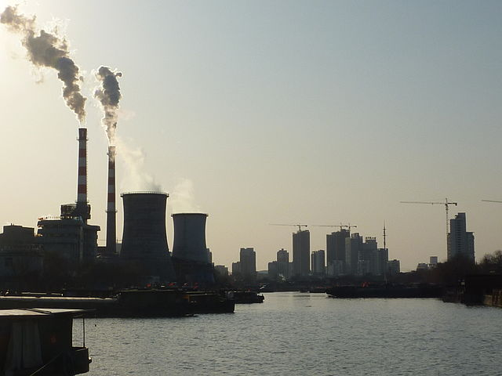
Pollution nowadays
Pollution is one of the main problems of the 21st Century
  Urban pollution has increased because of the large number of cars and petrol-powered machinery in general
  Coal power plants are still the main source of energy for industries
  Nuclear energy and renewable forms of energy could be the answer for the increasing level of pollution in the world
The consequences of pollution could be devastating
  Climate change is a reality and will lead the extinction of several species
    Earth temperature will rise as well as the sea level
  Ozone depletion will increase skin cancers, blindness, photo aging and will damage crops and food production
A power plant in China

Slide 12
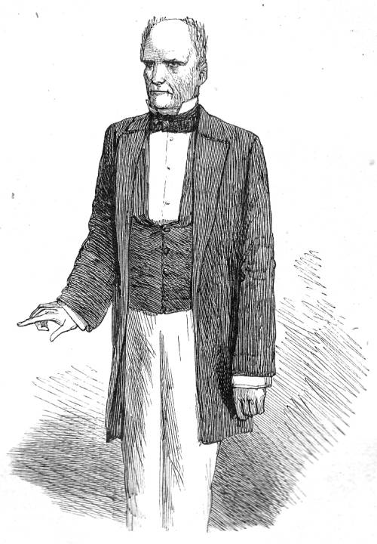
Education - Dickens
Victorian education
  Elementary Education Act (1870) increased literacy rate in England
  Despite the act many remained hostile to Universal Education, rejecting mass education
    An educated working class meant more revolutions and less profit for capitalists
  Dickens was a strong believer of a non-sectarian and Universal education
    However he never offers practical solutions
Dickens develops the theme of education in Hard Times, using the character of Mr. Thomas Gradgrind
  He is a "man of fact" who accepts only data and cold facts or numbers
  He thinks he can measure everything, even humans
  He rejects every kind of emotion
Mr. Gradgrind

Slide 13
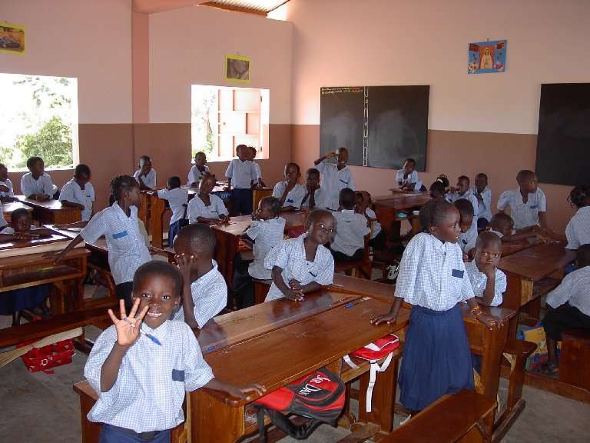
Education nowadats
Education is guaranteed as one of the Universal Right of men
  Due to the Right of Education elementary education is free
  Public schools in England are mandatory from 5 to 15 years
  Pre-primary education and higher education are not free but should be accessible to anyone
Nowadays 99.7% of the population of England can read and write
  World literacy rate is 84.1%
    Africa is the continent with the lower literacy rate
  Universal education is one of the most important cultural objectives of 21st Century
African students

Slide 14
Resources
http://thebell.us/
http://en.wikipedia.org/
http://www.wordreference.com/
http://dickens.ucsc.edu/
http://www.victorianweb.org/
http://www.bl.uk/

