Slide 1
The Modern Age
1890-1930
Indri Patrick, 5^A

Slide 2
Global crisis: Wealth does not mean Well Being
Science and industry had not produced a better world
Economic depression
1870's and 80's
unemployment
Liberalism is not accepted anymore
government must exercise some control over economy
Welfare State
national insurance for pensions
unemployment pay
medical treatment

Slide 3
The Communist Manifesto - 1848
Communism represents an alternative to liberalism and democracy
Marxism offered an optimistic view of the future
A socialist state would guarantee equality and diffused wealth
1917: Lenin takes control of Russia and the Bolshevik party rules in the name of the working class
He influences European countries such as Poland, Germany and France

Slide 4
The religious crisis
A deep spiritual crisis affects the Victorians at the end of the century
Life has no meaning and no God
Man feels isolated and weak, vulnerable
He is not part of a divine and perfect plan anymore
He must choose between Good and Evil, right or wrong and no God can help him
Such insecurity can be clearly spotted in the works of writers of the period
Writers and novelists provides no set of values
Characters speak for themselves, presenting their own point of view which is just their vision of reality
The reader is not provided with other points of view: he has no alternative
The novelist dissapears from the novel

Slide 5
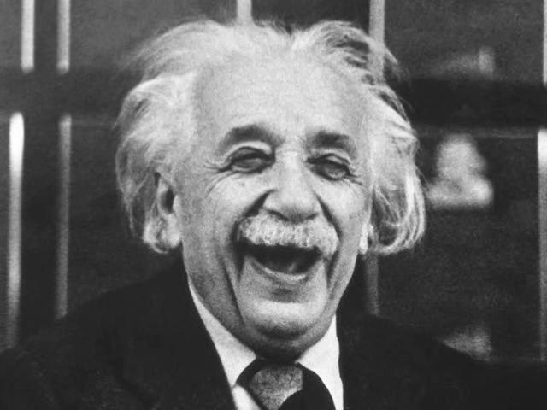
The scientific crisis
Science itself passes trough a deep crisis
Euclidean geometry
the world cannot be fully described using Euclid's geometry
Newtonian physics
Newton's laws are just an approximation of what force, gravity and speed are
Einstein's relativity
Different observers have a different perception of reality
Time is not an absolute and changes according to the observer
Bergson's idea of time
Past and future do not exist but in people's mind: they are a unique entity fuse together in the very present of men's mind (stream of consciousness)

Slide 6
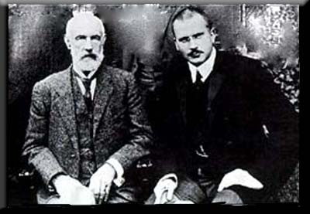
Freud and Jung
Sigmund Freud: irrational and subconscious determine people's actions
"The Interpretation of Dreams" (1900)
People are
motivated by instinct (Id)
controlled by social conditioning (Super-Ego)
left with a small part of their conscious self (Ego)
Carl Jung: racial memory and collective subconscious
"The Psychology of the Unconscious" (1916)
Man's unconscious
is made of a racial and primitive memory
operates on a symbolic level

Slide 7
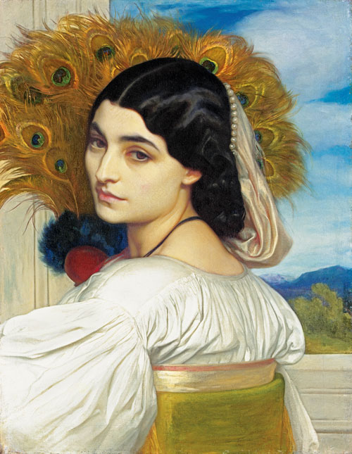
Simbolism and Aesthetic Movement
French Symbolist poets
they give mystical significance to their impressions of the world
they use language to speakto the irrational rather than the rational
they influenced Aesthetes
W. Pater is the philosopher of Aestheticism
Aesthetic poetry breaks with the Victorian tradition being inspired by the Preraphaelite Brotherhood
There is no serious attempt to come to terms with the spiritual anguish of the modern world
"Art for art's sake", this is the Aesthetic poets' motto
Art must be beautiful and its contemplation is the only thing that can stop time (Aesthetic moment)

Slide 8
The new dramatic novel
Old Novels
They were mainly narrative novels
The omniscient narrator summarizes, comments and describes the events
he is visible, both in the 3rd person and in the 1st person
20th century novels are self-told stories
They are dramatic novels
The narrator is invisible and hides himself
The analysis and interpretation of events is transferred for the narrator to the reader
Ambiguity permeates the novel

Slide 9
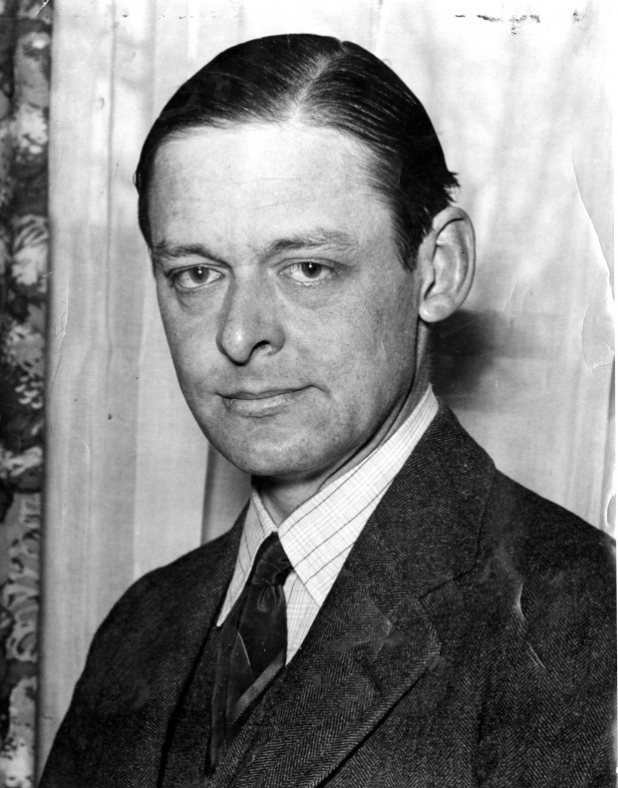
T.S. Elliot
Myths and rituals are means of ordering contemporary experience, bringing it to significance
Elliot uses compression instead of expansion (Joyce)
The reader is compelled to put his expirience into the text in order to complete it
Elliot's poetry is illogical: it is made of frames and each one of them is not directly connected to the previous/next one
Elliot's objective correlative
Elliot finds the best balance between form and mater
He uses peculiar word that convey a precise sensation or feeling

