Slide 1
THE MODERN AGE THE CRYSIS OF CERTAINTIES
1890-1930

Slide 2
AIM OF THE PATH
To understand the processes which brought to the First World War
To catch how new scientific researches turned upside down traditional beliefs
To analize the different reactions to the crysis of assurances and values
To recognize new theories about writing and new concepts of art, which developed as a reaction to the crysis

Slide 3
BACKGROUND
INDUSTRIAL REVOLUTION
Economic depression
Unemployment
Social disparities
International competition for raw materials
Control of trade routes
FIRST WORLD WAR

Slide 4
REVOLUTIONS IN SCIENCE AND LITERATURE
Albert Einstein
Henri Bergson
Sigmund Freud
Carl Jung
SCIENCE
LITERATURE
Thomas Hardy
Walter Pater
Oscar Wilde
Thomas S. Eliot

Slide 5
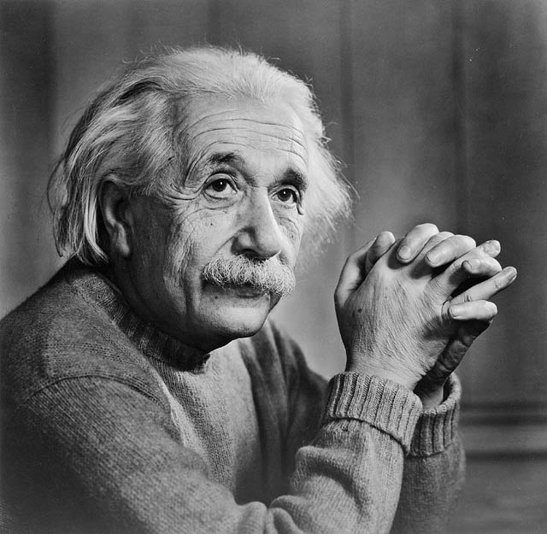
ALBERT EINSTEIN
From his General Theory of Relativity (1906)
Demolition of Euclidean
Geometry and Newtonian
Physics
Space and time are not
absolute: they change
according to the point of
view adopted by the
observer

Slide 6
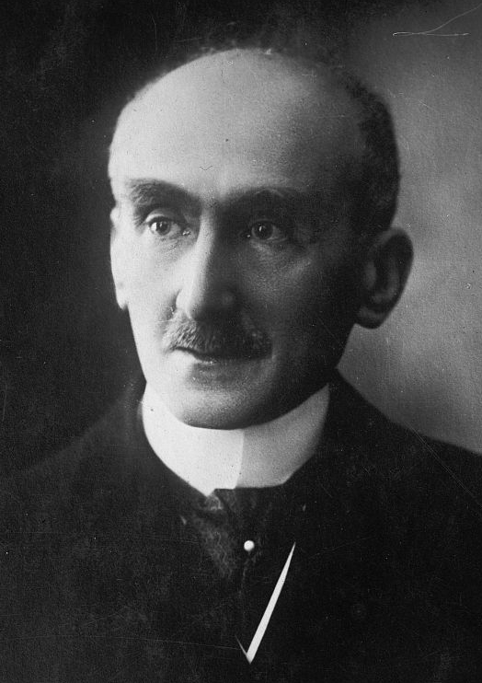
HENRI BERGSON
Rejection of conventional idea of time as a sequence of events
Past and future co-exist in our mind
The stream of consciousness flows at a semi-conscious level and determines one’s thinking

Slide 7
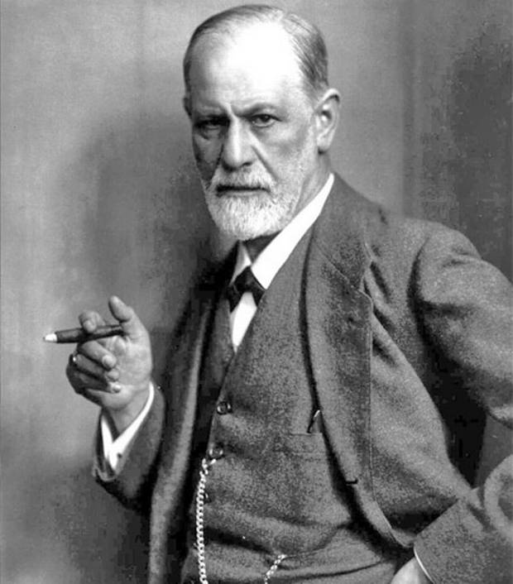
SIGMUND FREUD
From his The Interpretation of Dreams (1900)
People give oneself away
unconsciously from their
behaviour
Our attitude depends on
our unconscious part of mind,
where instincts are hidden (ID)

Slide 8
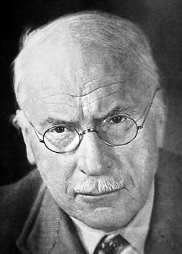
CARL JUNG
The Psychology of the Unconscious (1916)
Our mind is formed by
Racial memory, the
experience of our race
during evolution
It operates on a symbolic
level

Slide 9
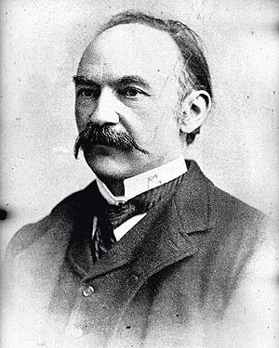
THOMAS HARDY
The first poet of the Anti-Victorian reaction
His poetry is chacaterized by the difficulties of living
In his novels he brings to surface the most moralistic and hypocritical aspects of Victorian society

Slide 10
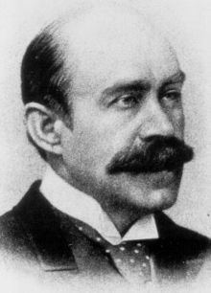
WALTER PATER
He is the theorist of the Aesthetic Movement, according to which life was an intense experience
Its demoralising message consisted of an uncoventional existance, based on excess and the cult of beauty and art
Art was not moralistic or didactic, beauty was a duty owed to society

Slide 11
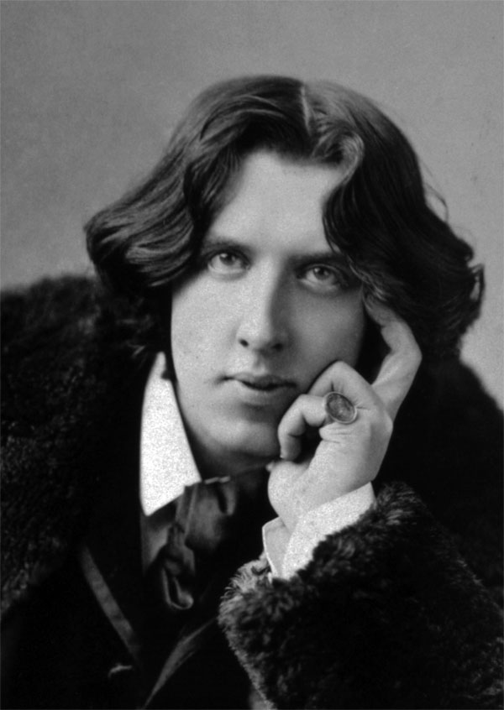
OSCAR WILDE
Manifesto of The Picture of Dorian Gray (1891)
He expounds his theory of
writing, according to which art
was a beautiful thing, completely
distant from morality
The artist loses his importance
in spite of art, even if he is still the
one able to express everything

Slide 12
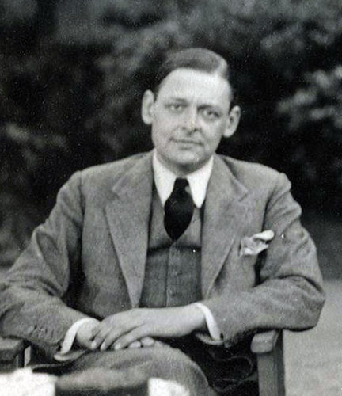
THOMAS S. ELIOT
He sees myth and ritual as a means of ordering and transforming contemporary reality
Art requires balance between form and matter

