Slide 1
Charles Dickens and actuality
Lenarduzzi Camilla
a.s. 2014/2015
cl. 5°BLS

Slide 2
INDEX
Charles Dickens’ time
Charles Dickens’ poetry
Most relevant problems:
Children living conditions
High crime rate

Slide 3
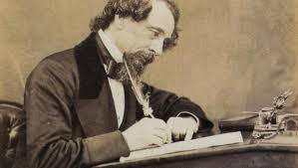
CHARLES DICKENS’ TIME
Charles Dickens was born is 1812 in the start of the Victorian era; it was a period characterised by moral responsability and by the industrial revolution effects.
In this period of progress occurred however difficulties, specially for the lower classes.

Slide 4
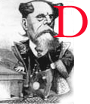
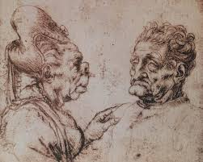
CHARLES DICKENS POERTY
Charles Dickens in his novel wants to denounce the children’s living conditions at the time and the high crime rate.
With the use of the narrative strategy of the grotesque and the further elicit of “phatos” Dickens highlights the moral characterization of the Victorians.

Slide 5
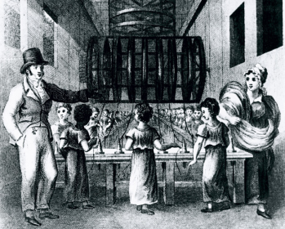
MOST RELEVANT PROBLEMS
The first half of the 19° century was a time of troubles: it was characterised by unemployment, poverty and terrible working conditions for woman and children.
The lower classes were compeld to split their families to move near coal mines; their living conditions were squalid and hygienically deplorable, with harsh schedule and no protection for women and children.

Slide 6
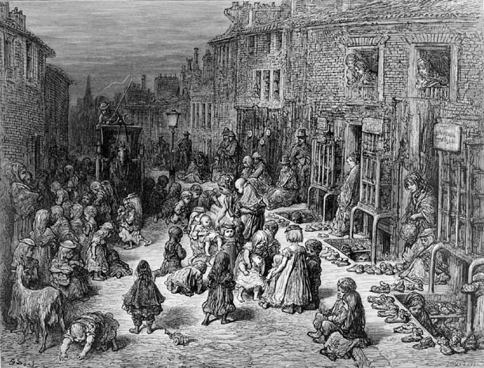
CHILDREN LIVING CONDITIONS – at the time
Dickens, underlines strongly the children’s living conditions; theose of lower classes of who lived in workhouses where often employed under dreadfull conditions for harsh works because of their malleability and fast learning skills.
Children were compelled to live away from their families, they were less or not paid and forced to work for many hours under the stricht control of the exploiters.
A clear example of children way of living is «Oliver Trwist», it is mostry focused on children orrible and shamefull conditions in workhauses.

Slide 7
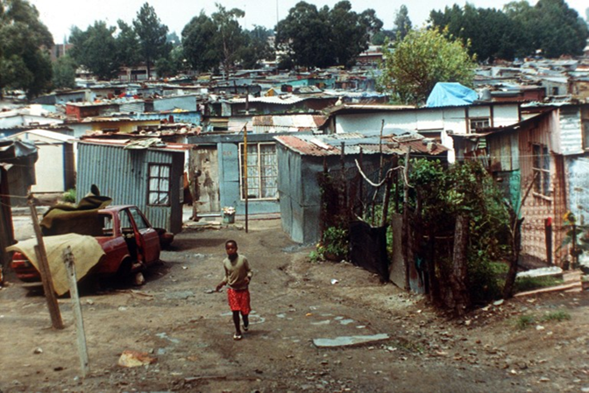
CHILDREN LIVING CONDITIONS - now
Every day in the world thousands of children die due to lack of food , water and health care; many are marginalized and does not have the chance to go to school. Other children are involved in the worst forms of exploitation (as military campaigns), some of them are banned to attend school and are economically exploited in works with dreadful healthy conditions and daily risking their live.

Slide 8
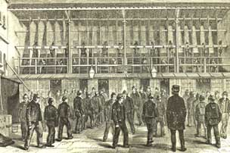
HIGH CRIME RATE – at the time
The crime rates during the Victorian era were very high as many people had no other choice than turning to crime. Harsh punishments didn’t have any great effect upon crime as those who were breaking the law only did it because they had no other choice. Prisons were constantly overcrowded, them were never cleaned and many prisoners died before they could be trialed. As an alternative to hanging, the government started sending criminals to the colonies to serve their sentences.

Slide 9
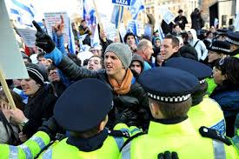
HIGH CRIME RATE - now
In some Caribbean countries and in central and south America there is a significant increase in the murder rate and this could be due to the rise of organized crime, drug trafficking, the activity of the bands but also the lack of work and the absent of the family.
Not only in Latin America but also in the African continent the situation regarding the crime rate has worsened.
The living conditions of detainees in prisons, in most cases overcrowded, are too often intolerable and unsustainable.

Slide 10
BIBLIOGRAPHY and SITOGRAPHY
Charles Dickens «Oliver Twist»
School notes
Schoolbook
www.marilenabeltramini.it
http://www.slideshare.net/Tarkena94/the-victorian-period-and-charles-dickens-13329017
https://problemsbusters.wordpress.com/about/project-matters/crime-and-punishment/
http://www.italiansinfuga.com/2014/10/05/i-paesi-con-piu-criminalita/
http://doc.studenti.it/appunti/ricerche/condizione-minori-mondo.html
http://lab.senatoperiragazzi.it/post/11/le-condizioni-dei-bambini-e-delle-bambine-del-terzo-mondo

