Slide 1
The Modern Age
1890 - 1930

Slide 2
Victorians’ doubts and fears
In the early 20th Century Victorians doubts and fears about society
Optimistic hopes were disappointed

Slide 3
British situation in 1890
In 1890 many countries, like the USA, France, Germany and Japan became competitive
It generated an economic and social crises in the UK ➔ loss of economic and political supremacy
Workers started to demand welfare and reforms ➔ Welfare State and social politics
Trade Unions became stronger ➔ creation of the Labour Party (1900)

Slide 4
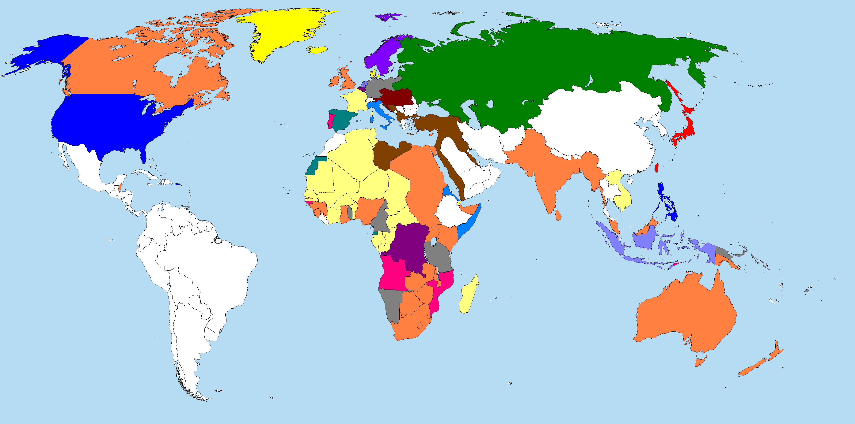
At the beginning of the 20th century, UK was the stronger state in the World;
In fact, British Empire lost its economical supremacy on the World after the WWI, when dollar became more economically stronger than British Pound.

Slide 5
Socialism
A substantial part of European workers believed in Marxist optimistic view of the society ➔ The Communist Manifesto (1848)
1917: Lenin and the Bolsheviks toke the control of the former Russian Republic ➔creation of the USSR
Creation of more important communist movements in Europe (particularly in Germany, Italy and Hungary)

Slide 6
The Victorian religious fear
Sense of isolation ➔ T. Hardy and J. Conrad
Indifferent mechanical universe;
Life without God;
Spiritual vulnerability;
➔ The only sure point of reference was himself

Slide 7
The New dramatic novel
It is a new type of novel, developed in later 19th century, where:
The narrator is invisible
Characters tells and represents the story
Absence of comments , judgments ➔ novel became ambiguous
Absence of moral convintions
Aesthetic values have taken the place of moral values ➔ H. James, J. Conrad

Slide 8
Philosophy
Sigmund Freud ➔people’s behavior depends from unconscious part of their minds
Carl Jung ➔ basic elements of man’s unconscious mind was formed by his racial memory (the primitive memory preserved by each individual)

Slide 9
Symbolism
Symbolism was a literal current that rejected the realism ➔ mystical significance of the World
The movement influenced works of Ezra Pound and T.S. Eliot
It broke completely with the Victorian tradition

Slide 10
J. Fraser and anthropology
The golden bough
New interest on mythology and pre-history
➔ Symbolist movement and Darwin’s theories
Art is an unconscious thing

