Slide 1
Regione Friuli Venezia Giulia
Liceo Scientifico “Albert Einstein”
5^BLS
Notes:
This template can be used as a starter file for presenting training materials in a group setting.
Sections
Sections can help to organize your slides or facilitate collaboration between multiple authors. On the Home tab under Slides, click Section, and then click Add Section.
Notes
Use the Notes pane for delivery notes or to provide additional details for the audience. You can see these notes in Presenter View during your presentation.
Keep in mind the font size (important for accessibility, visibility, videotaping, and online production)
Coordinated colors
Pay particular attention to the graphs, charts, and text boxes.
Consider that attendees will print in black and white or grayscale. Run a test print to make sure your colors work when printed in pure black and white and grayscale.
Graphics, tables, and graphs
Keep it simple: If possible, use consistent, non-distracting styles and colors.
Label all graphs and tables.

Slide 2
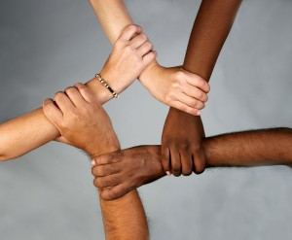
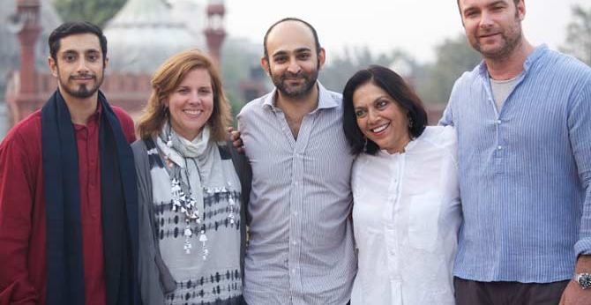
Our Contribution
In-betweenness: a linguistic and cultural experience of learning and critical thinking.
Vivere fra culture: un’esperienza di apprendimento linguistico-culturale di riflessione critica.

Slide 3
A Short Video
Notes:
This is another option for an overview using transitions to advance through several slides.

Slide 4
Learning Steps
step 1: Reading and Comprehension
step 2: Analysis of structure and the potential of the dramatic monologue
step 3: Identifying intercultural themes
step 4: Learning and discovering the context
step 5: Comparing the original novel and the Italian translation
step 6: Coming to a conclusion
step 7: Thinking about our learning process
Notes:
Use a section header for each of the topics, so there is a clear transition to the audience.

Slide 5
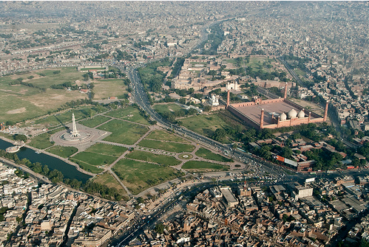
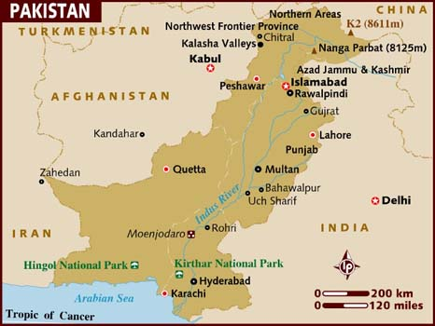
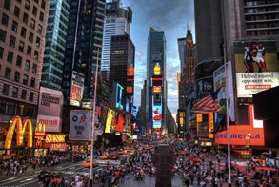
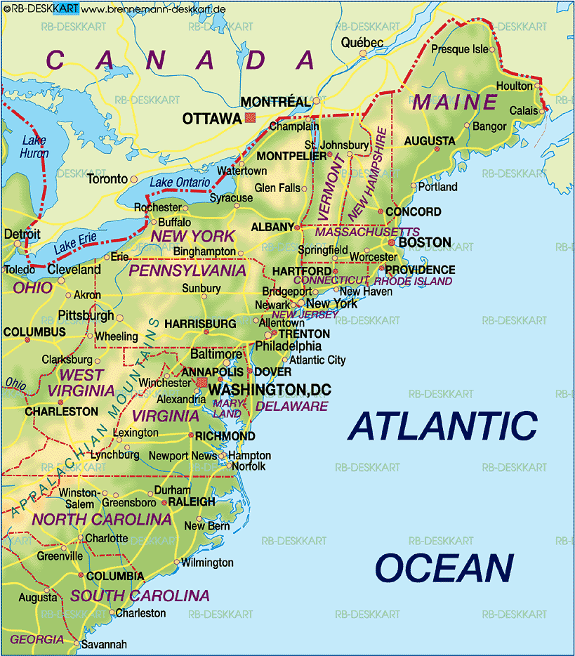
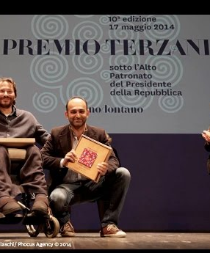
Contexts
Pakistan
The United States
Islam
Symbols of Islam
Italian poetry on 1911 (giannizzeri, Udine Mohsin Amid, Udine “vicino e lontano”)
“The Reluctant Fundamentalist” at Rai Letteratura
School resources: English and IRC
L’Asia siamo noi
L’altro siamo noi
Notes:
Use a section header for each of the topics, so there is a clear transition to the audience.

Slide 6
the Dramatic Monologue and its Cultural Encounter
Examples of students’ work
Work 1:
Work 2:
Work 3:
Notes:
This is another option for an overview slide.

Slide 7
Intercultural Themes
Different people, different languages, different cultures
The language of the encounter
Fundamentalism/s
Men meet women: modern and traditional models
Stereotypes are worldwide
Identity or identities
The difficulty of leaving in in-betweenness
The relationship with the foreigner and the stranger
Human nature facing fear and tragedy
Communication/s and culture/s

Slide 8
Intercultural Objectives
Comparing languages
Finding intercultural keywords
Trying to interpret differences and similarities
Learning about different cultural codes
Recognizing similarities and dissimilarities in the Italian translation of the novel
Improving linguistic knowledge of the language
Learning about Christianity and Islam
Comparing opinions about the novel

Slide 9
Comparing Quotations relevant to Intercultural Dialogue
Quotation 1:
Quotation 2:
Quotation 3:
Notes:
Add slides to each topic section as necessary, including slides with tables, graphs, and images.
See next section for sample table, graph, image, and video layouts.

Slide 10
Similarities – Differences – Common Points
Similarities:
Differences:
atteggiamento nei confronti della tradizione
atteggiamento nei confronti della storia
Americani futuro
Changez passato
la paura di fronte all’incertezza
La formalitità e l’informalità
Common points:
both attracted by women from a physical point of view
overall happiness during their holiday

Slide 11
conclusions
Abbiamo capito che:
l’atteggiamento multiculturale è importante
l’atteggiamento multiculturale non riguarda solo il confronto con lo straniero ma con qualsiasi persona diversa da noi
l’atteggiamento multiculturale ci aiuta a decentrarci, a non vederci come gli unici
l’atteggiamento multiculturale ci serve ad aprirci all’altro senza sospetti e stereotipi e pregiudizi
’atteggiamento multiculturale ci serve a costruire la nostra identità, perché noi capiamo chi siamo solo se ci confrontiamo con gli altri
I linguaggi della comunicazione (verbali, o non verbali) non sono mai neutri, portano sempre con sé un modo di essere
Bisogna essere disponibili all’ascolto per poter arrivare alla com-prensione
Le religioni sono spesso dei pretesti per altri interessi
L’esistenza degli esseri umani viene prima di tutti gli altri segnali culturali

Slide 12
What we have learnt?
We have:
improved knowledge of the language
learnt new vocabulary
compared English and Italian
reflected on the symbolical value of proper names
the importance of language strategies to convey meaning
the different concept of time in the 2 cultures
learnt Eastern culture privileges a poetry-like form of communication
learnt the condition of in-betweenness one lives when he has to meet different cultures and people

