Slide 1
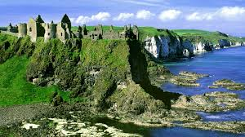
IRELAND

Slide 2
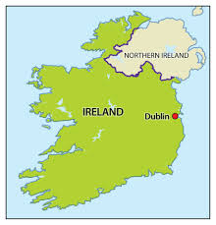
Index
History in brief
Dublin
Climate
Irish food
Irish flag
Bray, Ireland
Belfast, Northern Ireland

Slide 3
History in brief
Ireland is an island in north-western Europe which has been divided politically in Ireland and Northern Ireland since 1920.
Ireland consists in 32 counties and six of them are known as Nothern Ireland.
The name "Ireland" applies to the island as a whole, but in English is also the official name of the independent state since 1921. It is also called “Green Ireland”.
In 1922 Ireland gained self government.
Celtic tribes settled on the island in the 4th century BC. Invasions began in the early 12th century and set in place Ireland's uneasy position within England's sphere of influence.
1800- The act of Union in which Catholics, 90% of the Irish population, were excluded from Parliament - saw Ireland joining the United Kingdom.
1919-1921- Irish War of Independence
1922-1923- The Irish Civil War

Slide 4
History in brief
1949- The Irish Free State became "Ireland" and withdrew from the British Commonwealth of Nations.
Ireland's history post-partition has been marked with violence, a period known as "The Troubles", generally regarded as beginning in the late 1960s, which saw large scale confrontation between opposing paramilitary groups seeking to either keep Northern Ireland as part of the United Kingdom or bring it into the Republic of Ireland as well as with the security forces.
1998 -Was finally approved a peace settlement known as the Good Friday Agreement and is currently being implemented.
1973 - Ireland joined the European Community.
Between the mid 1990s and late 2000s, Ireland saw massive economic boom.
The global banking crisis and subsequent recession have hit Ireland hard, and high levels of unemployment have returned.

Slide 5
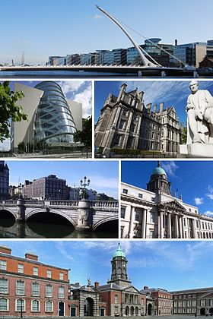
Dublin
It is the capital city of Ireland. Its vibrancy, nightlife and tourist attractions are renowned and it is the most popular entry point for international visitors to Ireland. Dublin is in the province of Leinster on Ireland's east coast, at the mouth of the River Liffey. Founded as a Viking settlement, the Kingdom of Dublin became Ireland's principal city following the Norman invasion. The city expanded rapidly from the 17th century and was briefly the second largest city in the British Empire before the Act of Union in 1800. Following the partition of Ireland in 1922, Dublin became the capital of the Irish Free State, later renamed Ireland. It is a historical and contemporary centre for education, the arts, administration, economy and industry.

Slide 6
Climate
Overall, Ireland has a mild but changeable oceanic climate with few extremes. In Ireland you may indeed experience 'four seasons in one day’. You may notice slight differences in temperature between the north and south of the country, and more rain in the west compared with the east.
Mean daily winter temperatures vary from 4°C to 7°C, and mean daily summer temperatures vary from 14.5°C to 16°C. Temperatures will rarely exceed 25°C and will rarely fall below -5°C.
Regardless of when you visit Ireland, even in middle of the summer, you will more than likely experience rain, so if you intend being outdoors, a waterproof coat is recommended.

Slide 7
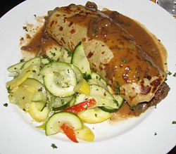
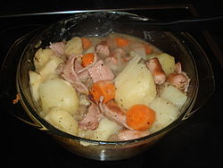
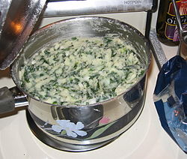
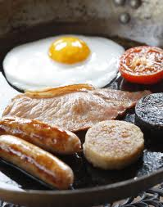
Irish Food
Irish cuisine evolved from centuries of social and political change. The cuisine takes its influence from the crops grown and animals farmed in its temperate climate. The introduction of the potato in the second half of the 16th century heavily influenced Ireland's cuisine thereafter and, as a result, is often closely associated with Ireland. Representative Irish dishes include Irish stew, bacon and cabbage, boxty, coddle, and colcannon.
Irish cuisine can charitably be described as hearty: virtually all traditional meals involve meat (especially lamb and pork), potatoes, and cabbage.
Breakfast is the most important meal: a famously filling spread of bacon, eggs, sausages and white and/or black pudding, a type of pork sausage made with blood (black) or without (white).

Slide 8
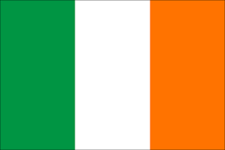
Irish Flag
The national flag of Ireland frequently referred to as the Irish tricolour – is a vertical tricolour of green, white, and orange.
The Irish government has described the symbolism behind each colour as being that of green representing the Gaelic tradition of Ireland, orange representing the followers of William of Orange in Ireland, and white representing the aspiration for peace between them.
The flag was adopted in 1916 by the Easter Rising rebels and subsequently by the Irish Republic during the Irish War of Independence (1919–1921). Its use was continued by the Irish Free State (1922–1937) and it was later given constitutional status under the 1937 Constitution of Ireland.
The flag, as a whole, is intended to symbolize the inclusion and hoped-for union of the people of different traditions on the island of Ireland, which is expressed in the Constitution as the entitlement of every person born in Ireland to be part of the independent Irish nation, regardless of ethnic origin, religion or political conviction.

Slide 9
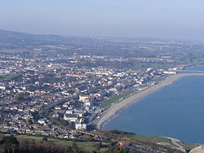
Bray Ireland
Bray is a town in north County Wicklow, Ireland. It is a busy urban centre and seaside resort, with a population of 31,872 making it the ninth largest urban area in Ireland. It is situated about 20 km south of Dublin on the east coast.
The name of the town means hill or rising ground, possibly referring to the gradual incline of the town from the Dargle Bridge to Vevay Hill.

Slide 10
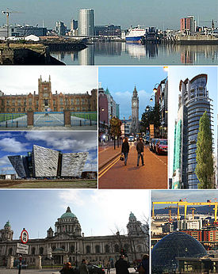
Belfast Northern Ireland
Belfast is the capital and largest city of Northern Ireland. By population, Belfast is the 17th largest city in the United Kingdom and the second largest on the island of Ireland.
The name Belfast is derived from the Irish Béal Feirsde. The word béal means "mouth" or "rivermouth" while feirsde/feirste is the genitive singular of fearsaid and refers to a sandbar or tidal ford across a river's mouth. The name would thus translate literally as "(river) mouth of the sandbar" or "(river) mouth of the ford".This sandbar was formed at the confluence of two rivers at what is now Donegall Quay: the Lagan, which flows into Belfast Lough, and its tributary the Farset.

Slide 11
Work done by
Entina Agolli

