Slide 1
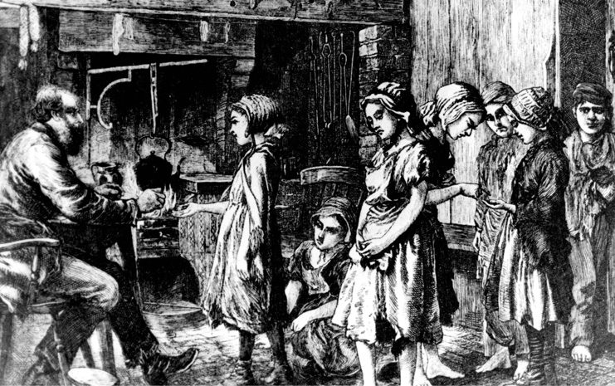
Child labour
Croda Chiara

Slide 2
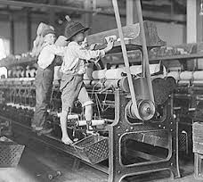
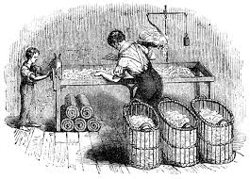
Charles Dickens criticizes some aspects of his society
In his work (Hard Times) he describes the major problem at the time:
the children’s condition

Slide 3
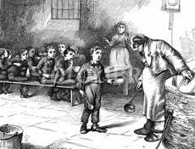
Infact, when he describes the life of children,
Dickens criticizes the social institutions and
the social conditions of the industrial
revolution, which forced children to work in
the workhouses in miserable conditions.

Slide 4
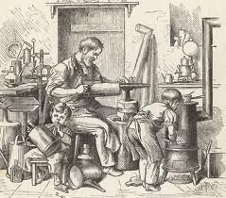
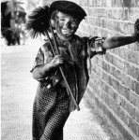
Many children started work at the age of 5, the same age
as children start school today. They went to work as soon
as they were big enough.

Slide 5
Many Victorian children were poor and worked
to help their families. Few people thought this
strange or cruel. Most people thought work
was good for children. The Industrial Revolution
created new jobs, in factories and mines. Many
of these jobs were at first done by children,
because children were cheap - a child was paid
less than adults.

Slide 6
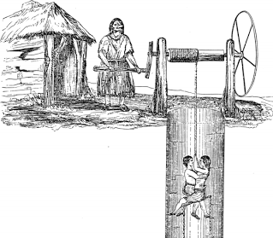
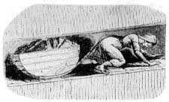
Children worked on farms, in homes as servants, and in factories. Children often did jobs that required small size and nimble fingers. But they also pushed heavy coal trucks along tunnels in coal mines. Boys went to sea, as boy-sailors, and girls went 'into service' as housemaids.

Slide 7
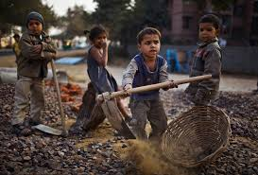
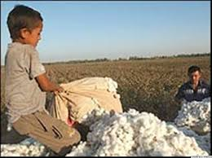
Child labour is still common in many parts of the world.
Estimates for child labour vary.
It rangesbetween 250 to 304 million, if children aged 5–17 involved in any economic activity are counted.

Slide 8
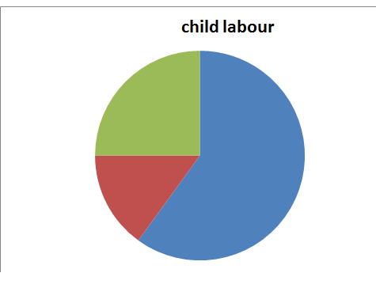
Some 60 percent of the child labour was involved in agricultural activities such as farming, dairy, fisheries and forestry.
Another 25 percent of child labourers were in service activities such as retail, picking and recycling trash, polishing shoes, domestic help, and other services.
The remaining 15 percent in assembly and manufacturing
in informal economy, home-based enterprises, factories,
mines, packaging salt, operating
machinery, and such operations.

Slide 9
