Slide 1
Tolloi Elisa 5BLS
SIMILARITIES BETWEEN THE VICTORIAN AGE AND THE MODERN WORLD.

Slide 2
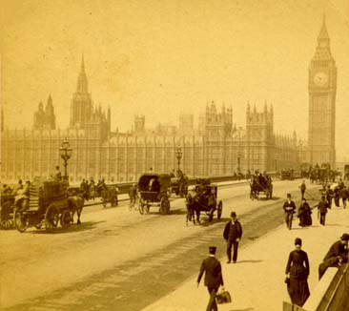
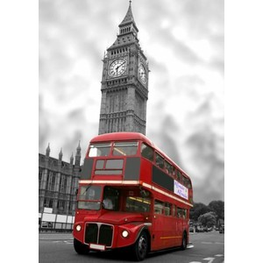
The Victorian age was characterized by social and economic problems which are still present in our society.

Slide 3
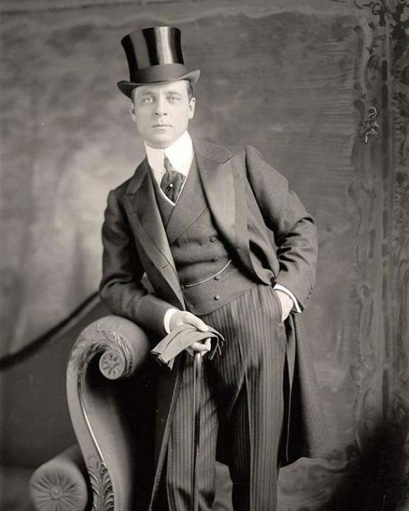
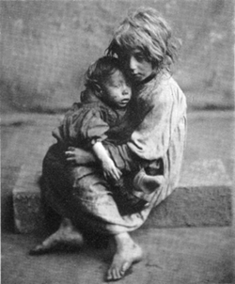
CONTRADDICTIONS:
Social contradiction of the development model of advanced societies
DEVELOPMENT MODEL OF
PURPOSE :
PROGRESS AND GROWTH OF WEALTH
GROWTH OF WEALTH WAS DIRECTLY PROPORTIONAL TO GROWTH OF POVERTY
THE VICTORIAN AGE
THE MODERN WORLD

Slide 4
Scientific explanation to explain the origin of man, in contrast to the religious vision of cosmology.
Carles Darwin: “The theory of evolution”
It holds that the evolution of species occurs as a result of necessity; nature selects the individuals who have the characteristics needed to survive.
Peter Higgs,Francois Englert, Fabiola Gianotti and Joe Incandela
Bosone di Higgs:(God particle ). The elementary particle that forms the raw material.
These discoveries had allowed man to understand the fundamental laws of nature, responsible for the creation of atoms, molecules, planets and human life.

Slide 5
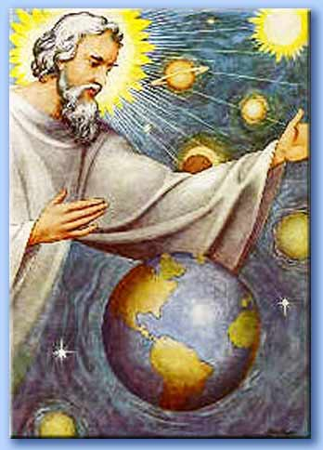
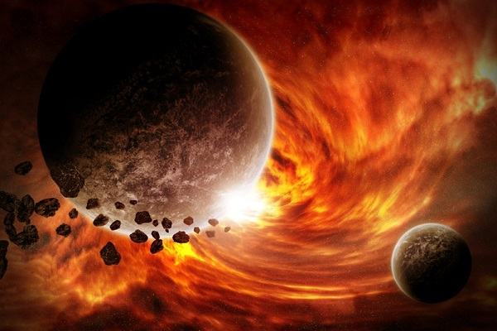
Man was not created by God, in line with the principles of religion.
VS

Slide 6
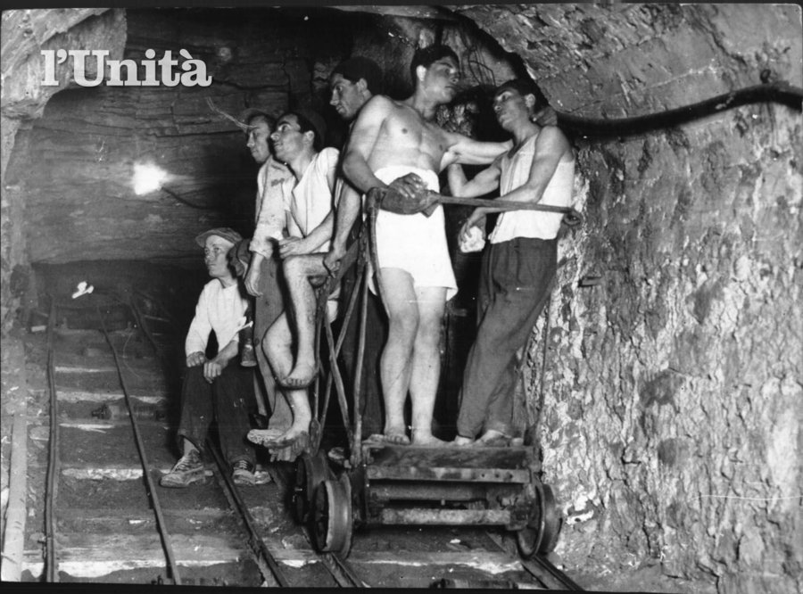
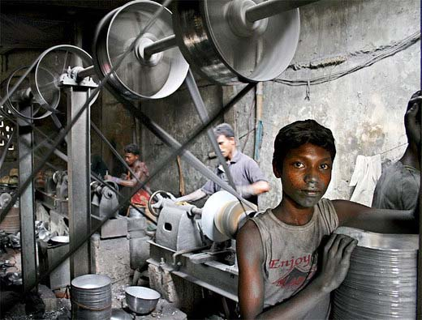
INADEGUACY IN THE SOCIAL SERVICIES:
DURING THE VICTORIAN AGE The measures to protect the health and safety of workers did not exist
ACTUALLY In almost all workplaces, workers are in contact with dangerous substances .
In some less developed countries security measures are still an option
The only important thing is production, according to the view of the Industrial Revolution

Slide 7
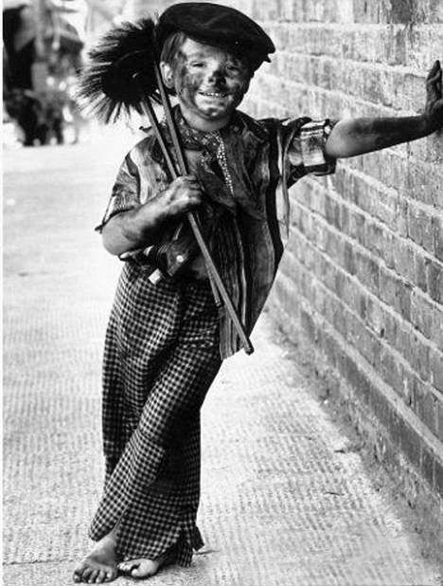
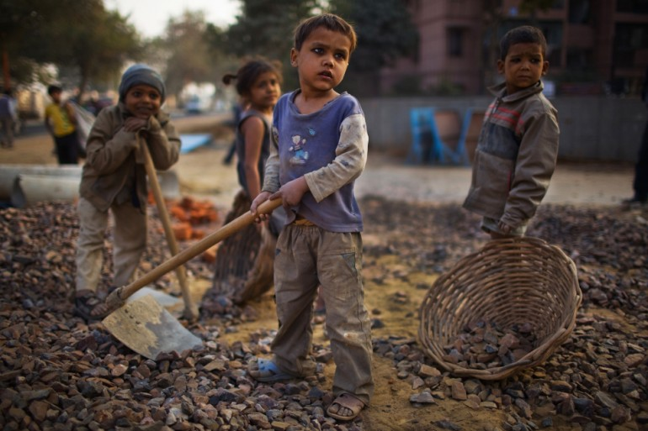
Exploitation of child labor:
-THEY WERE MALLEABLE
-THEY WERE UNDERPAID
-THEIR SMALL STATURE ALLOWED THEM TO MAKE WORKS WHICH WERE DIFFICULT FOR ADULTS

Slide 8
In factories or mines, in extreme living conditions. Usually they work to build balls, shoes or sewing clothes.
- More than 250 million children between the ages of 5 and 14 work in the world;
- Of these, 171 million play dangerous job
- 8 million are victims of the worst forms of exploitation
WHERE?
SOME DATA..

Slide 9
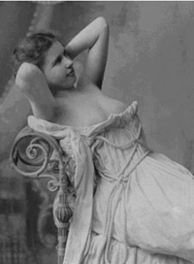
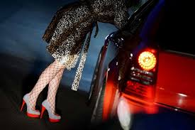
PROSTITUTION ethical-religious problem socio-economic problem
During the Victorian Age the Middle Classes created moral standards sex was a taboo the phenomenon of prostitution grew
Dickens and other writers condemned prostitution mechanization and industrialization of modern life, painting prostitutes as human commodities consumed and thrown away as waste.

Slide 10
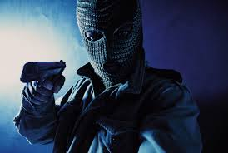
Conditions of hunger and poverty CRIME:
When people have nothing to lose, and they don't have a job or a way to support themselves, they seek alternative ways to get food to survive.
“La lotta alla mafia e quella alla corruzione sono priorità assolute”. From the speech of Sergio Mattarella, President of the Italian Republic.

Slide 11
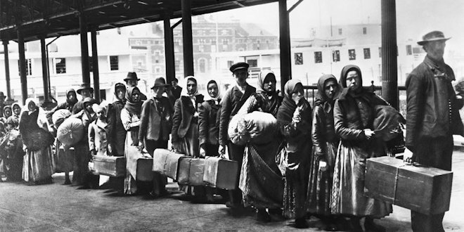
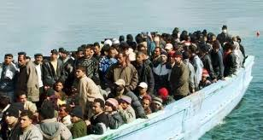
IMMIGRATION:
Conditions of poverty People look for work and food and to move in places where there is less unemployment
As The capital of a powerful empire, London became an attraction for a large mass of immigrants from its colonies and for the poor of Europe.

