Slide 1

THE ANGLO-SAXONS
PRESENTED BY:
Clementin Emilio, Dibarbora Mattia, Zamò Federico.
Liceo Scientifico Scienze Applicate
«A.Einstein» , Cervignano del Friuli. CL. 3 ASA

Slide 2
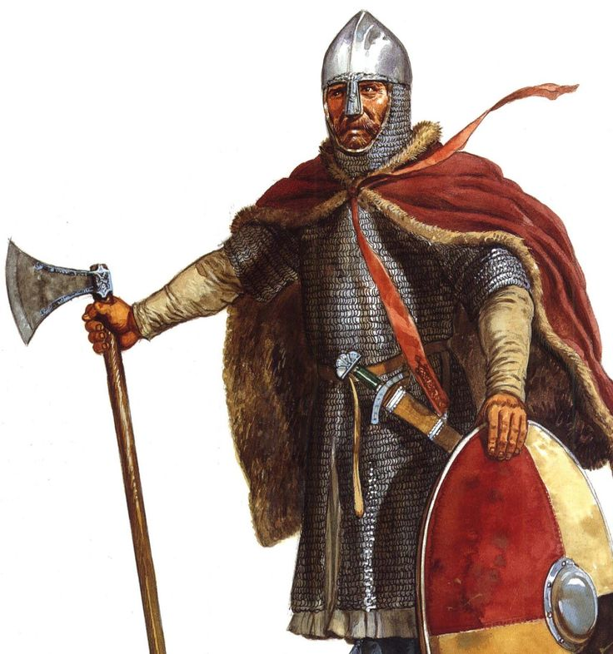
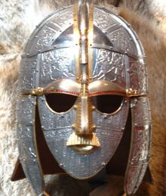
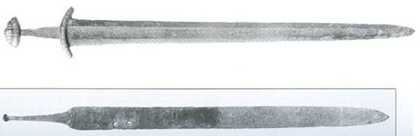
The Anglo-Saxons:
The peoples that germanised Britain.
PERIOD: THE ANGLO – SAXONS DEVELOPED FROM 410 AD TO 1100 AD.

Slide 3
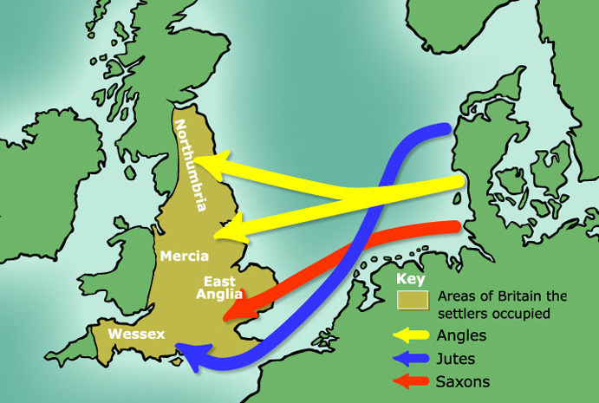
Where did they come from?

Slide 4
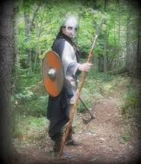
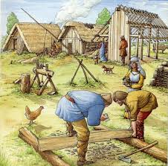
FEAUTRES OF THE ANGLO-SAXONS:
They were in search of richer lands, so they invaded Britain.
Their values were freedom, courage and loyalty.

Slide 5
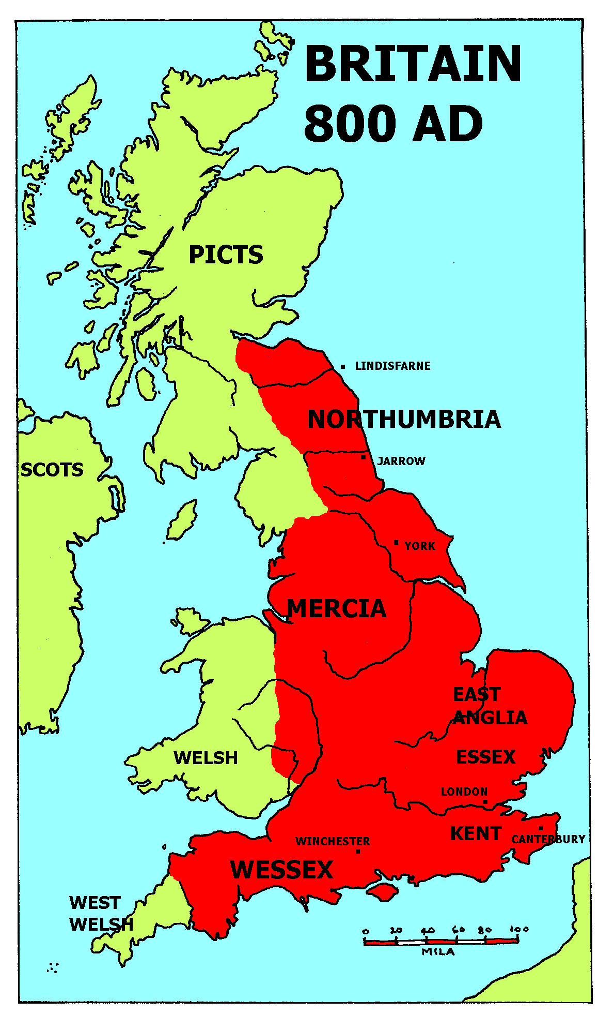
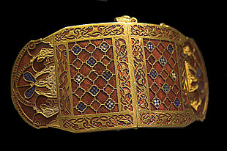
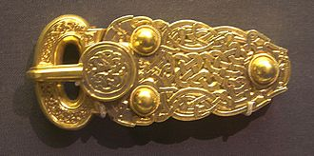
CONTRIBUTION:
They conquered England and in the 879 a «Kingdom of the Anglo-Saxons» was born.
They praised beauty: this demonstrates their skill in making decorations and ornaments.
Gold buckle (Sutton hoo)
Shoulder-clasp (Suttun hoo)

Slide 6
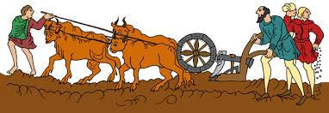
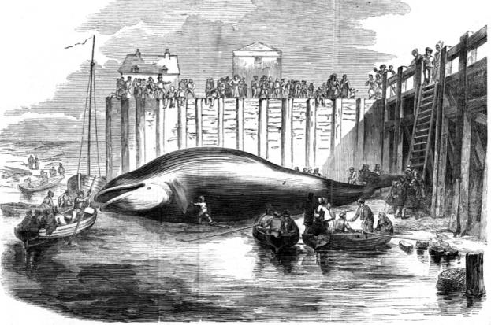
OCCUPATIONS:
They were farmers.
They also were fishermen; they fished seals and wheals in the Ocean.

Slide 7
SOCIAL ORGANIZATION:
The social organization of the Anglo-Saxons, being based on tribes, developed into extended families called clans.
FAMILIES
CLANS
TRIBES

Slide 8
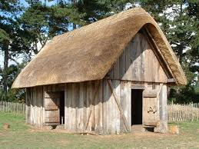
LIVING PLACE:
Their houses were huts
made of wood with
roofs thatched with straw.
There was only one
room where everybody ate,
cooked, slept and
entertained their friends.
The hall was the biggest
house in an Anglo-Saxon
village and the chief lived there with his warrior.

Slide 9
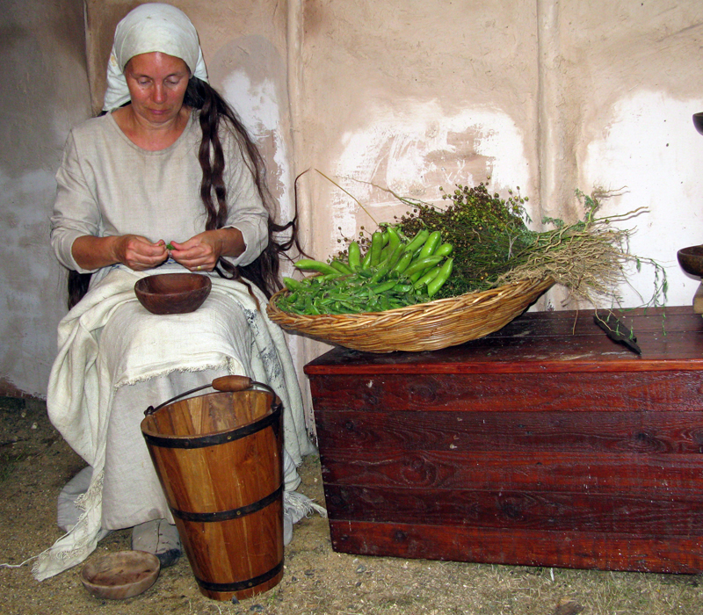
ROLE OF WOMEN:
Where marriage was concerned, Anglo-Saxon women could choose the men they wanted to marry.
Excluding the ordinary role as mother, wife and caregiver, women could assume other also others different roles:
Cupbearer
Motivators
Memory keepers

Slide 10
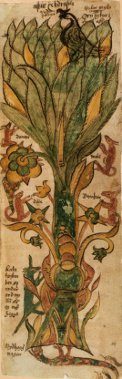
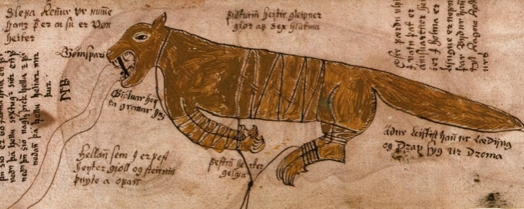
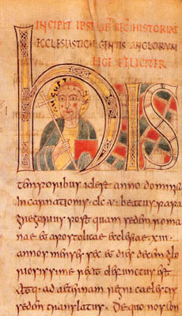
RELIGION:
Paganism: they worshipped in the Norse gods
(for example Woden, Thunor, Loki…)
Christianism: arrive of the monk Sainte Augustine and conversion of the Anglo-Saxons to the Christianity at the end of the sixth century A.D.
The Yggdrasill
Fenrir, the wolf

Slide 11
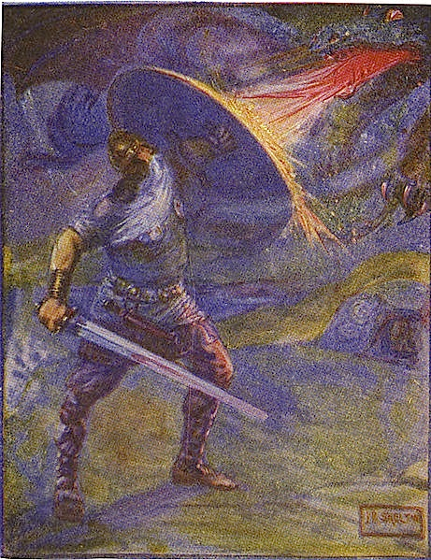
LITERATURE:
Their literature was essentially formed by heroic poems and most of them involved the bravery of the warriors taking as example for the people.
These heroes epitomized the strength of those population.
Beowulf (the most famous of them)

Slide 12
CURIOSITY:
We know that these populations influenced English culture. This is only an example:
Monandæg ( Moon's day ) - Monday
Tiwesdæg ( Tiw's-day ) - Tuesday
Wodnesdæg ( Woden's day ) - Wednesday
Ðunresdæg ( Thor's Day ) - Thursday
Frigedæg ( Freyja's day ) - Friday
Sæternesdæg ( Satære's day ) - Saturday
Sunnandæg ( Sun's day ) - Sunday

