Slide 1
THOMAS STEARNS ELIOT
Grando asia 5als

Slide 2
TABLE OF CONTENT
Who was T.S. Eliot
The Waste Land
Mythical method

Slide 3
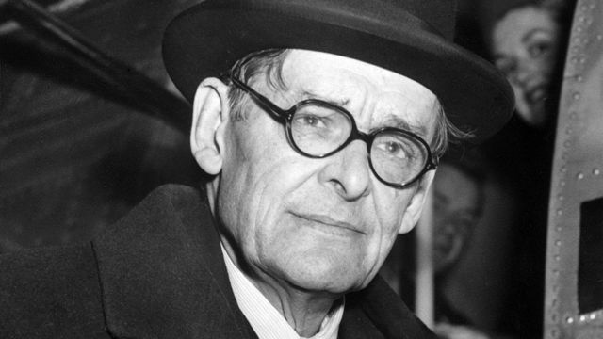
WHO WAS T.S. ELIOT
Thomas Stearns Eliot was born in St. Louis, Missouri.
He studied at Harvard, the Sorbonne in Paris, and Oxford.
He settled in London where he started to work first as a clerk al Lloyds Bank
His first masterpiece was the collection of poems Prufrock and Other Observations.
He published The Waste Land in 1922 after the American poet Ezra Pound had contributed to reduce it to its final form.
Eliot dedicated it to Pound himself with Il miglior fabbro – the better craftsman (a quotation from Dante’s Purgatory).
T. S. Eliot ; 26 September 1888-4 January 1965

Slide 4
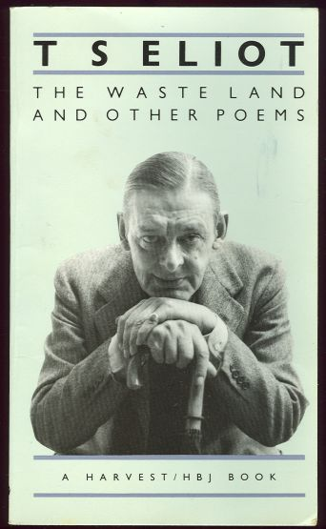
THE WASTE LAND
It was published in 1922 and it is divided into five sections:
The Burial of the Dead: it is about the opposition between sterility and fertility, life and death.
A Game of Chess: it presents the juxtaposition between present and past way of being.
The Fire Sermon: it presents the theme of present alienation through the description of a loveless sexual encounter.
Death by Water: it will about a death caused by a shipwreck.
What the Thunder Said: it evokes religions from East and West. The solution might be a sort of sympathy with other human beings but it does not modify the general atmosphere of utter desolation.
T. S. Eliot ; 26 September 1888-4 January 1965

Slide 5
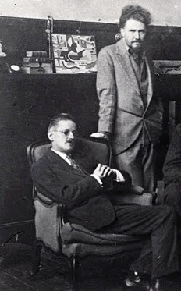
THE MYTHICAL METHOD
Mythical allusions convey the contrast between the present and the past.
Fragmentary: mixture of different poetic styles such as blank verse, the ode, the quatrain and free verse stand for the chaos of modern civilization.
Metaphors and symbols replace direct statements.
Technique of the “objective correlative” which is the attempt at communicating philosophical reflections and feelings.
Technique of juxtaposition for example between trivial elements with sublime ones..
It is simply a way of controlling, of ordering, of giving a shape and a significance to the immense panorama of utility and anarchy which is contemporary history.
Ulysses, Order and Myth
T. S. Eliot ; Ezra Pound

Slide 6
THE END

