Slide 1
THOMAS STEARNS ELIOT Introduction to his poetry
Credits:
Francesca Pecorella

Slide 2
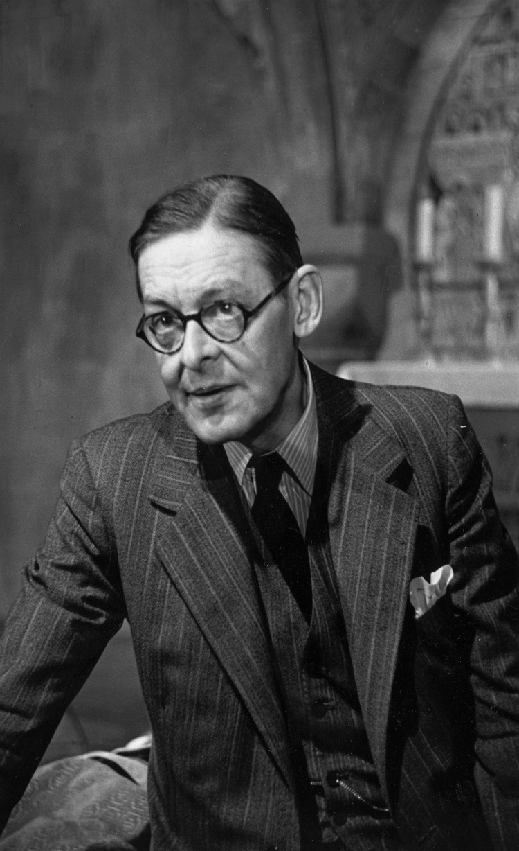
T.S. ELIOT 26 September 1888 – 4 January 1965
Thomas Stearns Eliot was born in St. Louis, Missouri. He was educated at Harvard and did graduate work in philosophy at the Sorbonne, Harvard, and Merton College, Oxford. He settled in England, where he worked as a schoolmaster, a bank clerk, and a literary editor for the publishing house Faber & Faber, of which he later became a director.
Eliot has been one of the most daring innovators of twentieth-century poetry.

Slide 3
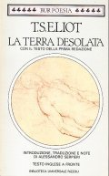
I will now summarize the most important elements and features of Eliot’s poetry traced through the reading of Alessandro Serpieri’s “T.S. Eliot, La terra Desolata”
Therefore, in the next slides, I will try to answer the following questions:
Why T.S.Eliot is considered as an innovative poet?
What kind of strategies he made use of?
What kind of language did he adopt?
How did he react to the historical changes happened during his life?
Who affected his poetry?

Slide 4
Features of T.S.Eliot’s poetry
His poems are characterized by the absence of explicit logic transitions and by the use of metric blocks interrelated thanks to similarities, parallels and similar logical and syntactic structures related with an analogical kind of language.
Absence of a coherent structure, in favour of an innovative one, no longer focused on sequential, logical-causal and monologue compositional methods. Eliot’s works compel the reader to participate actively: he / she is required to conjecture, to guess and to reconstruct the different fragments, provided without a necessary order of cause and effect or a chronologic criterion.

Slide 5
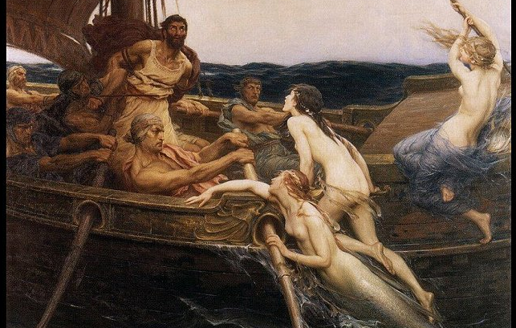
Eliot, unlike the writers of the previous century, adopts a relational and dialogic method. In particular, he refers to Ezra Pound’s method. Pound was an American poet, essayist and translator, who became Eliot’s mentor and allowed him to cut out his way into the world of writing and poetry. Pound’s method was defined by the same Eliot a “mythical method”.
Eliot’s works will therefore stand for containers of images and literary elements extracted from the paradigms of the mythological and the classical world literature apparatuses.
Therefore, the frequent and almost incessant quotations and the decision to use different languages seems coherent. Thus, his poems become suitable examples of polyphony: therefore the reader attends the presence of multiple points of view, of different items and as a consequence, of different perspectives and interpretations.

Slide 6
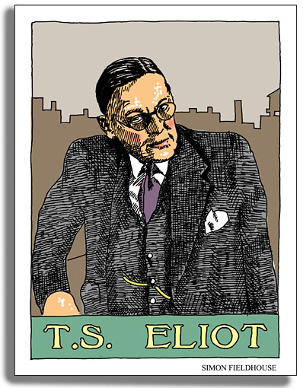
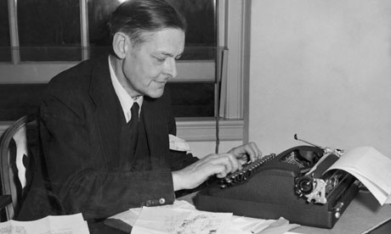
Eliot’s works are made up of fragments not connected to one another by logical connections. Eliot exploits the fragmentation of both characters and landscape. The fragments derive, as anticipated, by the absorption and the destruction, the de-fragmentation, of other texts taken by the intertextual field.
All the features traced by Serpieri are coherent with the Modernist literature devices. Indeed, in conclusion, it is evident Eliot joined the philosophy of the Modernist movement. It is evident that he broke with the previous traditions, perceiving the culture of the past as an obsolete one. His aim was, therefore, to mix different poetic style in order to create an innovative work, not by the point of view of themes and subjects, but regarding the style, the techniques and the devices used.

