Slide 1
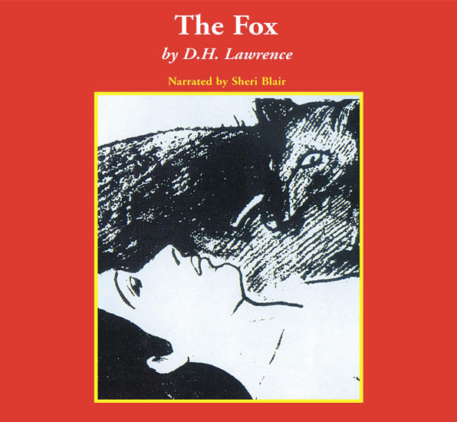
THE FOX
David herbert Lawrence
E. Agolli, S. Carrara, F. Cicogna, F. Cisilino, A. Decorte, G. Fedrizzi. Liceo scientifico “A. Einstein”, Cervignano del Friuli

Slide 2
Index
About the novelist
About the book
Characters
The plot
Main themes
Historical context and setting
About the war
War and women
Relationships during the World War I
Message

Slide 3
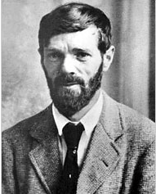
About the novelist
David Herbert Lawrence was born in 1885 in Eastwood, England. He was an English novelist, poet, playwright, essayist and literary critic.
About the book
“The fox” is a novel that first appeared in The Dial in 1922. Set in Berkshire, England, during World War I, The Fox deals with the psychological relationships of three protagonists in a triangle of love and hatred.

Slide 4
Characters
March and Bandford: thirty-year-old ladies, farm owners. March is a worker as able as a man and she is subdued to March. Bandford is physically weak and gentle. The two names are nicknames: March refers to the month in which the nature awakes and Bandford refers to something distant (to band) and strong. The nicknames communicate how the two ladies are.
Henry: a soldier that arrives in the farm. He is seen like a fox by March and like an obstacle by Bandford. The reader is able to create an idea of Henry thanks to many information read all over the text.
The Fox: the fist male figure that appears in the novel and to March, it is identified in the figure of Henry. Since it touched March deeply, it becomes a focus of the lady of feelings which arise in her, placing her on a border line between exciting and dangerous unknown.

Slide 5
The plot
Nellie March and Jill Bandford struggle to maintain a marginal livelihood at the Bailey Farm. A fox has raged through the poultry, and although the women have tried to shoot the intruder, he seems always to elude traps or gunshot. The fox appears in Nellie’s nightmares as a dominating and sexually threatening force that both attracts and repels her.
Henry Grenfel, a soldier who worked in the military forces in Canada, returns to the farm, which was once owned by his grandfather. Bandford allows him to stay with them for some days, until he finds another place to live. Both are charmed by his boyish vigor, but Nellie, in particular, identifies him with the fox. Henry asked March to marry him, she agreed and Bandford had to deal with this unwanted piece of news. The lady tries to make March to change her idea and behaves rudely to make the boy leave. Henry kills the fox and he goes back to war. After few days he receives a letter from March, where she writes she cannot marry him because she loves Bandford. He asks an authorization to his captain to return to the farm. When he comes back, he kills Bandford and marry March.

Slide 6
Main themes
Love and friendship: the novel makes the reader think about interpersonal relationships, based on jealousy, loyalty, fidelity, submission and more;
Female emancipation: March and Bedford do not need any male figure in their life because they are able to do what they need to survive on their own;
Gender: there is a female environment. The two ladies, living without male company, suggest particular qualities. Firstly, the reader can understand inside the female gender, there are different roles (March bodies the male figure, Bandford is the house-lady). The two ladies are representative of two aspects of character that many women find competing in themselves during and after the war. Then, when Henry goes to the farm, there is a contrast between the two genders. Indeed, Henry feels menaced by the ladys’ independence.s
Sexuality: when March hunts the fox, she thinks she is hunting a ma. This act describes once more something else than itself: March’s sexuality and her manner of dealing with it. She is uncertain if she wants him to die or to live. When she is in front of the fox, she does not raise her gun till it has casually run away.

Slide 7
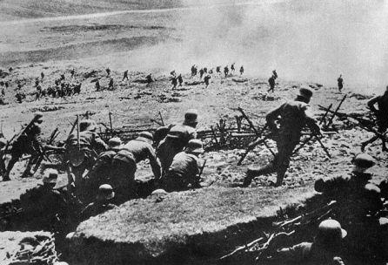
Historical context and settings
The novel is set during the aftermath of the First World War. Great Britain took part in the conflict in 1914. It was allied with France, Russia and USA. At the end of the war (1818) it was one of the winners.
Even if Great Britain wasn’t the place in which the conflict was fought, the country was highly damaged. Since it was the main investor of the war, there was inflation so people were not able to survive.

Slide 8
About the war through the text
Henry might represent the patriarchy that the women in the novel should rise against. The two ladies are fearful because the society see women subdued to men.
Since the two girls are so closed and do not need a male figure in their life, Henry feels menaced from their power so he asks March to get married. At first, the lady denied but when Henry became aggressive, March agreed. This highlights the women’s submission toward the male figure.
Henry is described in the story as “silent, unconscious, with all the blood burning in all his veins, like fire in all the branches and twigs of him.”
The reader can understand men and women had a relationship of submission. Indeed, women had to do what their husband wanted them to do. However, since women started to be independent to men, the male figure lost his power and men were afraid to loose their influence. This is why Henry compelled March to marry him.

Slide 9
War and women
March and Bandford live together. Both girls embody a role: March is mainly masculine instead Bandford is a house-lady, since she cooks and takes care of the house. There is not any male figure so they are supposed to substitute men. Indeed, they have to work in the fields to get something to eat.
The novel underlines the role of women during the war. Since men were busy in the battle, women had to substitute them to survive.
War creates the women’s opportunity to become part of the society and to emancipate themselves. Indeed at the beginning of the 20th century, women became aware of their role. They didn’t want to be subdued to men anymore and they wanted to have the same rights as men had.

Slide 10
Relationships during the World War I
Henry might represent the patriarchy that the women in the novel should rise against. The two ladies are fearful because the society see women subdued to men.
Since the two girls are so closed and do not need a male figure in their life, Henry feels menaced from their power so he asks March to get married. At first, the lady denied but when Henry became aggressive, March agreed. This highlights the women’s submission toward the male figure.
Henry is described in the story as sitting “silent, unconscious, with all the blood burning in all his veins, like fire in all the branches and twigs of him”.
The reader can understand men and women had a relationship of submission. Indeed, women had to do what their husband wanted them to do. However, since women started to be independent to men, the male figure lost his power and men were afraid to loose their influence. This is why Henry compelled March to marry him.

Slide 11
Message
The novel makes the reader reflect on the First World War and on the role of women, focusing the attention on the relation between men and women and the role of the two gender in the every-day life.

