Slide 1
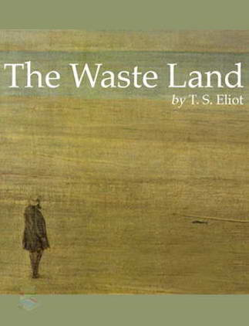
The Waste Land
T. S. ELLIOT

Slide 2
“Prufrock and Other Observations”
Many lacks of logic transitions and the combination between meter blocks and significant
parallelisms and inter-testual quotations
No relation between causes and effects, characters and environment fall apart. The structure is not coherent: the speaking voice tells about the character and time in a fragmentary way

Slide 3
The “mythic method” …
Elliot, Pound and Joyce are aware of how literary methods work.
They are interested in putting into a relationship subject-obtect, present-past, realty-myth, text-text.
The “mythic method” came out from these relationships and it was first defined by Eliot in Joyce’s “Ulysses” review:
“In using the myth, in manipulating a continuous parallel between contemporaneity and antiquity, Mr. Joyce is pursuing a method which others must pursue after him. They will not be imitators, any more than the scientist who uses the discoveries of an Einstein in pursuing his own, independent, further investigations. It is simply a way of controlling, of ordering, of giving a shape and a significance to the immense panorama of futility and anarchy which is contemporary history. It is a method already adumbrated by Mr. Yeats, and of the need for which I believe Mr. Yeats to have been the first contemporary to be conscious. It is a method for which the horoscope is auspicious.”

Slide 4
… and an “original” literary work
The “mythic method” substituted the narrative method;
It was used in Eliot’s first works and it is able o express something that cannot be expressed in the traditional way. Indeed, the poet could compare each psychological and emotional scheme on mythic, literary and anthropological bases.
In his essay, Eliot wants to understand why a literary work might be considered “new” and “original”. In Eliot’s mind, people think a original literary work is completely different from the traditional ones, but people are wrong. Indeed, The more a literary work is “original”, the more western literary tradition is inside his DNA. In few words, if you want to write something “original”, you must study traditional works. Modern texts are built assimilating and destroying other poetical texts. These texts are “alter-junctions” .

Slide 5
A quotation from Kristeva
Il significato poetico rinvia a significati discorsivi altri, di modo che l’enunciato poetico sono leggibili molti altri discorsi. si crea cosi, intorno al significato poetico uno spazio testuale multiplo, i cui elementi sono suscettibili d’essere integrati nel testo poetico concreto. chiameremo questo spazio “intertestuale”. il risultato è un’assorbimento di più testi nel messaggio poetico, il quale si presenta accentrato attorno a un senso. Quel senso, in Elliot, non è mai proiettivo, piuttosto sta nella paralisi semantica di un presente negativo

Slide 6
In conclusion …
The meeting between Eliot and Pound happens in the common field ofite “mythic method” which Pound faithfully developed. When Eliot’s poem was finished, Pound read it and dellated all the information that didn’t follow the “mythic method”.
***
The extraordinary story of the writing of the poem is the developing of the “mythic method”, with a consequent removal of what could appear stranger to that type of writing.

