Slide 1
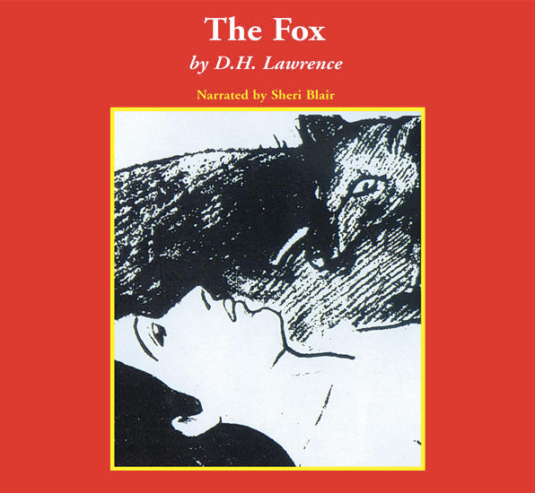
THE FOX
David herbert Lawrence
E. Agolli, S. Carrara, F. Cicogna, F. Cisilino, A. Decorte, G. Fedrizzi. Liceo scientifico “A. Einstein”, Cervignano del Friuli

Slide 2
Index
About the novelist
About the novel
Characters
Plot
Main themes
Historical context and setting
About the war
War and women
Relationships during the World War I
Message

Slide 3
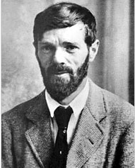
About the novelist
David Herbert Lawrence was born in 1885 in Eastwood, England. He was an English novelist, poet, playwright, essayist and literary critic.
About the book
“The Fox” is a novel that first appeared in The Dial in 1922. Set in Berkshire, England, during World War I, The Fox deals with the psychological relationships of three protagonists in a triangle of love and hatred.

Slide 4
Characters
March and Bandford: thirty-year-old ladies, farm owners.
March is a worker as able as a man. Bandford is physically weak and gentle.
The two names are symbolical: March refers to the month when nature awakes Bandford refers to something distant (to band) and strong. The names communicate aspects of the two characters’ personalities.
Henry: a soldier who appeared at the farm. He is seen like a fox by March and like an obstacle by Bandford.
the fox: the fist male figure that appears in the novel March identifies it with Henry. It touches March deeply and becomes a narrative focus.
The reader is provided the opportunity to make up a personal idea of the characters thanks to the handling of point of view.

Slide 5
The plot
Nellie March and Jill Bandford struggle to maintain a marginal livelihood at the Bailey Farm. A fox has raged through the poultry, and although the women have tried to shoot the intruder, he seems always to elude traps or gunshot. The fox appears in Nellie’s nightmares as a dominating and sexually threatening force that both attracts and repels her.
Henry Grenfel, a soldier who worked in the military forces in Canada, returns to the farm, once owned by his grandfather. Bandford allows him to stay with them for some days, until he finds another place to live.
Both young women are charmed by his boyish vigor, but Nellie, in particular, identifies him with the fox.
Henry asks March to marry him, she agrees and Bandford has to deal with the unwanted piece of news. The lady tries to make March change her idea and behaves rudely to make the boy leave.
Henry kills the fox and goes back to war. After a few days he receives a letter from March, where she writes she cannot marry him because she loves Bandford. He asks his captain for permission to return to the farm.
Once there he kills Bandford and marries March.

Slide 6
Main themes
Love and friendship: the novel makes the reader think about interpersonal relationships, based on jealousy, loyalty, fidelity, submission and more;
Female emancipation: March and Bedford think they do not need any male figure in their life because they are able to do what they need to survive on their own;
Gender: there is a female environment. The two ladies, living without male company, suggest particular qualities. Firstly, the reader can understand, there are different roles (March enbodies the male figure, Bandford is the house-lady) inside the female gender. The two ladies may represent two opposing aspects competing in women.
When Henry goes to the farm a contrast between the two aspects comes to life. Henry feels menaced by the ladies’ independence
Sexuality: when March hunts the fox, she thinks she is hunting a man.
March’s sexuality and her attitude to it come to surface. She is uncertain if she wants the fox to die or to live.
When she is in front of the fox, she does not raise her gun till it has casually run away.

Slide 7
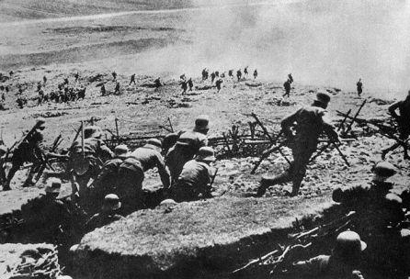
Historical context settings
The novel is set during the aftermath of the First World War. Great Britain took part in the conflict in 1914. It was allied with France, Russia and USA. At the end of the war (1818) it was one of the winners.
Even if Great Britain wasn’t the place where the conflict was fought, the country was highly damaged. Since it was the main investor of the war, there was inflation and so people had to face difficulties to to survive.

Slide 8
the war
Henry might represent the patriarchy the women want to rise against. The two ladies do not feel at ease because the society of the time expected women to be subdued to men.
At first the two girls feel they do not need a male figure in their life, Henry feels menaced from their power and asks March to get married. At first, the lady denies but when Henry become pushy and aggressive, March agrees. This highlights the women’s submission toward the male figure.
Henry is characterised as “silent, unconscious, with all the blood burning in all his veins, like fire in all the branches and twigs of him.”
The reader can understand the relationship man-woman was one of submission. Indeed, women had to do what their husband wanted them to do.
Women started to fight for Independence from men, Men’s position gradually lost prominence and as a result men were afraid to loose their influence. This is why Henry compelled March to marry him.

Slide 9
War and women
March and Bandford live together. Both girls embody a role: March is mainly masculine while Bandford is a house-lady: she cooks and takes care of the house.
At first there is not any male figure so they are supposed to substitute men. Indeed, they have to work in the fields for their living..
The novel underlines the role of women during the war. Since men were busy in the battles, women had to take their place to survive.
War obliges women to take men’s position thus offering them the opportunity to become active part of the society and to emancipate themselves.
Indeed at the beginning of the 20th century, women became aware of their role in society. They did not want to be subdued and they wanted to have the same rights of men.

Slide 10
Relationships during the World War I
Henry might represent the patriarchy that the women in the novel should rise against. The two ladies are fearful because the society see women subdued to men.
Since the two girls are so closed and do not need a male figure in their life, Henry feels menaced from their power so he asks March to get married. At first, the lady denied but when Henry became aggressive, March agreed. This highlights the women’s submission toward the male figure.
Henry is described in the story as sitting “silent, unconscious, with all the blood burning in all his veins, like fire in all the branches and twigs of him”.
The reader can understand men and women had a relationship of submission. Indeed, women had to do what their husband wanted them to do. However, since women started to be independent to men, the male figure lost his power and men were afraid to loose their influence. This is why Henry compelled March to marry him.

Slide 11
Message
The novel makes the reader reflect on the First World War and on the role of women, focusing the attention on the relation between men and women and the role of the two genders in every-day life.

