Slide 1
The birth of the “green-eyed monster”
Andrada Iordache 4PLSC a.s. 2018-2019

Slide 2
Iago’s destructive plan: a curious metaphore
(act I, s. III)
There are many events in the womb of time which will be delivered. (v.378)
Il tempo è gravido di molti eventi da partorire
It’s the beginning of an extended metaphore: Iago makes a prediction like if he would warn of danger the listeners, his tone is solemn and mysterious as if he had the world in his hands. The interpretation is supported by:
Semantic level:
womb= the uterus, undoubtedly a metaphore meaning “what the time sets aside”
to deliver=a verb also used in medical sematic area to express “giving birth”
He uses a codefied language like he were a sorcer

Slide 3
Phonological level:
The alliteration of sound “w” makes the verse pronounced slowly, and also the vowels help in that. This aspect, also, adds a tenebrous voile
Syntactic level:
It is used the passive form as if it were the destiny to decide the events and not the characters.
That’s a proof of Iago perfidy because he plots against Othello.

Slide 4
The plan conception
Vediamo un po’, dopo un certo tempo
potrei insinuare nell’orecchio di Otello
che si prende confidenze con sua moglie.
Ha un bel fisico e una disposizione
che legittima il sospetto, da tentar le donne.
Il Moro è d’indole franca e leale,
ritiene onesto chiunque tale appaia
e si farà docilmente menare per il naso
come un asino
È fatta, ha preso corpo.
Ora la notte e l’inferno tenebroso
daranno alla luce questo parto mostruoso.
After some time, to abuse Othello's ear
That he is too familiar with his wife.
He hath a person and a smooth dispose
To be suspected, framed to make women false.
The Moor is of a free and open nature,
That thinks men honest that but seem to be so,
And will as tenderly be led by the nose
As asses are.
I have't. It is engender'd. Hell and night
Must bring this monstrous birth to the world's ligh

Slide 5
At the end of the first act there’s Iago’s soliloquy. Its content is very important for the development of the play: he plans Othello’s downfall pushing on Othello’s insecurities caused by the differences between him and his wife.
Semantic level:
To abuse= the verb has a negative shade and in the context could be interpreted like a violation or a rape. Planting the seed of suspicion that will express it in the plague of all relationships: jelousy
To be suspected= key word: Iago explains his plan to lie about Cassio and Desdemona relationship
I ha’t, it is endengered= Iago announces the plan conception, after he explained it very clearly

Slide 6
Hell and night must bring this monstrous birth to the world’s light= this verse is rich of meaning. First of all, the words “hell” and “night” that refer to evil are the sources of the plan called “monstrous birth”. This will come to life and infect all the positive things
It is also present a chiasmus, that underlines the contrast between “hell”- “night” (dark) and “light” and maybe the transition from Iago’s diabolic mind to reality.
The tone is the same of the previous quotation, like a naughty wizard proclaiming the destiny of someone.

Slide 7
Phonological level:
The word monstrous may convey to the audience fear, also its vowels get slower the verse rhytm. That may make somebody’s think about the slow process of Othello’s downfall, made by Iago’s hints. It seems like the drop that erode the rock.
There is also a rhyming couplet night-light that sticks in the mind of the reader/ listener
enforces the concept
Syntactic level:
Must= is used like something that has to be done absolutely
Will= used for something that will certainly happen in the future

Slide 8
The plan is very rational, and it needs pacience to succeed in fact Iago tells Roderigo there is no witch craft but depends only on the time ( scene II act III.)

Slide 9
It is interesting to think of the possible reasons why Shakespeare compared the plan to a birth. In the Middle Ages was considered a blessing and also the newborn’s survival. Maybe because are both delicate and need time to form, but also dangerous like Iago’s position if the plot is descovered.

Slide 10
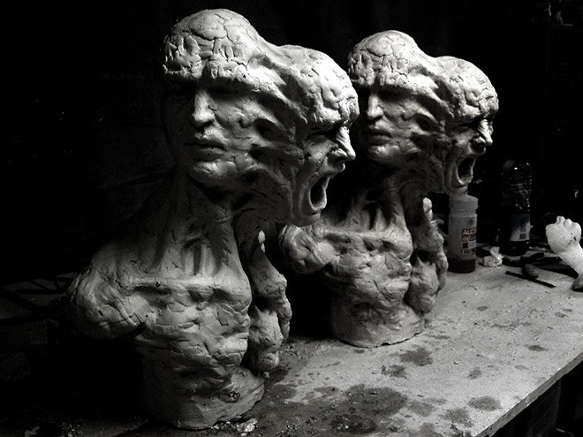
In conclusion the rational and the irratonal aspects are very present in the play, and are seen like the good and the devil. By this cruel plan Othello slowly loses his rational part and lets the place to a monster blind of jelousy.

