Slide 1
Deceptive appearances
Alice Santoro 4PLSC

Slide 2
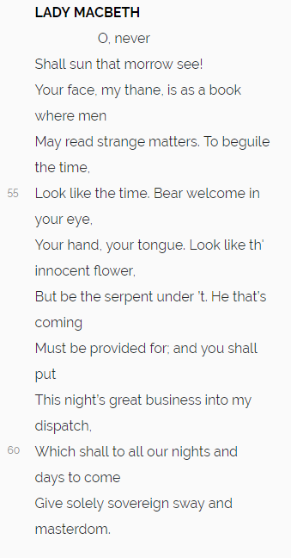
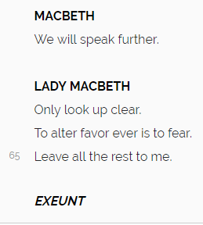
THE EXTRACT I CHOSE
( from Macbeth act 1 scene 5 by William Shakespeare)

Slide 3
CONTEXTUALIZATION
What had happened before?
Macbeth had met three witches
The three witches had predicted Macbet’s future
Macbeth had written a letter to his wife to warn her about the predictions
Who are the speaking characters?
Macbeth, Thane of Glamis and Cawdor, later king of Scotland
Lady Macbeth, Countess of Glamis and Cawdor, later Queen of Scotland

Slide 4
Phonological level analysis
Alliteration of letter G in the very first line (“Great Glamis”) to underline the noble title’s importance
Anaphorical repetition of the th syllable (lines 54-56) to relate the lines to each other
Use of open vowel sounds (ex. “My dearest love” line 57”) that convey the meaning of something distant. Considering the extract there is a distance between Lady Macbeth’s dirty intentions and Macbet’s innocent ones
Three times repetition of the adjective “your” (lines 62-62) to underline that Macbeth himself has to act as his wife wants him to do

Slide 5
Alternate use of harsh and soft sounds to underline the opposition between appearence and reality
ex the innocent flower sweet sounds
(line 64) (how Macbeth has to look like)
the serpent under’t harsh sounds
(line 65) (how Macbeth has to be)
Rhyme betweet clear (line 69) and fear (line 70) to underline the opposition of the two different meanings. The rhyme is uded to display the force of Lady Macbeth’s thone

Slide 6
Semantic level analysis
Lady Macbeth adresses to her husban using very dignified names and showing his stand in society (Great Glamis, Worthy Cawdor)
Shakespeare chose to use the plural form of the noun “letter” in line 54 even tough the audience knows only one letter in order to prefigure the character of Macbeth’s face (“a book” line 60)
many expressions are related to time ( ignorant present, now, future, instant, tonight, tomorrow, never, time, nights and days) to underline the difference between the present situation and the future one
Some expressions come from the semantic field of nature ( flower, serpent) to convince that it can be natural to act in that way
Use of the imperative (look like,bear, be) to issue commands. They underline Lady macbeth’s imposing thone
Use of the modal verb shall (lines 65 and 67) to express strong intentions

Slide 7
Rhetorical level analysis
Climax of increasing importance noble titles in the very first lines that show desire fore power
Personification: “this ignorant present” (human quality of beeing ignorant)
Paradox : “I fell now the future in an istant” to underline that Macbeth is meant to be king as soon as possible
Ambiguity: “O never shall sun that morrow see”
two possible interpretations
they will be such wonderful hosts that he won’t to leave
Lady Macbeth is planning to kill king Duncan
It show’s Lady Macbeth’s dishonest thone

Slide 8
Sintactic level analysis
Massive use of punctuation in Lady Macbeth’s third exchange of dialogue to slow down the rhythm and to create some distance between contrasting concepts
The punctuation adopted in lines 68/69 indicate that Lady Macbeth interrupts Macbeth and therefore suggest his irresolution.
In the first part Lady Macbeth speaks a lot, but then ends the conversation with a very short sentence and doesn’t allow Macbeth to reply. This underlines that she is gives little room for Macbeth to disagree with her

Slide 9
Similes
“your face is as a book” that means that the king and his company may be able to discern Macbeth’s real thoughts
“look like the time “ : Macbeth should appear to conduct himself as others expect him to
“look like the innocent flower” that means Macbeth has not to appear guilty
a metaphor
“be the serpent under’t” that means Macbeth has to act paradoxically and so different than others percieve

Slide 10
Summing up
Lady Macbeth is having a conversation with her husband
The effect of a commanding thone is created mainly by intentional ambiguity and paradox between appearance and reality
She is pretending her husband to act like she wants him to (imperative form)
She doesn’t allow her husband to reply (use of punctuation)

