Slide 1
William Shakespeare
Simone Formentin
Macbeth

Slide 2
William Shakespeare
Born in April 1564 in Stratford-upon-Avon
He received a classical education including Latin, Greek, History, Math, Astronomy and Music
He began his career as an actor
He wrote :
38 plays including comedies, historical dramas, tragedies and romances
A collection including 154 sonnets, chronologically divided into 2 sections

Slide 3
Brief introduction to Macbeth
Composed in 1606
It is one of the most famous Shakespearean tragedies
It is the shortest tragedy composed by Shakespeare
The plot is simple but it hides deep moral aspects if carefully analyzed
The play is set in Scotland

Slide 4
The plot
The play opens with the traitor thane of Cawdor failing during the attempted invasion by the Norwegians. While returning from the battle, Macbeth and his friend Banquo meet three witches, who predict Macbeth’s fate as thane of Cawdor, and they say that Banquo’s sons will succeed to the throne one day. After the first prediction about Macbeth realizes, he carries out a plan to kill King Duncan with his wife, so as to become the new king. Duncan is murdered, but Macduff (another Scottish thane) and Banquo suspect him. Later, since Macbeth is worried because of the prediction about Banquo’s sons, he sends two hired assassins to kill him and his son, Fleance, but the last one manages to run away. Macbeth meets the three witches again. They warn him to beware of Macduff and they say he will die only when Birnam Wood will move towards him. In the last act Malcolm (Duncan’s son) marches into Scotland with his army against Macbeth, hiding behind cut branches from Birnam Wood: the last prediction has realized. Here Macbeth, who has become crazy after the king’s assassination, is killed by Macduff.

Slide 5
General features of Shakespearean world reflected in Macbeth:
The main character has a fatal flaw which leads him to his downfall
The hero is a person of good character at the beginning
There is no villain who stands againts the hero, the only anthagonist is Macbeth himslef, who’s not able to control himself
The main character is influenced by an external pressure (Lady Macbeth)
The tragedy begins in an ordered world, but end with chaos
The enviroment reflects the psychological changes during the play

Slide 6
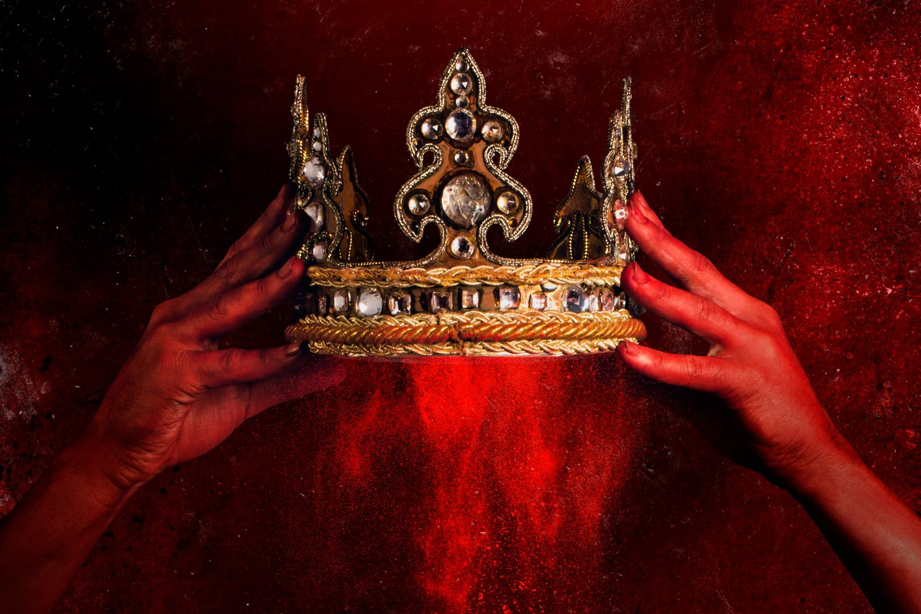
Main topics:
Ambition
Lust for power
Regicide
The reversal of values
Time

Slide 7
Main characters:
Macbeth, Thane of Glamis, later of Cawdor, later King of Scotland: he’s a brave soldier and nobleman, he’s ambitious but humane and noble in mind
Lady Macbeth: Macbeth’s wife, an ambitious and cruel woman. She urges his husband to kill Duncan, the King
Duncan: The magnanimous and benevolent King of Scotland
The Three Witches: They predict Macbeth’s apparently lucky fate
Malcolm and Donalbain: King Duncan’s sons
All the other thanes of Scotland

Slide 8
Emblematic quotation
“ I have no spur to prick the sides of my intent, but only vaulting ambition, which o'erleaps itself and falls on th' other.”
«Io non ho altro sprone da cacciare nei fianchi al mio proposito se non l’ambizione che volteggiando eccede nel balzo e cade dall’altra parte»

Slide 9
About the emblematic quotation
The quotation belongs to Act I, scene VII.
I consider it emblematic because it sums up the Macbeth’s doubt during the most important moment of the entire play. Indeed, it is part of the monologue Macbeth speaks a moment earlier than the King Duncan’s assassination. Here Macbeth expresses his awareness of what he’s going to do and he takes into consideration both sides of the question. He knows what consequences killing the king may lead to, but he’s also ambitious and this is the occasion to make the three witches’ prediction become real. On one side, he’s showing lack of motivation, since he’s noble in spirit and he owes a lot to the king, whom he’s always appreciated; on the other side he’s conscious of his ambition that has to be satisfied! The internal conflict between reason and passion is underlined by the punctuation, which contributes to convey the idea of a very profund and conflictual moment for Macbeth. The critical doubt is perfectly expressed by a metaphor: Macbeth intention is embodied by a horse, which nothing can «spur» but his ambition, that means he has no justification to kill the king, who has always been kind to him, apart from his lust for power. Therefore he has got different reasons not to kill the king and only one reason to do it.

Slide 10
In-depth analysis on different levels
The present quotation has to be deeply analyzed in order to really understand the meaning of Macbeth’s doubt. On the semantic level words used by Shakespeare belong to both the semantic fields of human beings’ personality and the animal’s world, which is the main feature of the entire metaphor. Indeed, the semantic level is strictly combined with the rhetorical one: the quotation is a metaphor itself, where Macbeth’s intent is embodied by a horse (the «sides» concern a horse’s body), while his ambition is represented by the spur (“ I have no spur to prick the sides of my intent, but only vaulting ambition”) , which makes the horse-intent run. At the end of the metaphor Macbeth’s reason “o'erleaps itself and falls on th' other”, which means that the horse-intent is spurred by the ambition to a point of no return, where Macbeth’s rational mind is surpassed by the irrational one. The semantic and the rhetorical level are fundamental to understand the syntactic level, which is based on the inclusion «but only vaulting ambition» between two commas. The present device underlines the importance of the «Ambition» in the decision Macbeth is going to make. The moment is also emphasized by the conjunction «but», which higlights the contrast between Macbeth’s conscience and his «vaulting ambition». In conclusion, on the phonological level, the first part of the quotation is characterized by strong sounds («no spur to prick»), while the final part is characterized by long and flowing sounds, obtained thanks to the vowels and the apostrophes. Such difference between the beginning and the end underlines the contrast betwwen rational and irrational Macbeth’s spirit one more time.

Slide 11
Which aspect I liked most?
The «Ambition»’s theme is one of the reasons why I liked Macbeth. Ambition literally is the core of the play, since it’s fundamental during the entire play. It’s the motor of Macbeth, it is what leads the main character to his own downfall. I found the topic interesting mainly because I think it’s a very contemporary and evergreen topic: it is part of human being in general. Indeed, in my opinion, ambition is what moves us everyday, what makes us decide what has to be done and what not. Ambition guides human beings through their dreams: it is one of the most important human nature’s values and Shakespeare expresses the primary role of Ambition throught Macbeth!

