Slide 1
ANALYSIS OF HAMLET’S MONOLOGUE
TO BE OR NOT TO BE

Slide 2
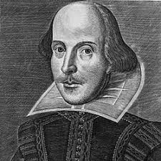
WILLIAM SHAKESPEARE
Born in 1564
The most important English writer
Dead in 1616

Slide 3
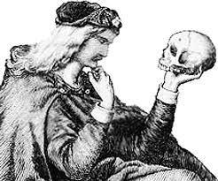
TO BE OR NOT TO BE
First line of the monologue
That is the question

Slide 4
SEMANTIC AND MORPHOLOGICAL MEANING
Use of infinite mode
Alliteration of the sound «t»
Choice of the verb «to be»

Slide 5
CHOICE OF THE INFINITE MODE
It makes the phrase always true (in the past, in the present and in the future)
It underlines the choice of the verb «to be»

Slide 6
ALLITERATION OF SOUND «T»
It reinforces the whole line
It draws the attention of the audience

Slide 7
CHOICE OF THE VERB «TO BE»
The verb «to be» contains many meanings (for example to live, to eat,…)
It makes the question much more extensive

