Slide 1
HUMAN RIGHTS
and its violation
Angelica Brandalise
5N LSU
s.y. 2019-2020

Slide 2
TABLE OF CONTENTS
Introduction to Human Rights
Historical phases of Human Rights’ evolution
Human Rights’ violations
Texts analysed in class about Human Right

Slide 3
WHAT ARE THE HUMAN RIGHTS?
Human rights are rights inherent to all human beings, regardless of race, sex, nationality, ethnicity, language, religion, or any other status.
Human rights include the right to life and liberty, freedom from slavery and torture, freedom of opinion and expression, the right to work and education, and many more.

Slide 4
HISTORICAL PHASES OF HUMAN RIGHTS’ EVOLUTION
The Cyrus Cylinder (539 B.C.)
The Magna Carta (1215)
Petition of Rights (1628)
United States Declaration of Independence (1776)
Declaration of the Rights of Man and the Citizen (1789)
Geneva Convention (1864)
The Universal Declaration of Human Rights (1948)

Slide 5
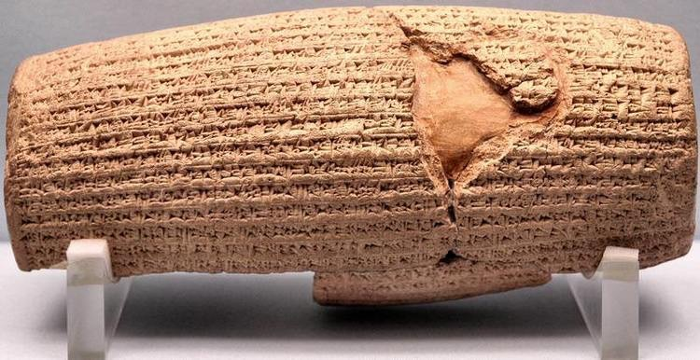
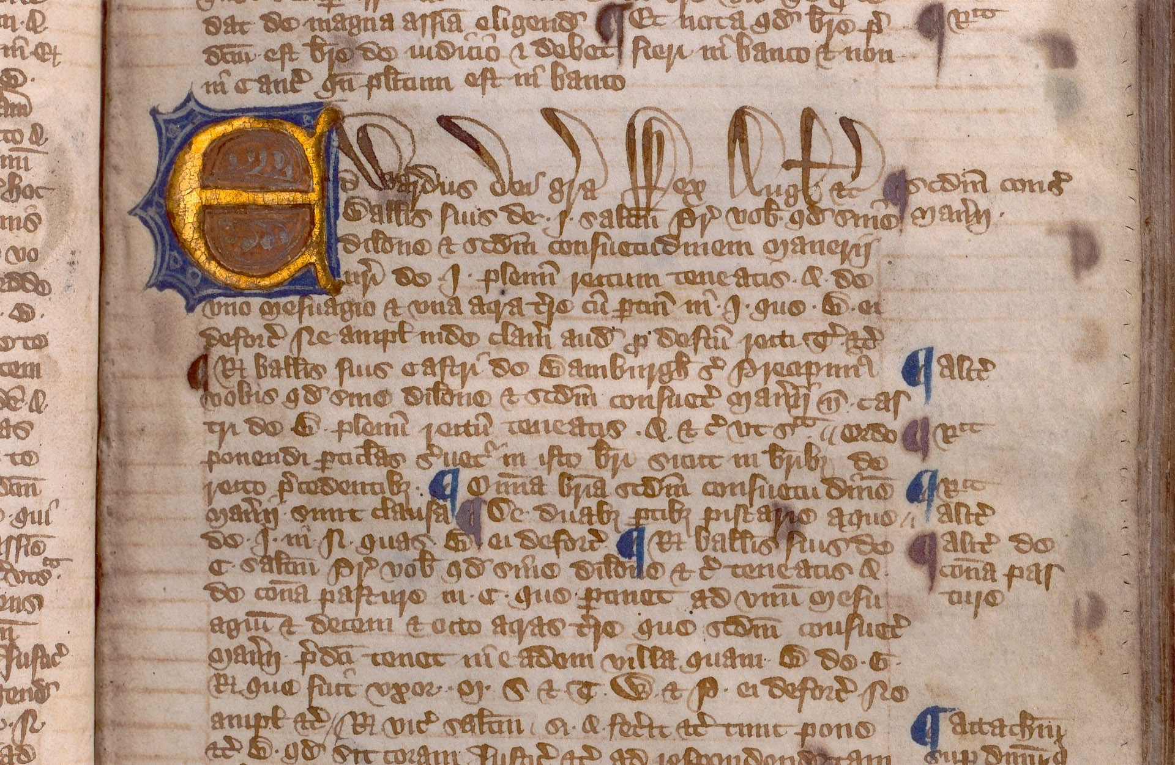
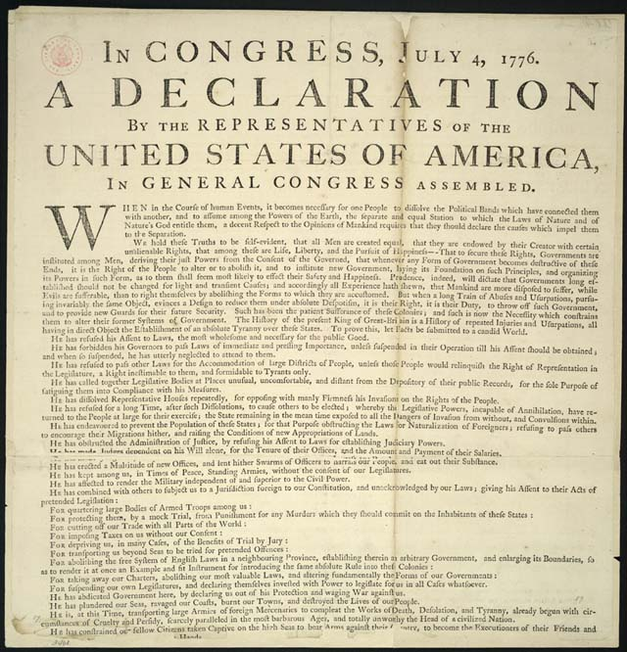
THE CYRUS CYLINDER
Cyrus the Great established racial equality
and the right to choose your own religion
THE MAGNA CHARTA LIBERTATUM
a series of written promises between
the king and his subjects
PETITION OF RIGHTS
Parliament severely limited the king’s power
UNITED STATES DECLARATION OF
INDEPENDENCE
written to tell that US was a free and
independent country

Slide 6
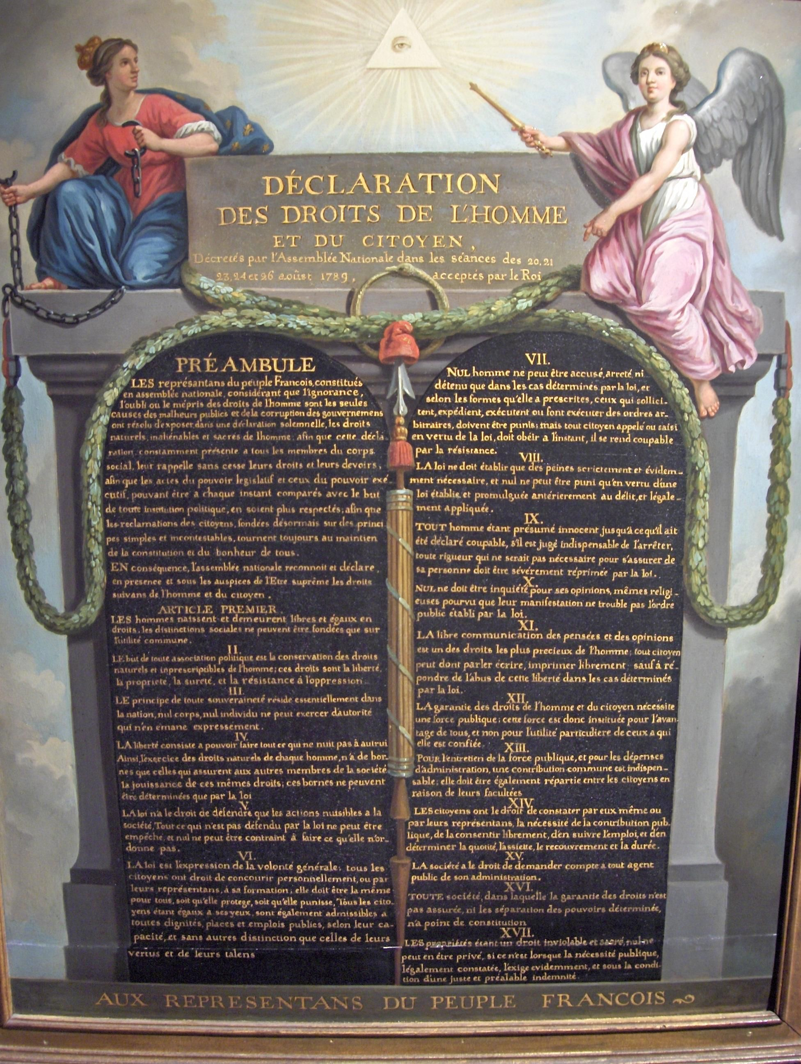
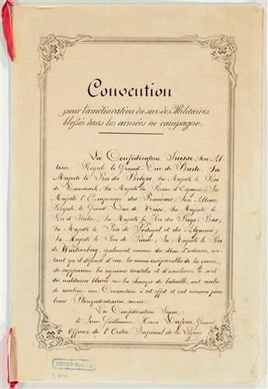
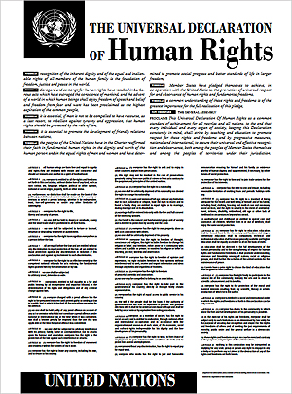
DECLARATION OF RIGHTS
OF MAN AND CITIZEN
proclaims that all citizens are
guaranteed with rights
GENEVA CONVENTION
extended care without discrimination
to wounded and sick military people
UDHR
adopt rights for all the citizen
in the world

Slide 7
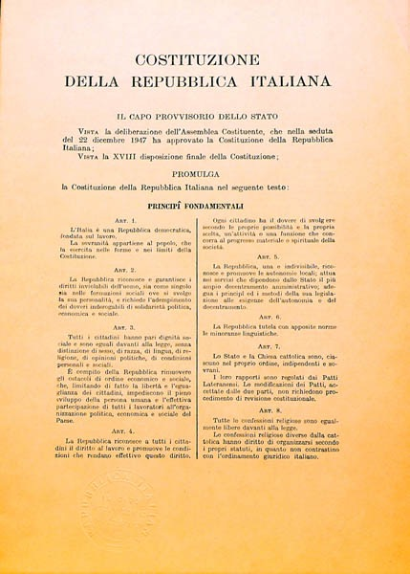
THE CONSTITUTION OF THE ITALIAN REPUBLIC (1947)
It wants to favor foreign citizens’ integration
It is divided into 4 sections

Slide 8
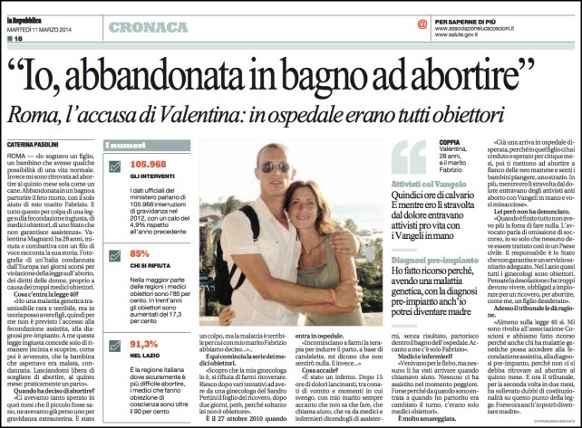
THE RIGHT TO CHOOSE
The Republic safeguards health as a fundamental right of the individual and as a collective interest, and guarantees free medical care to the indigent. No one shall be obliged to undergo particular health treatment except under the provisions of the law. The law cannot under any circumstances violate the limits imposed by respect for the human person.
(art.32)
Pro Choice or Pro Life

Slide 9
THE RIGHT OF LIFE
“Anyone who causes the death of a man is punished with imprisonment of not less than twenty-one years.” (art. 575 Penal Code)

Slide 10
THE RIGHT TO EQUALITY
“All citizens have equal social dignity and are equal before the law, without distinction as to sex, race, language, religion, political opinions, or personal or social condition.” (art. 3)
text: “Boys and Girls”

