Slide 1
Edith Wharton and her novel “Ethan Frome”
Bruno Arianna CL. 5^ N LSU A.S. 2018/2019

Slide 2
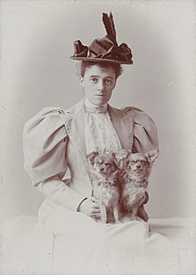
Edith Wharton
New York January 24, 1862
France August 11, 1937
American novelist, short story writer, playwright, and designer
Married with Edward Wharton
who developed mental disorders
they divorced
Edith moved to France
first woman to win the Pulitzer Prize for Literature in 1921

Slide 3
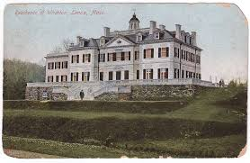
Historical and family background
Gilded age, late 19th century
America, millions of European immigrants
rapid expansion of industrialization
an era of abject poverty and inequality
She came from a puritan and rich family

Slide 4
causes and consequences
Unhappy marriage
Historical period
Her social class in decline
She studied a lot
temptations of illicit passion
Society and morality as obstacles to the fulfillment of desire
Science and rational philosophy
She uses irony to dusguise this problem
She talks about lower social classes

Slide 5
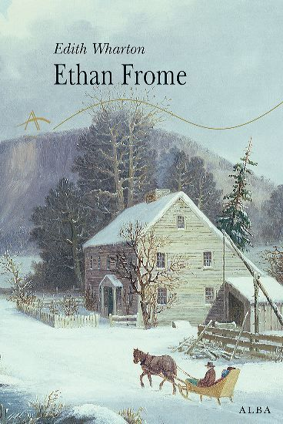
Examples
Ethan is attracted to Mattie also if he is married to Zeena
Because of social laws of that period Ethan could not escape the sictuation in which he was
Edith Wharton was a very cultured woman, she new a large amount of things also about lower social classes, indeed in Ethan Frome the couple was poor.

Slide 6
Descriptions
Why and through what she used descriptions:
realism as “the faithful representation of reality” and naturalism as “an application of scientific natural principles on the study of human beings
and social phenomenon”
material details perhaps derived from arts and architecture

Slide 7
narrator
Introduction and conclusion:
first person narrator,
he is an anonymous visitor to Starkfield
omniscient
Chapters:
third person narrator
reflects Ethan’s point of view

Slide 8
Narrator examples
First person narrator:
prologue “I had the story, bit by bit, from various people, and, as generally happens in such cases, each time it was a different story.”
Epilogue: “I said it right out to our minister once, and he was shocked at me.“
Third person narrator:
Chapters: “He had scrambled up on the logs, and was sitting astride of them, close over his shaggy grays, when, coming between him and their streaming necks, he had a vision of the warning look that Mattie had given him the night before.”

Slide 9
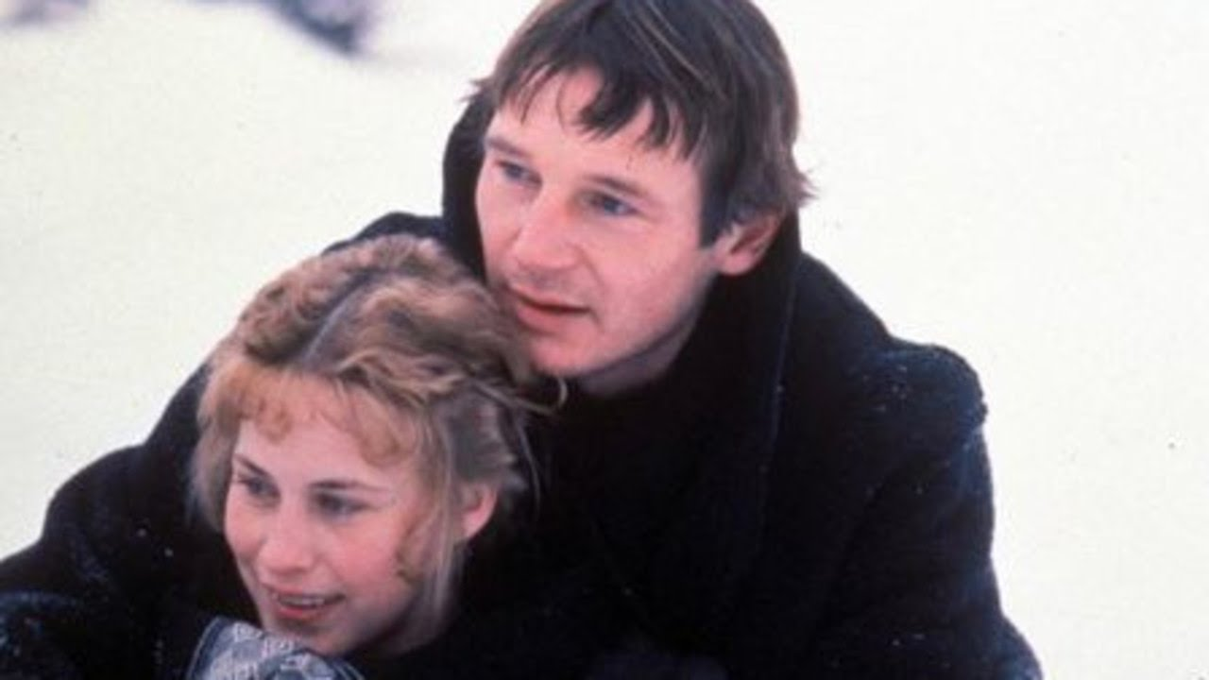
love
Illicit passion
illicit love
Desire to have what we can not have because of moral and social rules
Desire to find new emotions

Slide 10
My opinion on the theme “love”
I like how her treat the theme of love, because is a realistic way to do it, it is not “romanzato” o “fiabesco”, is real, is how it goes in everyday life, poeple get sick of other people, they want something new, they want to feel new emotions, it is rare to find a person of who we did not get sick of. I also think that Ethan maybe wants another women to “escape” from his difficult life, while his wife Zeena reminds him his precarious life.

Slide 11
the victim
In my opinion the victim in this novel is Zeena.
She is described like she is the evil character, but on the contrary she is only a poor woman who’s housband wants to commit adultery. The girl who stole Ethans heart live with them so the situationis everything but esay for Zeena.

