Slide 1
FREEDOM OF THOUGHT
Bruno Arianna CL. 5^NLSU A.S. 2018/2019

Slide 2
TABLE OF CONTENTS
Aim of the work
Introduction
Freedom of thoughts
History
Legislation
Connections with texts

Slide 3
PURPOSE:
To raise awareness
To informe
To undestand better our rights

Slide 4
HUMAN RIGHTS
Individual rights
Civil rights
Political rights
Economical rights
Social rights
Cultural rights

Slide 5
CIVIL RIGHTS
Civil rights include the ensuring of -integrity
peoples' physical and mental : -life
-safety
protection from discrimination -race -gender -sexual orientation on grounds such as : -age -color -national origin
-religion -ethnicity -disability
-political affiliation
individual rights : -privacy
-freedom of thought
speech
religion
press
assembly
movement

Slide 6
FREEDOM OF THOUGHT
is the freedom of an individual to hold or consider a fact, viewpoint, or thought, independent of others' viewpoints.
The precursor of:
Freedom of religion
Freedom of speech
Freedom of expression

Slide 7
LEGISLATION
Universal Declaration of Human Rights
article 18: “Everyone has the right to freedom of thought, conscience and religion; this right includes freedom to change his religion or belief, and freedom, either alone or in community with others and in public or private, to manifest his religion or belief in teaching, practice, worship and observance.”
Constitution of the Italian Republic
article 21: “Anyone has the right to freely express their thoughts in speech, writing, or any other form of communication.”

Slide 8
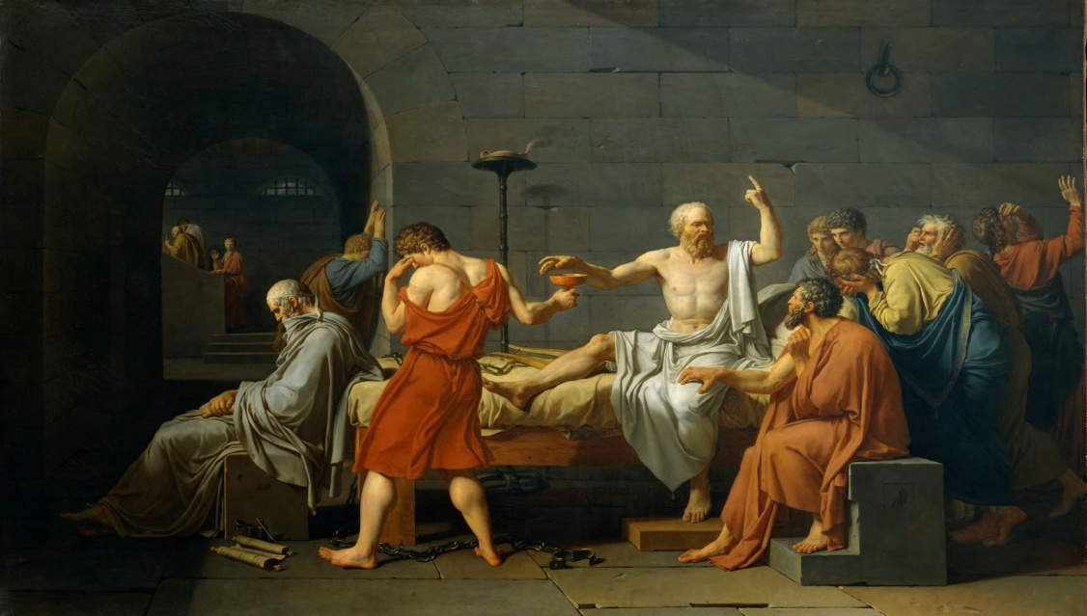
HISTORY
Poleis
Democracy
Feeedom of thought & freedom of speech
Called parresìa
Limits otherwise death penalty
Example: Socrate

Slide 9
CONNECTION WITH THE TEXTS
“ANY WIFE IS BETTER THAN NO WIFE”
Hasina
Has a different idea about marriage
Her family does not accept this
She runs away with her love
She believes in what she thinks also if it is not what the others think
Her thought is not chained

