Slide 1
ETHAN FROME
BY EDITH WHARTON
ALESSIA RET
5NLSU
A.S 2018/2019

Slide 2
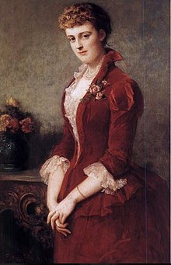
ABOUT EDITH WHARTON
Edith Wharton (1862-1937)
Was born in a rich family in New York
Was an American writer
She got married to Boston Edward Wharton
They love travelling indeed move to French
Was the first women to win the Pulitzer Prize for literature in 1921

Slide 3
ABOUT EDITH WHARTON
The writer was born in a elitist and conservative family
She felt a strong social closeness of her environment
Her parents wanted her to follow the rules and the lifestyle of Puritanism

Slide 4
influences
The themes chosen by Edith Wharton are influenced by her elitist and conservative environment
Such as the theme of Puritanism and the way of thinking of the upper class
The novelist was influenced by her relationship with her mother and by her vision of love

Slide 5
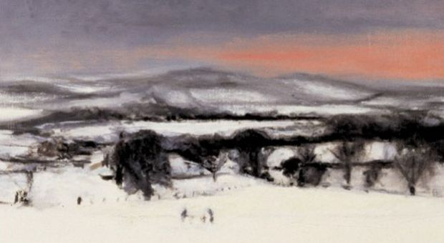
THEMES
Love
the love story between Ethan – Zeena and Ethan – Mattie.
Puritan society
the charcters are influenced by the religion
Illness
Zeena uses it in order to hold Ethan back
The meaning of life Ethan and Mattie must decide if going on living or not

Slide 6
THE setting
The novelist characterises the characters in diffe way Ethan is portrayed by his physical appearance while Zeena’s remains hidden
The environment is cold, harsh, snowy and it symbolically refers to Puritan standards of behaviour
Zenobia is always portrayed indoors, in a closed space while Mattie is generally outdoors and in close contact with nature.

Slide 7
THE NARRATOR
In the Prologue and Epilogue the narrator, unidentified, is speaking in the first person
The narrator permits to the “intelligent reader” to
understand that the novel is a collection of different points of view
The narrator then drops out of the story completely and the point of view shifts to the third person

Slide 8
THE NARRATOR
FIRST PERSON
THIRD PERSON
When the narrator speaks in first person , he refers to himself as “I”
The third-person narrator reflects the thoughts and feelings of Ethan Frome
Because the reader is seeing the events through his eyes, he speaks from Ethan’s point of view

Slide 9
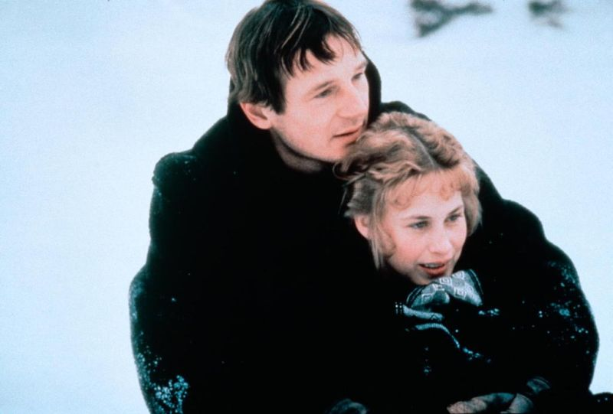
THE TEME OF LOVE
The love story between Ethan and Mattie is passionate and strong inside out
The relationship between Ethan and Zeena because he gets married her because of the fear of to be alone

Slide 10
MY OPINION
I appreciate
The two different love story described by the novelist
The complex feelings and the passion of the protagonist
The impressive and realistic descriptions of the environments

Slide 11
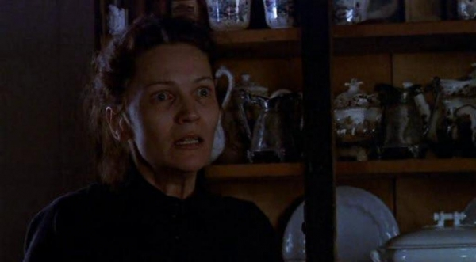
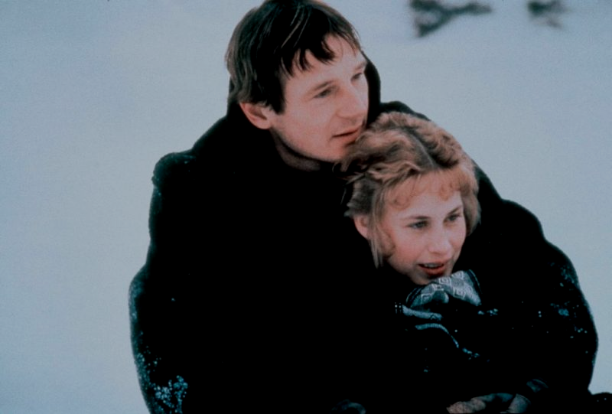
WHO IS THE VICTIM ?
Zenobia is the victim
She is alone and depressed. Her relationship with Ethan makes her suffer
She is a figure of “wife” so to stay at home, to take cure of others, to cook and clean
In addition also Ethan is unhappy of his life

