Slide 1
Edith Wharton and Ethan Frome
ALESSIA SCAREL 5N LSU

Slide 2
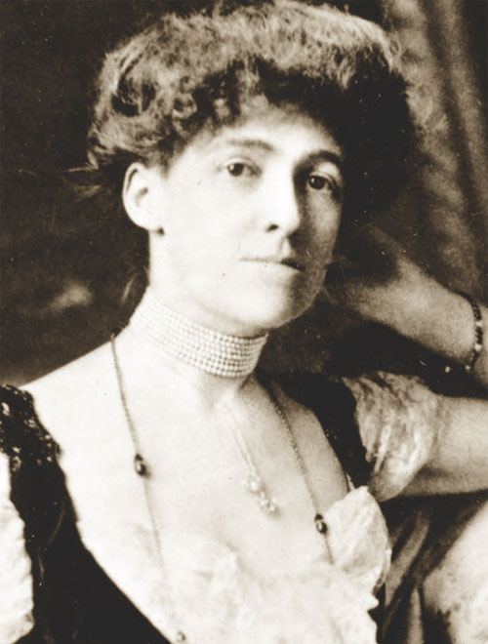
Who is Edith Wharton?
Edith Wharton was a writer and poetess of United State.
She was borned on 11 august 1937
She belongs to a rich family and she was born in New York.
She married with Edward Wharton and they divorced in 1813
She the first woman to win the Pulitzer Prize for Literature in 1921
In 1911 he published "Ethan Frome", according to many his best work, short and compelling and halfway between a long story and a short novel.

Slide 3
What was the environment?
late 19th century
in this period there were a lot of European people migrated
an era of poverty and unevenness
social closure
puritan family

Slide 4
How did she influence the issues you face in the novel?
Edhit Wharton was a Puritan, for this way he influenced the novel. Indeed in the novel you can find many characterists of Puritan's thought.
In that time the people had a lot of prejudices : when two people married, they usually remain together for all life and the divorce was not frowned upon.
The society and morality were an obstacles to the satisfaction of desires.
She describes the element of society with disgust and she uses an irony.

Slide 5
Examples
Although Ethan is attract to Mattie, she stays with his wife Zena
So Ethan couldn't reach his object of desire and Zena lives unhappy
The atmosfere is dark and cold and this rappresent the society at that time
She talk about the divorce which is not accepted at that time

Slide 6
Why did she use many details and description in the novel ?
First person :”I Had the story, bit by bit, from various people, and, as generally happens in such cases, each time it was a different story.”

Slide 7
Narrator: characteristics and functions
In the prologue and epilogue she uses the first person, the narrator is an anonymous visitor to Starkfield and he is omniscent
In the Chapter she uses the third person and sometimes there are Ethan's points of view

Slide 8
Examples of narrator descriptions
first person:”I Had the story, bit by bit, from various people, and, as generally happens in such cases, each time it was a different story.”
third person:” Ethan made a pretext of getting up to replenish the stove, and when he returned to his seat he pushed it sideways that he might get a view of her profile and of the lamplight falling on her hands.”

Slide 9
How is love treated and why?
a love is not expressed because of the rules and morality of the society
object of desire
a sort of combined marriage

Slide 10
what attract me about the novel
In my opinion the novel is a perfect example of the society at the time, besides she talks about real facts that still exist today as “love”. I think Ethan does not want to leave his wife because he can not manage alone. He has always lived with a female figure at his side and at his age it is difficult to live in solitude, especially in an era like the 800

Slide 11
who is the victim of love ?
In my opinion the victim of love is Zena because she is not a indipendent and determined woman but she rely from Ethan. She is rappresented as the bad character who actually turns out to be the victim of a relationship without love.

