Slide 1
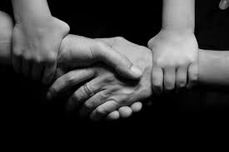
“Family is a right”

Slide 2
TABLE OF CONTENTS
The aim of the Power Point Presentation
Introduction on Human Rights
Historical background
Article of Italian Constitution
Text analysis
My opinion

Slide 3
AIMS
Talk deeply about the Human rights
Focus my attention on the “right to marry and form a family”
Give some historical information
Create a logical-path between Human rights and the text we analyze during English lessons
Give my personal opinion of the topic

Slide 4
Brief introduction on human rights
DEFINITION
Human: noun
A member of the Homo sapiens species; a man, woman or child; a person.
Rights: noun
Things to which you are entitled or allowed; freedoms that are guaranteed.
Human Rights: noun
The rights you have simply because you are human.
FEATURES
universal
choice and opportunity
resulted finally in the Universal Declaration of Human Rights

Slide 5
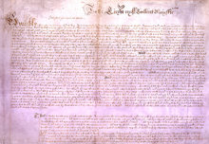


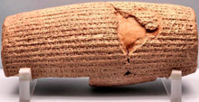
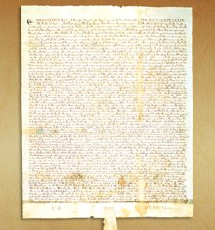
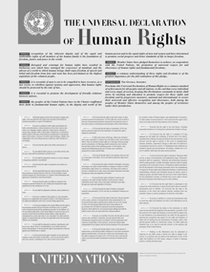
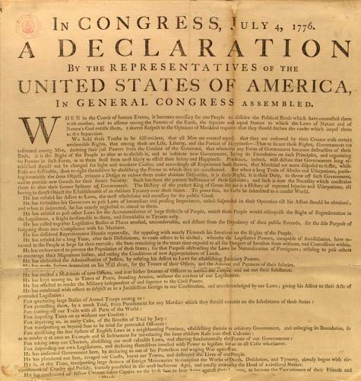
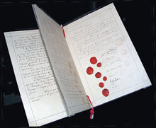
historical background
Petition of Right
The United Nations
Bill of Rights
The Cyrus Cylinder
1
(539 B.C.)
(1628)
(1791)
(1945)
(1215)
(1776)
(1864)
The Universal Declaration of Human Rights (1948)
The Magna Carta
The First Geneva Convention
United States Declaration of Independence

Slide 6
Article 9 –Right to marry and right to found a family
The right to marry and the right to found a family shall be guaranteed in accordance with the national laws governing the exercise of these rights.
Constitution of the Italian Republic
Art. 29. The Republic recognises the rights of the family as a natural society founded on marriage. Marriage is based on the moral and legal equality of the spouses within the
limits laid down by law to guarantee the unity of the family.

Slide 7
Extract from “Ethan Frome”, by Edith Wharton
All constraint had vanished between the two, and they began to talk easily and simply. They spoke of every-day things, of the prospect of snow, of the next church sociable, of the loves and quarrels of Starkfield. The commonplace nature of what they said produced in Ethan an illusion of long-established intimacy which no outburst of emotion could have given, and he set his imagination adrift on the fiction that they had always spent their evenings thus and would always go on doing so...
“This is the night we were to have gone coasting, Matt,” he said at length, with the rich sense, as he spoke, that they could go on any other night they chose, since they had all time before them.
She smiled back at him. “I guess you forgot!”
“No, I didn't forget; but it's as dark as Egypt outdoors. We might go to-morrow if there's a moon.”
She laughed with pleasure, her head tilted back, the lamplight sparkling on her lips and teeth. “That would be lovely, Ethan!”

Slide 8
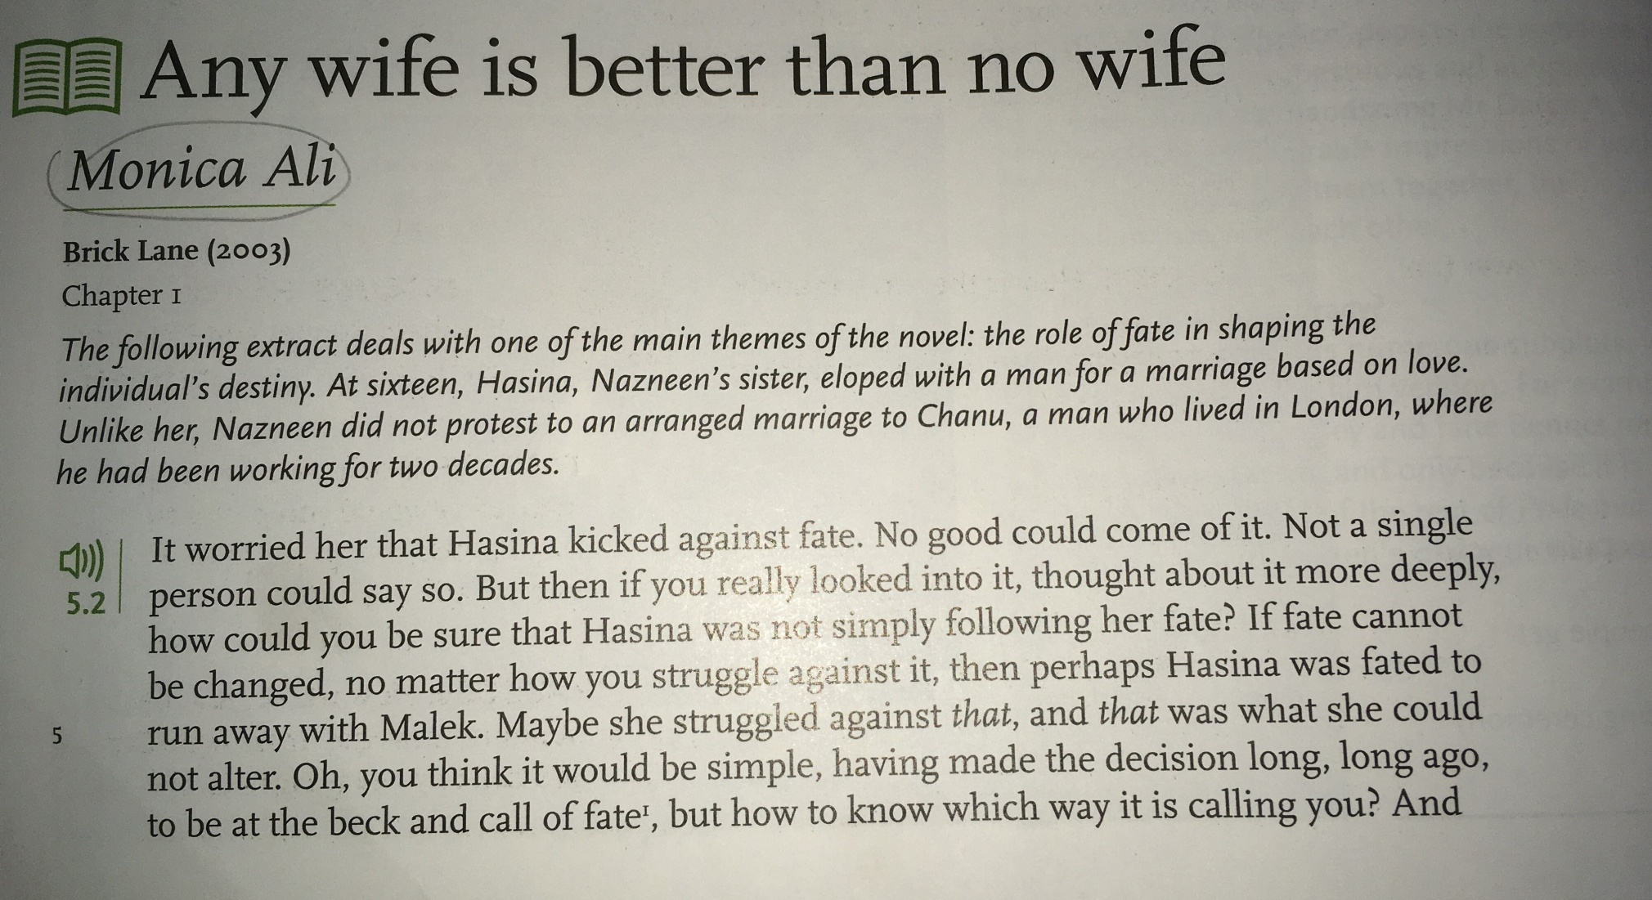

Slide 9
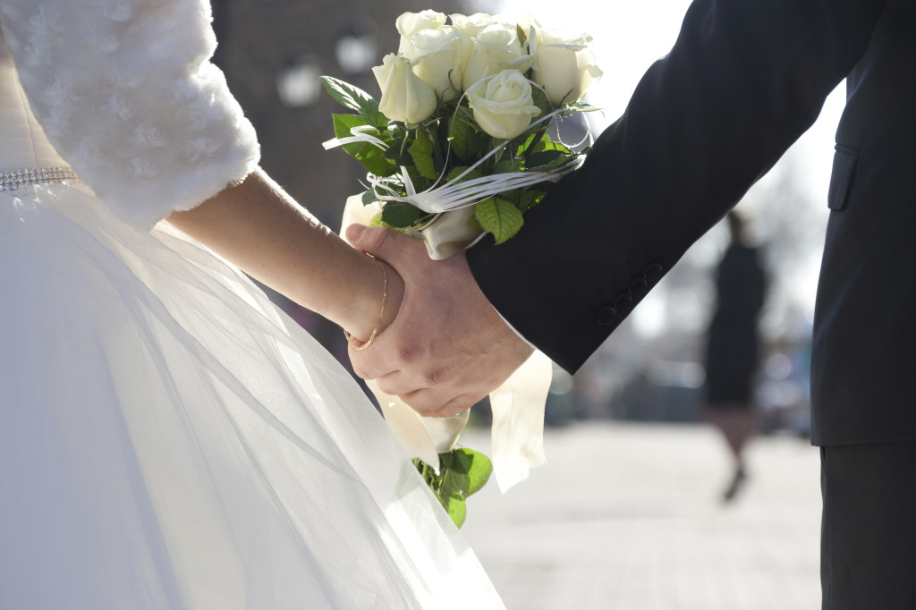
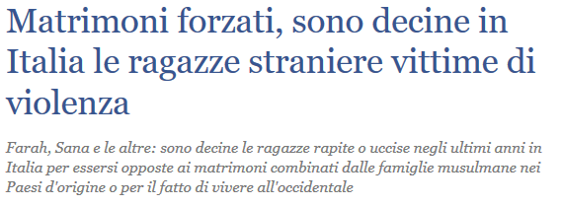

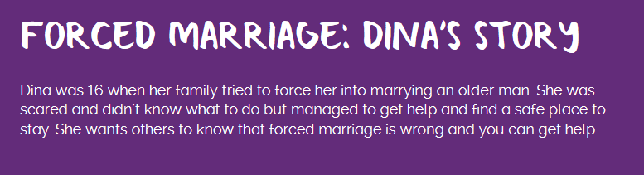
NOWADAYS…

Slide 10
RESOURCES
https://www.childline.org.uk/get-involved/real-life-stories/forced-marriage-dinas-story/
http://www.ilgiornale.it/news/cronache/matrimoni-forzati-sono-decine-italia-ragazze-straniere-1577574.html
https://www.humanrights.com/course/lesson/background-of-human-rights/the-background-of-human-rights.html
http://www.gliscritti.it/blog/entry/2619

